Slide 1
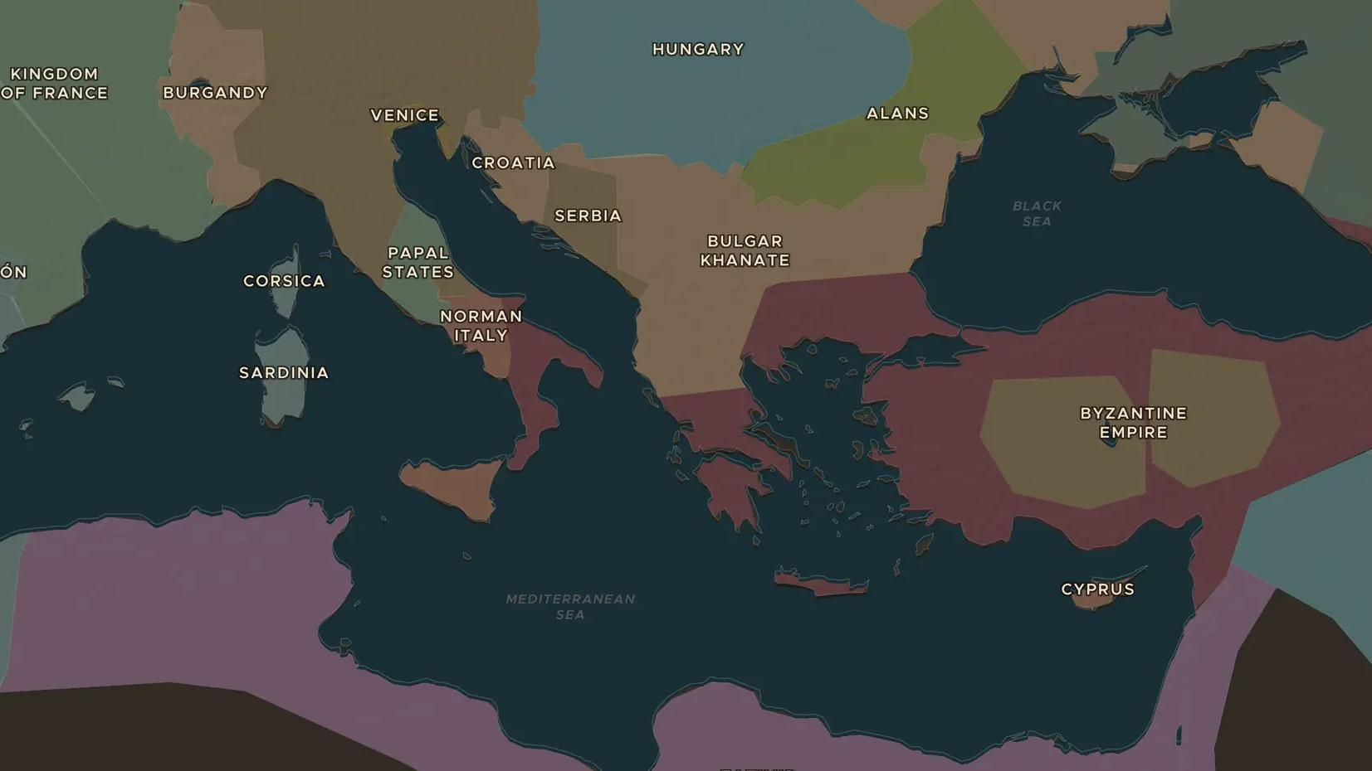
CRUSADES · 1095-1099
The First Crusade
ChronoAtlas Classroom · Plate 220 · Ages 13-16 · 50 min
ChronoAtlas Classroom · chronoatlas.nl/classroom/lesson/first-crusade-1095

Slide 2
THIS LESSON
What students take from it
In 1095 Pope Urban II calls on western knights to march east. Students follow the First Crusade from Clermont to Constantinople and the Holy Land, look at it through the eyes of crusaders, Byzantines, Jews and Muslims, and discuss how it should be remembered.
LENGTH
50 min
AGES
13-16
ON THE MAP
BY THE END, STUDENTS CAN
3 steps, AD 1095
Explain why Pope Urban II called the crusade and why so many people answered.
Trace the route of the First Crusade on the map from France to Jerusalem.
Describe the crusade from at least two perspectives, including those of its victims.
QUIZ
7 rounds
ChronoAtlas Classroom · chronoatlas.nl/classroom/lesson/first-crusade-1095
2

Slide 3
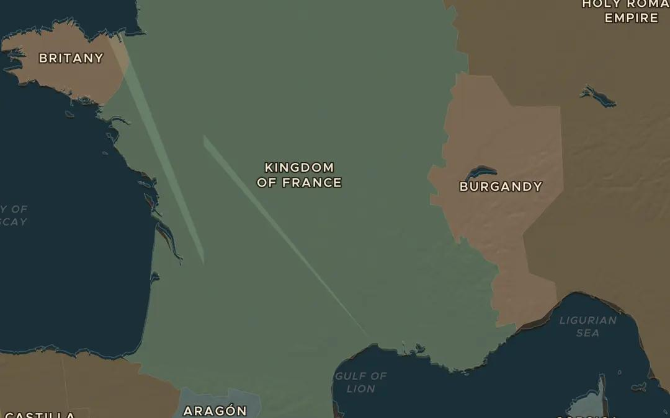
EXPLORE THE MAP · STEP A OF 3 · AD 1095
a
A call from Clermont
Open the map in 1095 on France. Find Clermont in the middle of the Kingdom of France. Urban II was himself a Frenchman. Why might he make his call here rather than in Rome?
Open this view on the live map →
ChronoAtlas Classroom · chronoatlas.nl/classroom/lesson/first-crusade-1095
3
Notes:
Open the map in 1095 on France. Find Clermont in the middle of the Kingdom of France. Urban II was himself a Frenchman. Why might he make his call here rather than in Rome?
https://chronoatlas.nl/?year=1095&lat=45.8&lng=3.1&zoom=6

Slide 4
CHRONOATLAS CLASSROOM
The rest of this deck comes with Classroom
19 more slides: the other map steps, the discussion questions, the quiz with its answers, and the worksheet.
Every lesson as a deck, every worksheet, every live lesson and homework.
€19 a month, cancel anytime. The free lesson, Rome at its height, comes whole.
https://chronoatlas.nl/pricing
ChronoAtlas Classroom · chronoatlas.nl/classroom/lesson/first-crusade-1095
4

