Slide 1
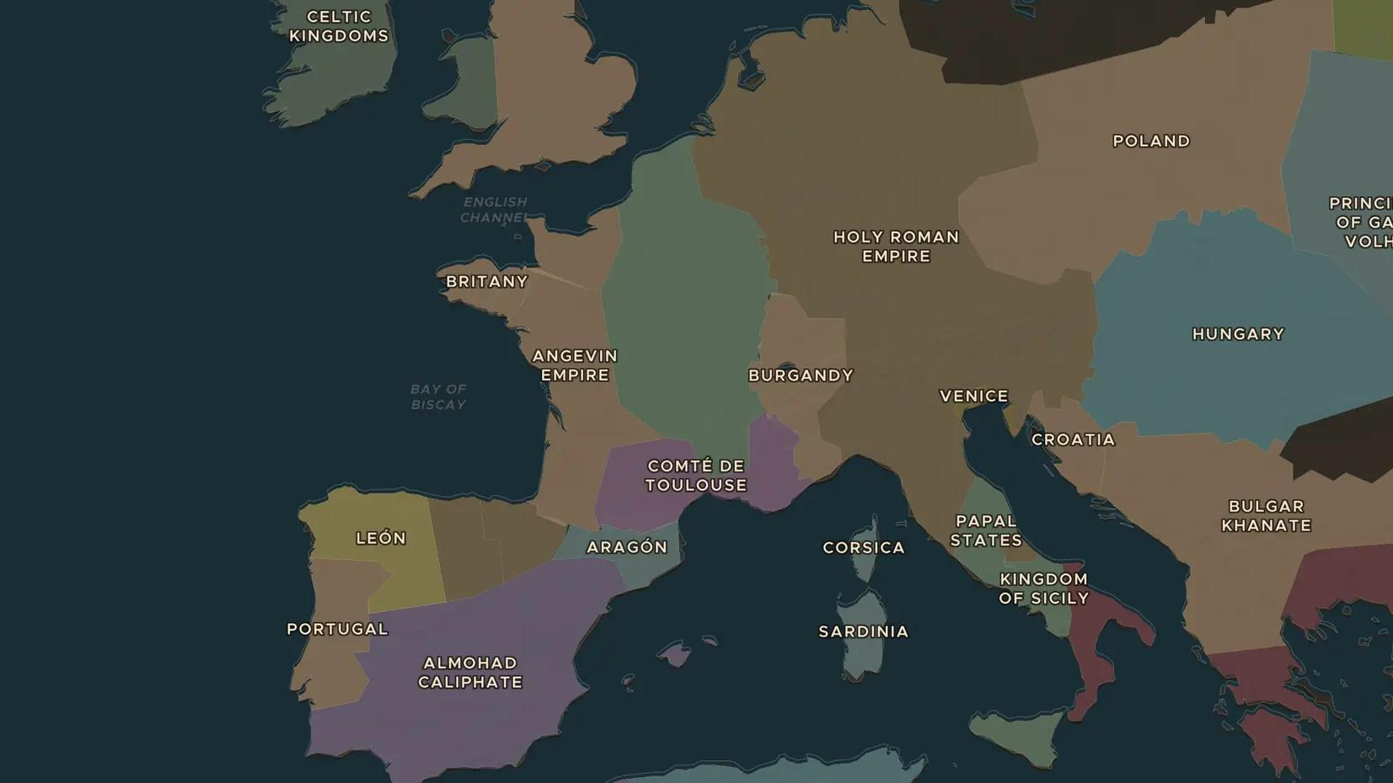
HIGH MIDDLE AGES · 1088-1300
The first universities
ChronoAtlas Classroom · Plate 219 · Ages 13-16 · 45 min
ChronoAtlas Classroom · chronoatlas.nl/classroom/lesson/first-universities

Slide 2
THIS LESSON
What students take from it
In Bologna, Paris and Oxford, students and teachers band together into a new kind of community: the university. Students explore what medieval scholars studied, how translations from Arabic changed European learning, and how much of it survives in schools today.
LENGTH
45 min
AGES
13-16
ON THE MAP
BY THE END, STUDENTS CAN
3 steps, AD 1088
Locate the first universities on the map and explain why they grew in those towns.
Describe what students studied, from the seven liberal arts to law, medicine and theology.
Explain how translations made in places such as Toledo brought Greek and Arabic learning to European universities.
QUIZ
7 rounds
ChronoAtlas Classroom · chronoatlas.nl/classroom/lesson/first-universities
2

Slide 3
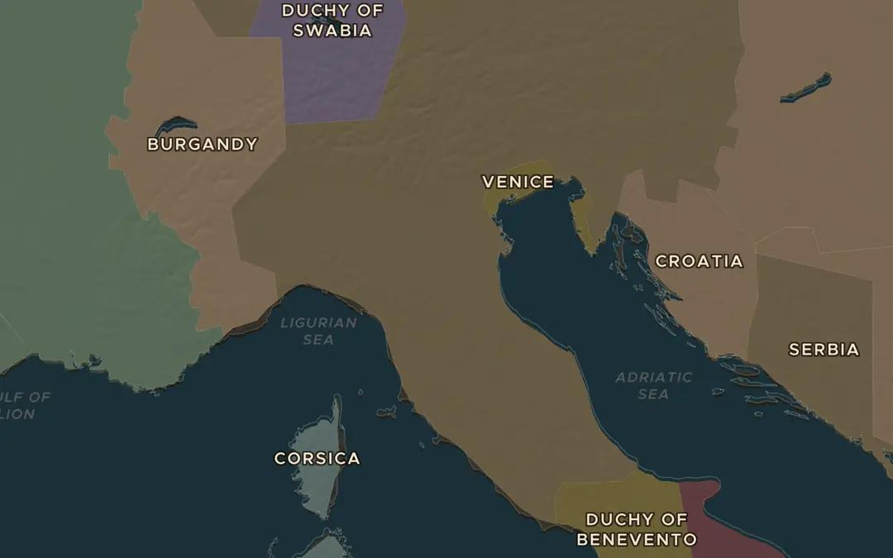
EXPLORE THE MAP · STEP A OF 3 · AD 1088
a
Bologna
Open the map in 1088 and turn on Historical Events (Cultural Milestones). Find the University of Bologna. Why might a rich town on the roads of northern Italy attract students of law?
Open this view on the live map →
ChronoAtlas Classroom · chronoatlas.nl/classroom/lesson/first-universities
3
Notes:
Open the map in 1088 and turn on Historical Events (Cultural Milestones). Find the University of Bologna. Why might a rich town on the roads of northern Italy attract students of law?
https://chronoatlas.nl/?year=1088&lat=44.49&lng=11.34&zoom=6

Slide 4
CHRONOATLAS CLASSROOM
The rest of this deck comes with Classroom
19 more slides: the other map steps, the discussion questions, the quiz with its answers, and the worksheet.
Every lesson as a deck, every worksheet, every live lesson and homework.
€19 a month, cancel anytime. The free lesson, Rome at its height, comes whole.
https://chronoatlas.nl/pricing
ChronoAtlas Classroom · chronoatlas.nl/classroom/lesson/first-universities
4

