Slide 1
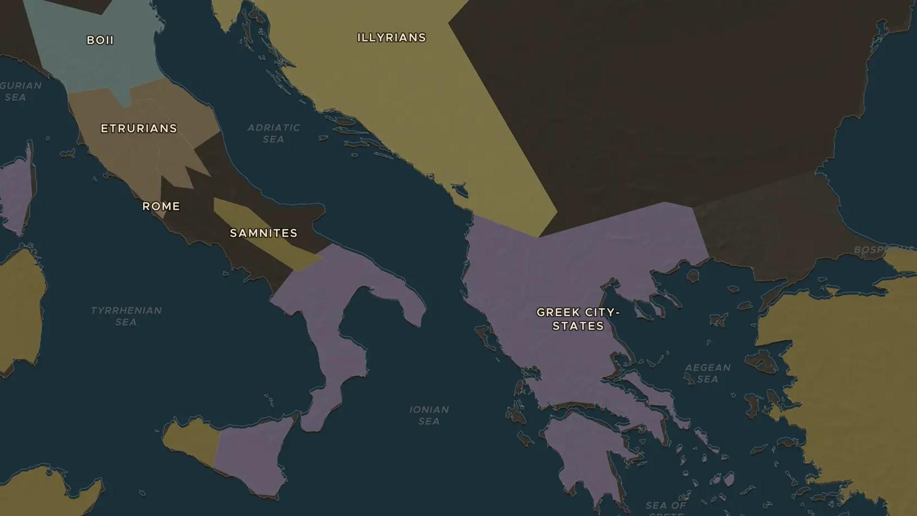
EARLY ROME · 753 BC
Romulus and Remus: how Rome began
ChronoAtlas Classroom · Plate 48 · Ages 10-13 · 45 min
ChronoAtlas Classroom · chronoatlas.nl/classroom/lesson/founding-of-rome-romulus-and-remus

Slide 2
THIS LESSON
What students take from it
Twins, a she-wolf and a quarrel on the Palatine Hill: Rome's founding legend is famous. Students compare the story with what archaeologists have found, and ask why the Romans told it.
LENGTH
45 min
AGES
10-13
ON THE MAP
BY THE END, STUDENTS CAN
3 steps, 753 BC
Retell the legend of Romulus and Remus and the traditional founding date of 753 BC.
Explain the difference between a legend and evidence found by archaeologists.
Give two reasons why the site of Rome, on the river Tiber, was a good place for a settlement.
QUIZ
7 rounds
ChronoAtlas Classroom · chronoatlas.nl/classroom/lesson/founding-of-rome-romulus-and-remus
2

Slide 3
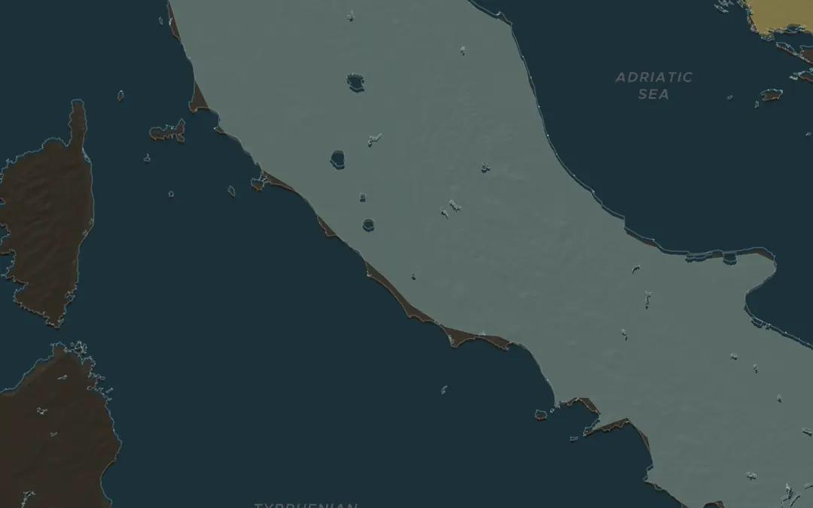
EXPLORE THE MAP · STEP A OF 3 · 753 BC
a
Where Rome began
Open the map in 753 BC. Turn on Historical Events and find the Political Events marker for the founding of Rome. Rome lies about 25 km from the sea, on the river Tiber. Why might a spot inland, by a river, be safer than the coast?
Open this view on the live map →
ChronoAtlas Classroom · chronoatlas.nl/classroom/lesson/founding-of-rome-romulus-and-remus
3
Notes:
Open the map in 753 BC. Turn on Historical Events and find the Political Events marker for the founding of Rome. Rome lies about 25 km from the sea, on the river Tiber. Why might a spot inland, by a river, be safer than the coast?
https://chronoatlas.nl/?year=-753&lat=41.9&lng=12.6&zoom=7

Slide 4
CHRONOATLAS CLASSROOM
The rest of this deck comes with Classroom
19 more slides: the other map steps, the discussion questions, the quiz with its answers, and the worksheet.
Every lesson as a deck, every worksheet, every live lesson and homework.
€19 a month, cancel anytime. The free lesson, Rome at its height, comes whole.
https://chronoatlas.nl/pricing
ChronoAtlas Classroom · chronoatlas.nl/classroom/lesson/founding-of-rome-romulus-and-remus
4

