Slide 1
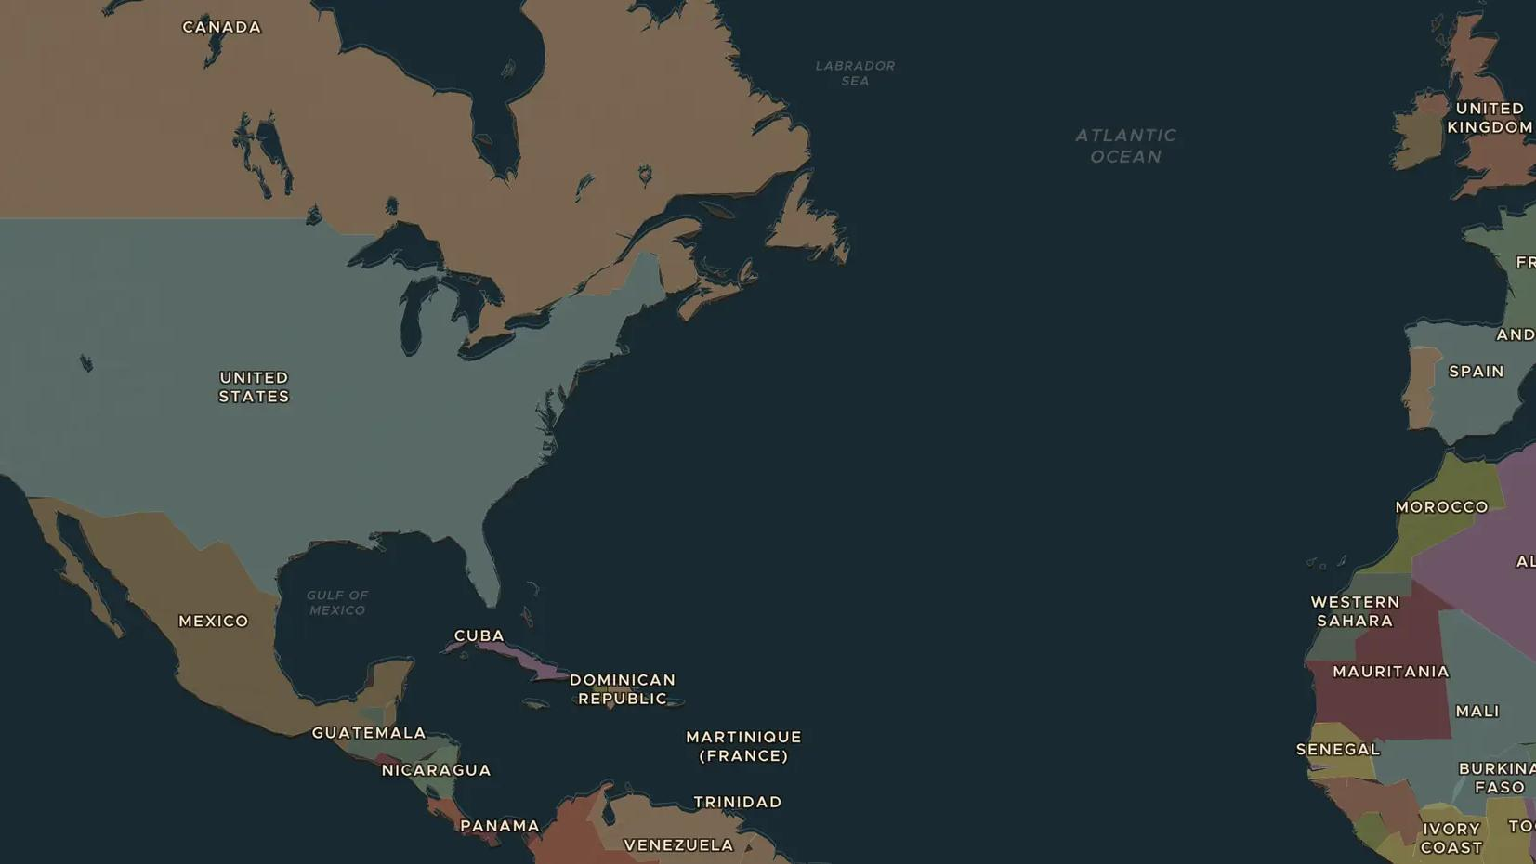
POSTWAR WORLD · 1945-1948
1945: the founding of the United Nations
ChronoAtlas Classroom · Plate 492 · Ages 12-15 · 45 min
ChronoAtlas Classroom · chronoatlas.nl/classroom/lesson/founding-united-nations

Slide 2
THIS LESSON
What students take from it
Before the Second World War had even ended, delegates from 50 countries met in San Francisco to found the United Nations. Students locate the UN's main cities, test how the Security Council works and read the Universal Declaration of Human Rights of 1948.
LENGTH
45 min
AGES
12-15
ON THE MAP
BY THE END, STUDENTS CAN
3 steps, AD 1945
Explain why the Allies created the United Nations in 1945.
Describe how the Security Council works, including the veto of the five permanent members.
Explain what the Universal Declaration of Human Rights of 1948 promises.
QUIZ
7 rounds
ChronoAtlas Classroom · chronoatlas.nl/classroom/lesson/founding-united-nations
2

Slide 3
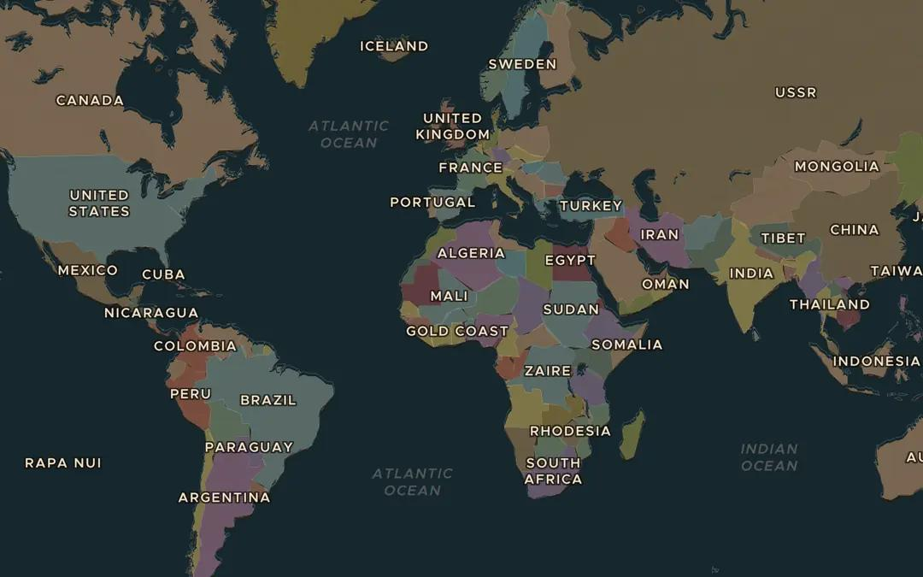
EXPLORE THE MAP · STEP A OF 3 · AD 1945
a
A world at war
Open the map in 1945 and zoom out to see the whole world. Ask the atlas: "Which countries founded the United Nations in 1945?" Which large parts of the world had no seat of their own?
Open this view on the live map →
ChronoAtlas Classroom · chronoatlas.nl/classroom/lesson/founding-united-nations
3
Notes:
Open the map in 1945 and zoom out to see the whole world. Ask the atlas: "Which countries founded the United Nations in 1945?" Which large parts of the world had no seat of their own?
https://chronoatlas.nl/?year=1945&lat=20&lng=0&zoom=2

Slide 4
CHRONOATLAS CLASSROOM
The rest of this deck comes with Classroom
19 more slides: the other map steps, the discussion questions, the quiz with its answers, and the worksheet.
Every lesson as a deck, every worksheet, every live lesson and homework.
€19 a month, cancel anytime. The free lesson, Rome at its height, comes whole.
https://chronoatlas.nl/pricing
ChronoAtlas Classroom · chronoatlas.nl/classroom/lesson/founding-united-nations
4

