Slide 1
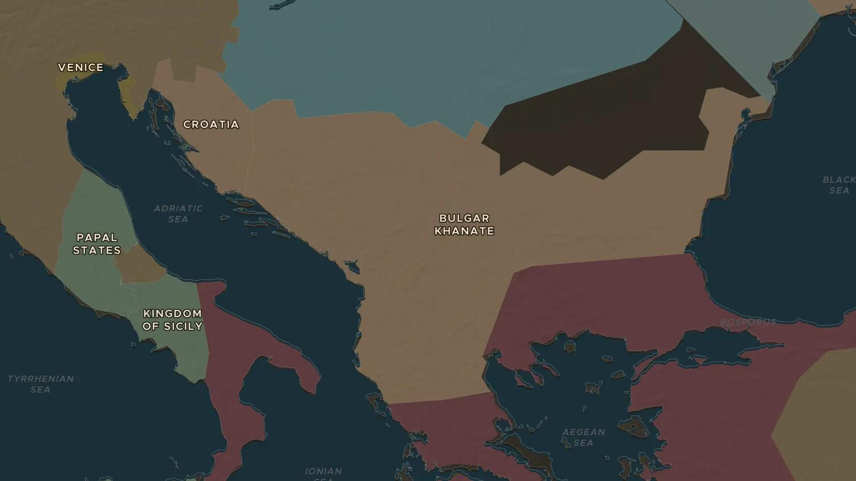
CRUSADES · 1202-1261
1204: the crusade that sacked Constantinople
ChronoAtlas Classroom · Plate 234 · Ages 13-16 · 50 min
ChronoAtlas Classroom · chronoatlas.nl/classroom/lesson/fourth-crusade-1204

Slide 2
THIS LESSON
What students take from it
A crusade meant for Egypt ends with crusaders looting the greatest Christian city in the world. Students trace the money, the ships and the decisions that led the Fourth Crusade to Constantinople in 1204, and follow the Byzantine states that fought back.
LENGTH
50 min
AGES
13-16
ON THE MAP
BY THE END, STUDENTS CAN
3 steps, AD 1200
Explain step by step how a crusade aimed at Egypt ended up attacking Constantinople.
Describe the role of Venice and its doge, Enrico Dandolo.
Locate the Byzantine successor states and explain how Constantinople was recovered in 1261.
QUIZ
7 rounds
ChronoAtlas Classroom · chronoatlas.nl/classroom/lesson/fourth-crusade-1204
2

Slide 3
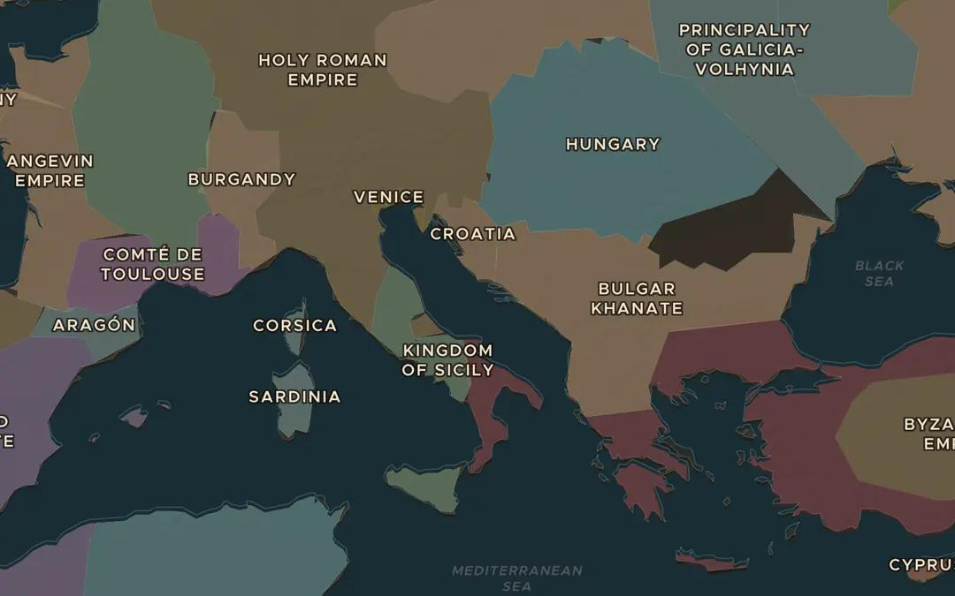
EXPLORE THE MAP · STEP A OF 3 · AD 1200
a
Venice and its sea
Open the map in 1200 and find Venice at the top of the Adriatic. Follow the coast south to Zara and on to the Aegean. Why did the crusaders need Venice?
Open this view on the live map →
ChronoAtlas Classroom · chronoatlas.nl/classroom/lesson/fourth-crusade-1204
3
Notes:
Open the map in 1200 and find Venice at the top of the Adriatic. Follow the coast south to Zara and on to the Aegean. Why did the crusaders need Venice?
https://chronoatlas.nl/?year=1200&lat=43&lng=16&zoom=4.8

Slide 4
CHRONOATLAS CLASSROOM
The rest of this deck comes with Classroom
19 more slides: the other map steps, the discussion questions, the quiz with its answers, and the worksheet.
Every lesson as a deck, every worksheet, every live lesson and homework.
€19 a month, cancel anytime. The free lesson, Rome at its height, comes whole.
https://chronoatlas.nl/pricing
ChronoAtlas Classroom · chronoatlas.nl/classroom/lesson/fourth-crusade-1204
4

