Slide 1
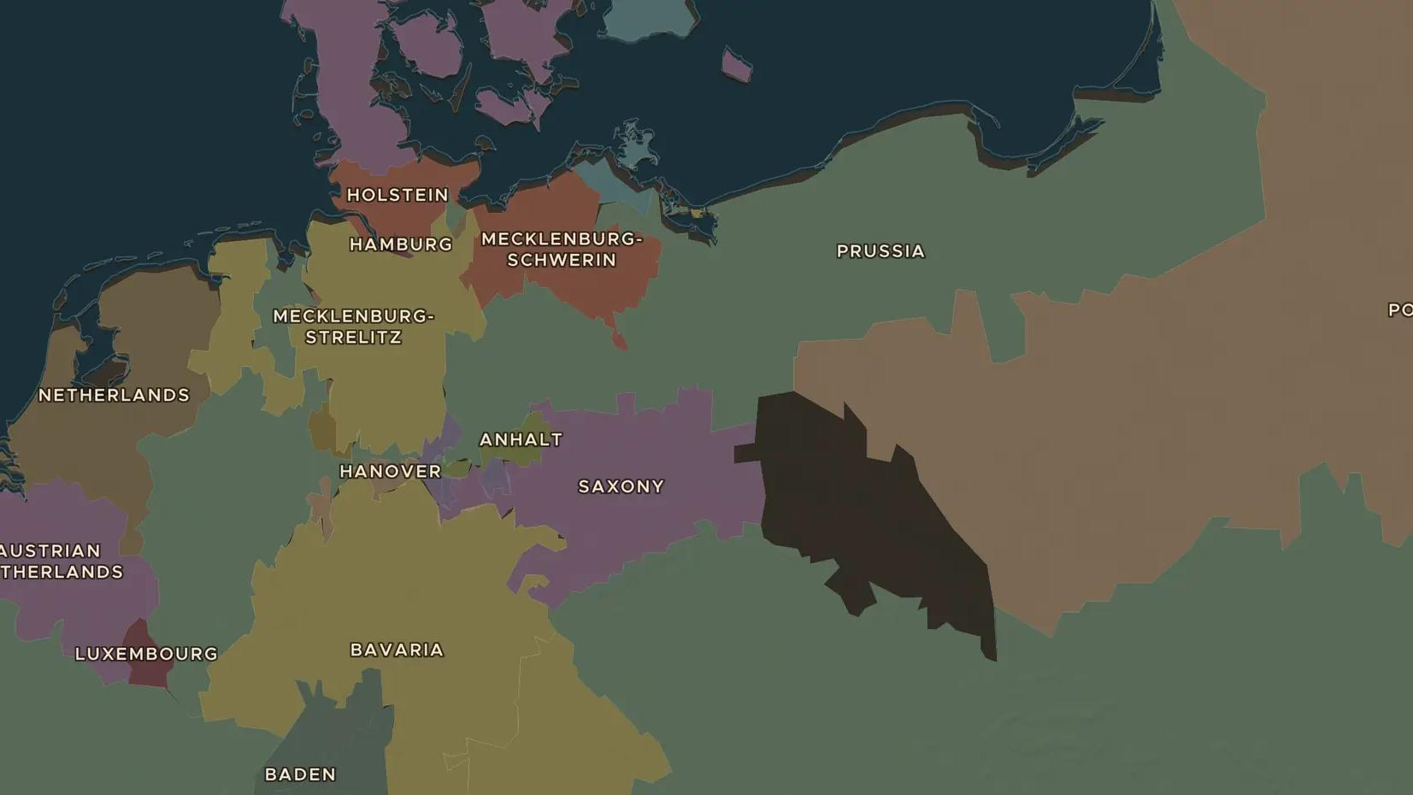
KINGDOM OF PRUSSIA · 1740-1786
Frederick the Great and the rise of Prussia
ChronoAtlas Classroom · Plate 381 · Ages 13-16 · 50 min
ChronoAtlas Classroom · chronoatlas.nl/classroom/lesson/frederick-the-great-prussia

Slide 2
THIS LESSON
What students take from it
A young king who loves flute music and French books seizes Silesia and turns Prussia into a great power. Students follow Frederick from Potsdam to the battlefields, and weigh the "enlightened" ruler against the man who started wars.
LENGTH
50 min
AGES
13-16
ON THE MAP
BY THE END, STUDENTS CAN
3 steps, AD 1740
Explain how Frederick the Great made Prussia a great power.
Locate Berlin, Potsdam and Silesia and explain why Silesia mattered.
Judge whether Frederick deserves to be called an "enlightened" ruler.
QUIZ
7 rounds
ChronoAtlas Classroom · chronoatlas.nl/classroom/lesson/frederick-the-great-prussia
2

Slide 3
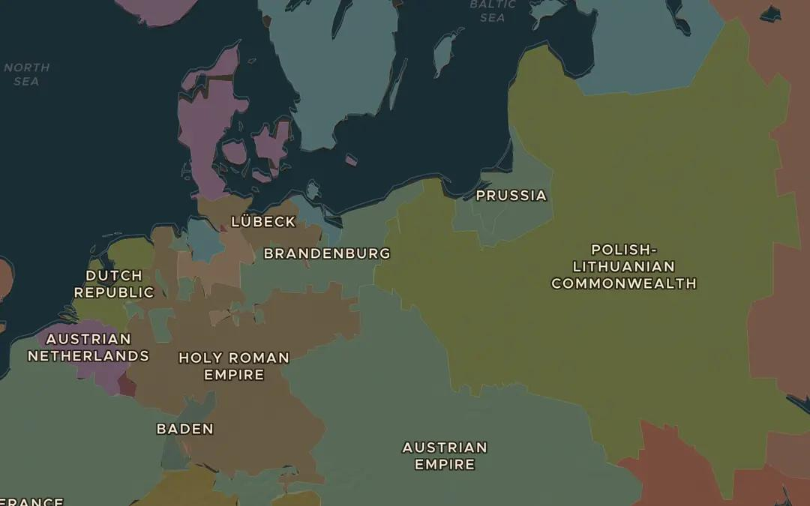
EXPLORE THE MAP · STEP A OF 3 · AD 1740
a
Scattered lands
Open the map in 1740 and find Brandenburg around Berlin and the separate duchy of Prussia further east. Are the king's lands joined together? Then find Silesia on the upper Oder, still ruled from Vienna.
Open this view on the live map →
ChronoAtlas Classroom · chronoatlas.nl/classroom/lesson/frederick-the-great-prussia
3
Notes:
Open the map in 1740 and find Brandenburg around Berlin and the separate duchy of Prussia further east. Are the king's lands joined together? Then find Silesia on the upper Oder, still ruled from Vienna.
https://chronoatlas.nl/?year=1740&lat=53&lng=17&zoom=5

Slide 4
CHRONOATLAS CLASSROOM
The rest of this deck comes with Classroom
19 more slides: the other map steps, the discussion questions, the quiz with its answers, and the worksheet.
Every lesson as a deck, every worksheet, every live lesson and homework.
€19 a month, cancel anytime. The free lesson, Rome at its height, comes whole.
https://chronoatlas.nl/pricing
ChronoAtlas Classroom · chronoatlas.nl/classroom/lesson/frederick-the-great-prussia
4

