Slide 1
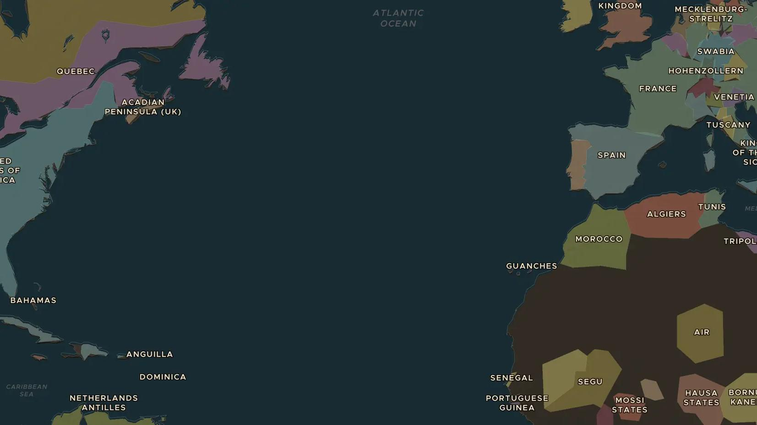
FRENCH REVOLUTION · 1792-1794
The Republic and the Terror
ChronoAtlas Classroom · Plate 398 · Ages 13-16 · 50 min
ChronoAtlas Classroom · chronoatlas.nl/classroom/lesson/french-republic-and-terror

Slide 2
THIS LESSON
What students take from it
At war with half of Europe, revolutionary France abolishes its monarchy, executes its king and turns to terror against its own citizens. Students trace how fear, war and big ideas pushed the Revolution to extremes.
LENGTH
50 min
AGES
13-16
ON THE MAP
BY THE END, STUDENTS CAN
3 steps, AD 1792
Explain how war with Austria and Prussia made the Revolution more radical after 1792.
Describe what the Terror was, who led it and how it ended in July 1794.
Weigh whether a government can defend freedom by taking freedoms away.
QUIZ
7 rounds
ChronoAtlas Classroom · chronoatlas.nl/classroom/lesson/french-republic-and-terror
2

Slide 3
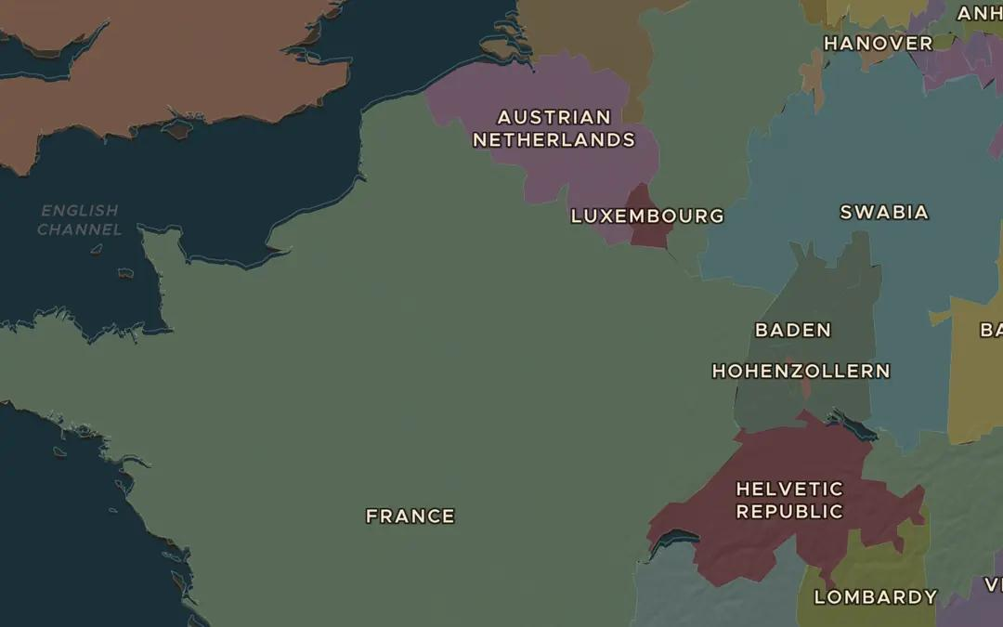
EXPLORE THE MAP · STEP A OF 3 · AD 1792
a
A country at war
Open the map in 1792 and turn on Historical Events. Find the battle of Valmy. How far is it from Paris, and why was an enemy army there so dangerous for the Revolution?
Open this view on the live map →
ChronoAtlas Classroom · chronoatlas.nl/classroom/lesson/french-republic-and-terror
3
Notes:
Open the map in 1792 and turn on Historical Events. Find the battle of Valmy. How far is it from Paris, and why was an enemy army there so dangerous for the Revolution?
https://chronoatlas.nl/?year=1792&lat=48.8&lng=3.8&zoom=6

Slide 4
CHRONOATLAS CLASSROOM
The rest of this deck comes with Classroom
19 more slides: the other map steps, the discussion questions, the quiz with its answers, and the worksheet.
Every lesson as a deck, every worksheet, every live lesson and homework.
€19 a month, cancel anytime. The free lesson, Rome at its height, comes whole.
https://chronoatlas.nl/pricing
ChronoAtlas Classroom · chronoatlas.nl/classroom/lesson/french-republic-and-terror
4

