Slide 1
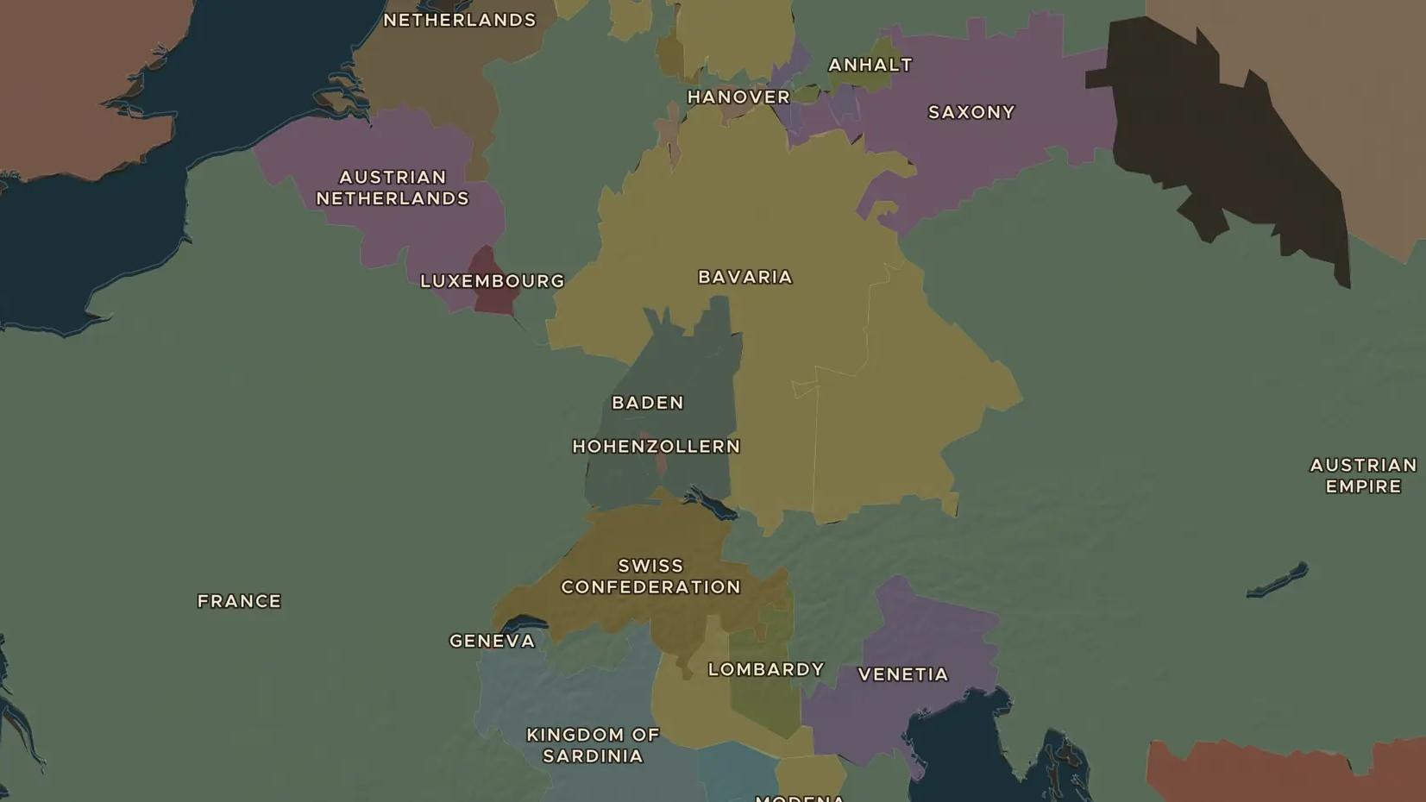
FRENCH REVOLUTION · 1789-1791
1789: France in revolution
ChronoAtlas Classroom · Plate 396 · Ages 12-15 · 50 min
ChronoAtlas Classroom · chronoatlas.nl/classroom/lesson/french-revolution-1789

Slide 2
THIS LESSON
What students take from it
A bankrupt king calls an old assembly, and within months Paris storms the Bastille and a National Assembly declares the rights of man. Students explore how a money crisis turned into a revolution.
LENGTH
50 min
AGES
12-15
ON THE MAP
BY THE END, STUDENTS CAN
3 steps, AD 1789
Explain how the debts of the French crown led to the meeting of the Estates-General in 1789.
Put the main events of 1789 in order: Estates-General, Tennis Court Oath, Bastille, Declaration of the Rights of Man.
Judge who gained from the new rights of 1789 and who was still left out.
QUIZ
7 rounds
ChronoAtlas Classroom · chronoatlas.nl/classroom/lesson/french-revolution-1789
2

Slide 3
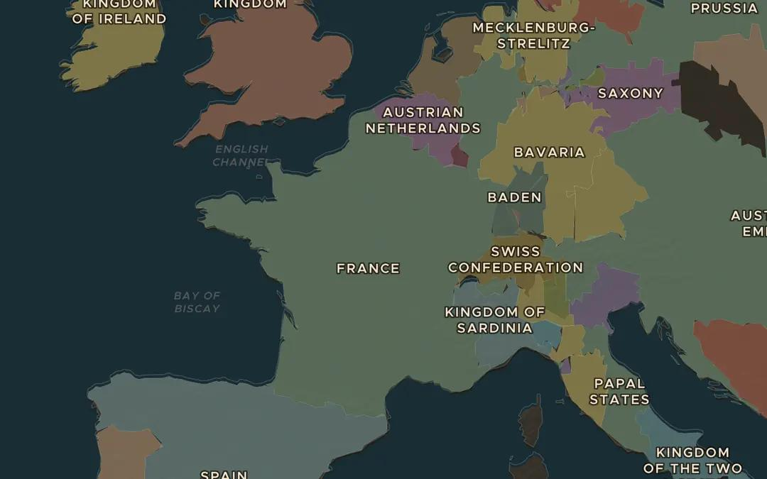
EXPLORE THE MAP · STEP A OF 3 · AD 1789
a
France in 1789
Open the map in 1789 and zoom in on France. Find Paris. The king lived at Versailles, about 20 km to the south-west. Which states border France to the north and east?
Open this view on the live map →
ChronoAtlas Classroom · chronoatlas.nl/classroom/lesson/french-revolution-1789
3
Notes:
Open the map in 1789 and zoom in on France. Find Paris. The king lived at Versailles, about 20 km to the south-west. Which states border France to the north and east?
https://chronoatlas.nl/?year=1789&lat=47.5&lng=3&zoom=5

Slide 4
CHRONOATLAS CLASSROOM
The rest of this deck comes with Classroom
19 more slides: the other map steps, the discussion questions, the quiz with its answers, and the worksheet.
Every lesson as a deck, every worksheet, every live lesson and homework.
€19 a month, cancel anytime. The free lesson, Rome at its height, comes whole.
https://chronoatlas.nl/pricing
ChronoAtlas Classroom · chronoatlas.nl/classroom/lesson/french-revolution-1789
4

