Slide 1
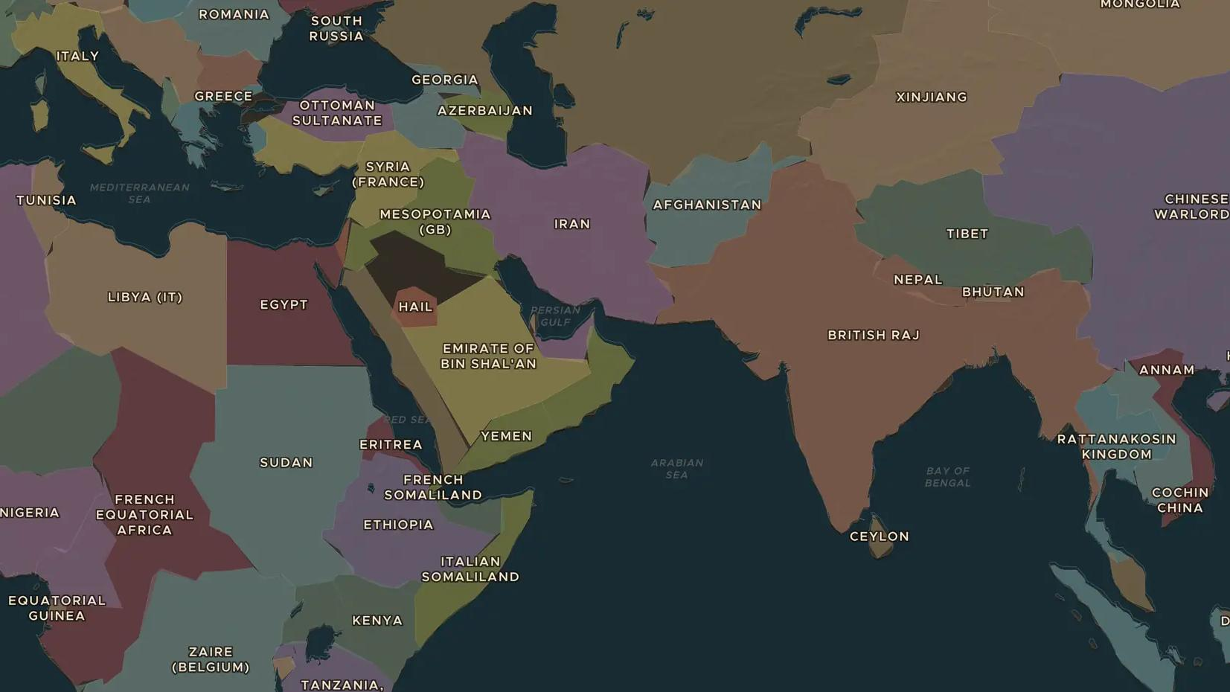
FIRST WORLD WAR · 1915-1916
Gallipoli 1915: the battle for the straits
ChronoAtlas Classroom · Plate 461 · Ages 12-15 · 45 min
ChronoAtlas Classroom · chronoatlas.nl/classroom/lesson/gallipoli-1915

Slide 2
THIS LESSON
What students take from it
In 1915 Britain and France tried to force the Dardanelles and knock the Ottoman Empire out of the war. Eight months later they gave up. Students see why the narrow straits mattered and why Turkey, Australia and New Zealand still remember Gallipoli.
LENGTH
45 min
AGES
12-15
ON THE MAP
BY THE END, STUDENTS CAN
3 steps, AD 1914
Explain why the Allies wanted to control the Dardanelles in 1915.
Locate the Gallipoli peninsula, the Dardanelles and Constantinople on the map.
Compare how Turkey, Australia and New Zealand remember Gallipoli today.
QUIZ
7 rounds
ChronoAtlas Classroom · chronoatlas.nl/classroom/lesson/gallipoli-1915
2

Slide 3
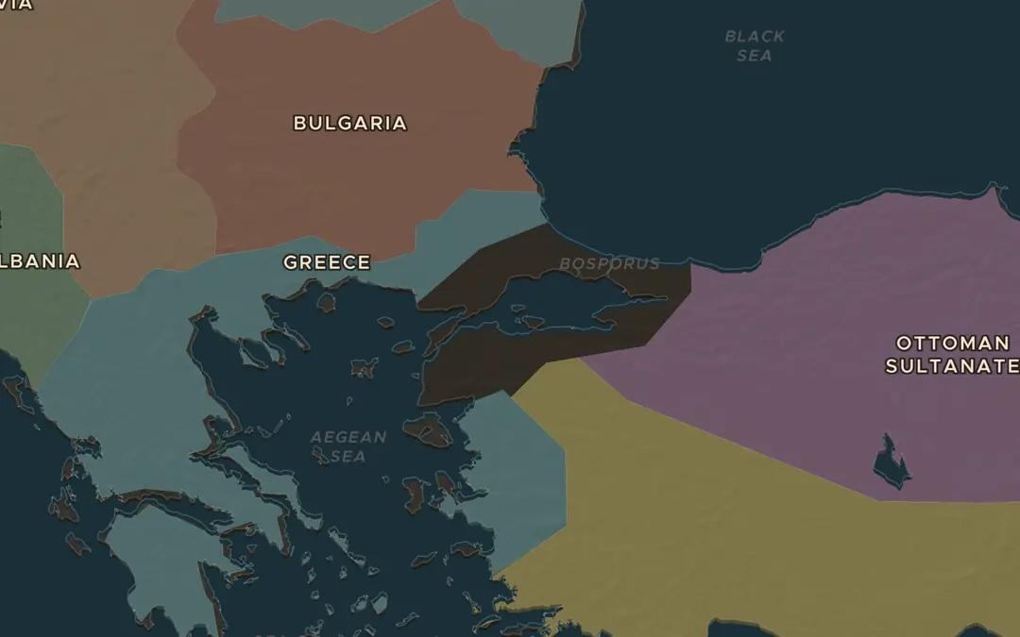
EXPLORE THE MAP · STEP A OF 3 · AD 1914
a
The straits
Open the map in 1914 and find the Ottoman Empire. Follow the sea route from the Mediterranean through the Dardanelles to Constantinople and the Black Sea. Which ally could Britain and France reach this way?
Open this view on the live map →
ChronoAtlas Classroom · chronoatlas.nl/classroom/lesson/gallipoli-1915
3
Notes:
Open the map in 1914 and find the Ottoman Empire. Follow the sea route from the Mediterranean through the Dardanelles to Constantinople and the Black Sea. Which ally could Britain and France reach this way?
https://chronoatlas.nl/?year=1914&lat=40.5&lng=27.5&zoom=6

Slide 4
CHRONOATLAS CLASSROOM
The rest of this deck comes with Classroom
19 more slides: the other map steps, the discussion questions, the quiz with its answers, and the worksheet.
Every lesson as a deck, every worksheet, every live lesson and homework.
€19 a month, cancel anytime. The free lesson, Rome at its height, comes whole.
https://chronoatlas.nl/pricing
ChronoAtlas Classroom · chronoatlas.nl/classroom/lesson/gallipoli-1915
4

