Slide 1
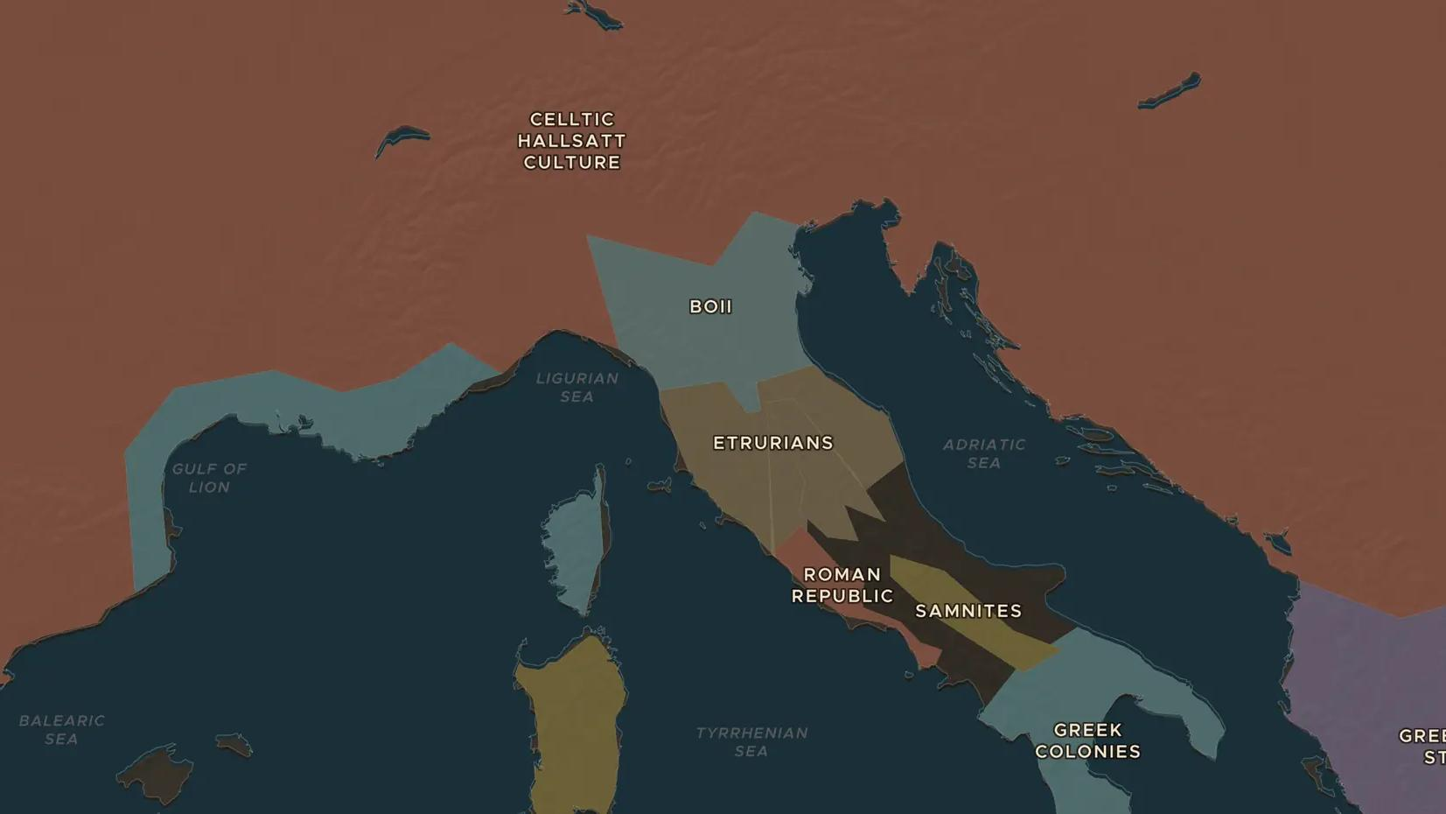
ROMAN REPUBLIC · 390 BC
390 BC: the Gauls sack Rome
ChronoAtlas Classroom · Plate 78 · Ages 10-13 · 45 min
ChronoAtlas Classroom · chronoatlas.nl/classroom/lesson/gauls-sack-rome

Slide 2
THIS LESSON
What students take from it
A Celtic army crushes the Romans at the river Allia and sacks Rome itself. Students separate legend from evidence, and see how the disaster made Rome build a stone wall and rethink its defense.
LENGTH
45 min
AGES
10-13
ON THE MAP
BY THE END, STUDENTS CAN
3 steps, 400 BC
Describe what happened at the Allia and in Rome around 390 BC.
Locate the lands of the Celtic peoples in northern Italy on the map.
Separate the facts of the sack from the legends Romans told about it, such as the sacred geese.
QUIZ
7 rounds
ChronoAtlas Classroom · chronoatlas.nl/classroom/lesson/gauls-sack-rome
2

Slide 3
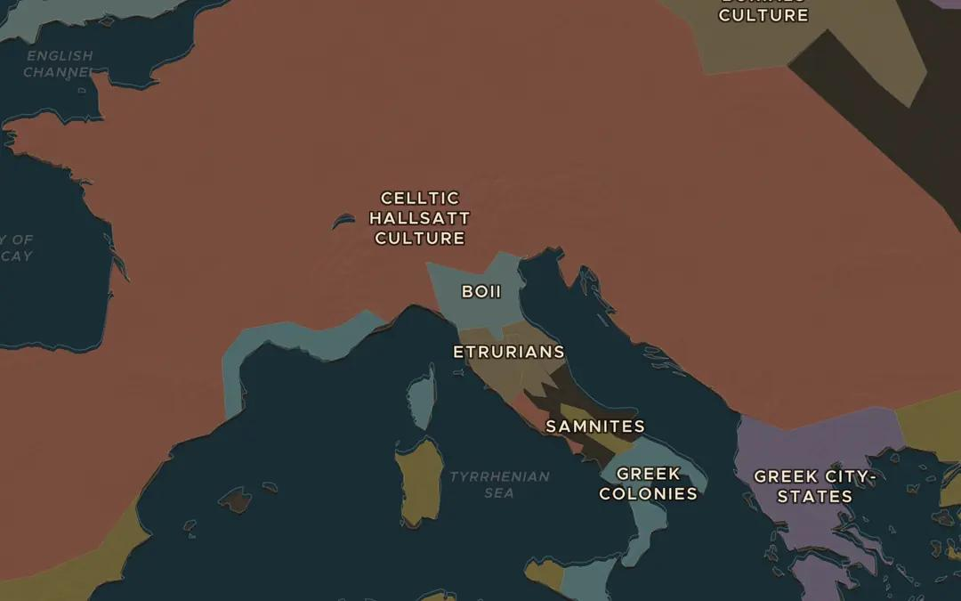
EXPLORE THE MAP · STEP A OF 3 · 400 BC
a
Celts in Italy
Open the map in 400 BC and look at northern Italy and the lands beyond the Alps. Find Celtic peoples such as the Boii. How far are they from Rome?
Open this view on the live map →
ChronoAtlas Classroom · chronoatlas.nl/classroom/lesson/gauls-sack-rome
3
Notes:
Open the map in 400 BC and look at northern Italy and the lands beyond the Alps. Find Celtic peoples such as the Boii. How far are they from Rome?
https://chronoatlas.nl/?year=-400&lat=44.5&lng=11&zoom=5

Slide 4
CHRONOATLAS CLASSROOM
The rest of this deck comes with Classroom
19 more slides: the other map steps, the discussion questions, the quiz with its answers, and the worksheet.
Every lesson as a deck, every worksheet, every live lesson and homework.
€19 a month, cancel anytime. The free lesson, Rome at its height, comes whole.
https://chronoatlas.nl/pricing
ChronoAtlas Classroom · chronoatlas.nl/classroom/lesson/gauls-sack-rome
4

