Slide 1
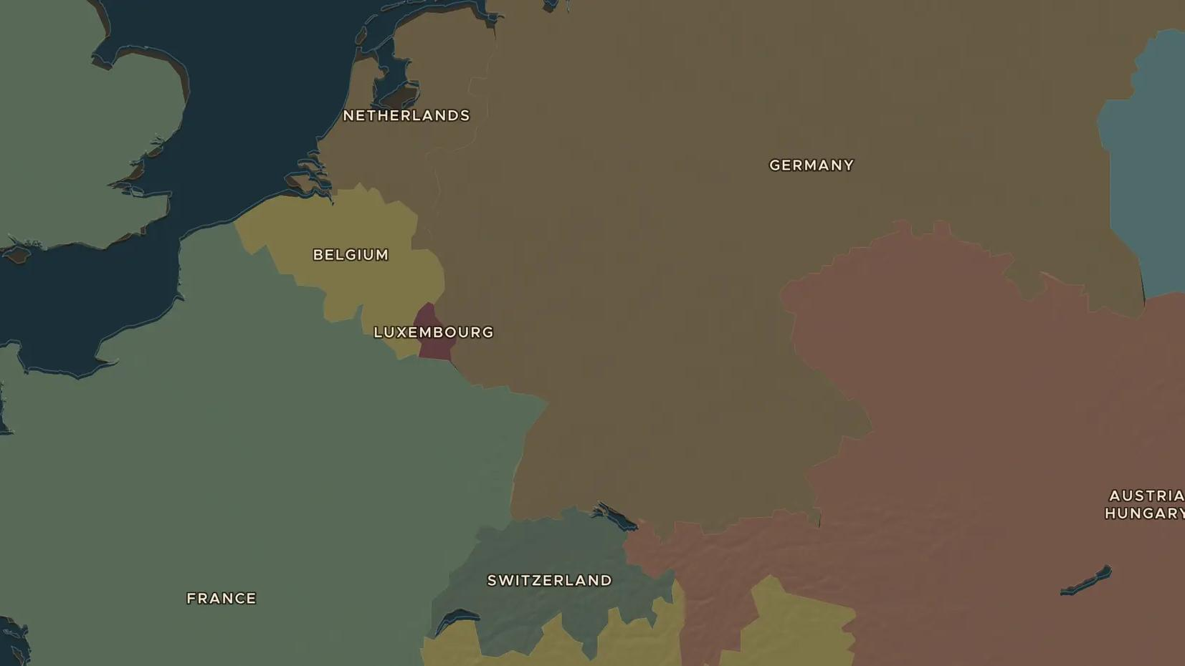
GERMAN UNIFICATION · 1862-1871
Bismarck and the making of Germany
ChronoAtlas Classroom · Plate 425 · Ages 13-16 · 50 min
ChronoAtlas Classroom · chronoatlas.nl/classroom/lesson/german-unification-bismarck

Slide 2
THIS LESSON
What students take from it
Through three short wars in seven years, Prussia's Otto von Bismarck turns dozens of German states into one empire, proclaimed in the palace of the French kings. Students follow "blood and iron" on the map and ask whose Germany it was.
LENGTH
50 min
AGES
13-16
ON THE MAP
BY THE END, STUDENTS CAN
3 steps, AD 1848
Explain how Prussia united Germany through the wars of 1864, 1866 and 1870-1871.
Describe Bismarck's methods and what he meant by "blood and iron".
Explain the results of the Franco-Prussian War for France and Germany.
QUIZ
7 rounds
ChronoAtlas Classroom · chronoatlas.nl/classroom/lesson/german-unification-bismarck
2

Slide 3
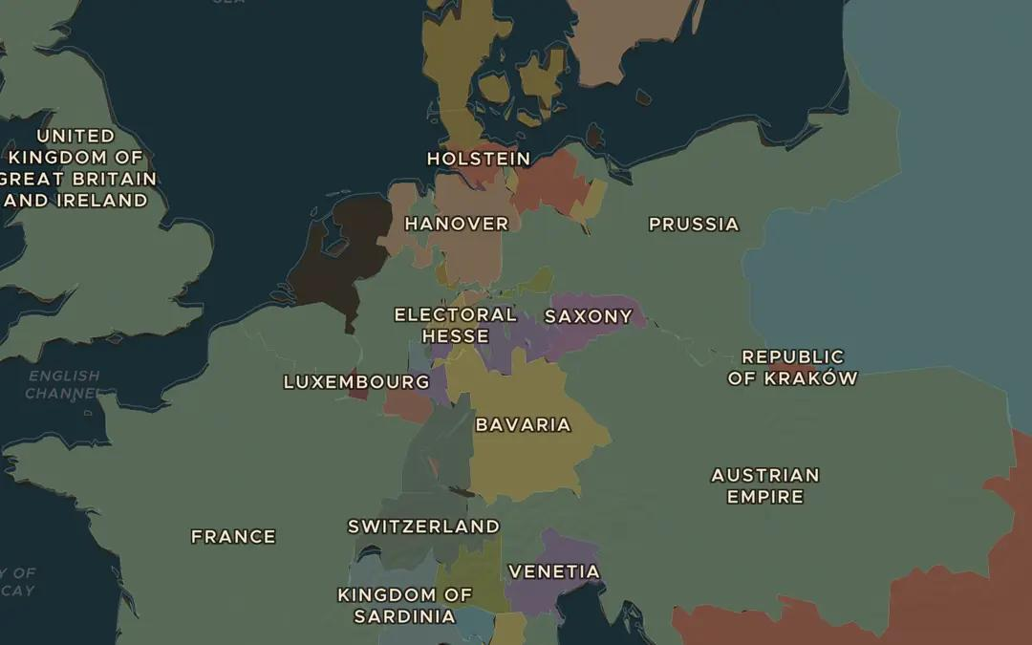
EXPLORE THE MAP · STEP A OF 3 · AD 1848
a
Many Germanies
Open the map in 1848 and zoom in on the German lands. Count as many states as you can. Which two big powers competed to lead them?
Open this view on the live map →
ChronoAtlas Classroom · chronoatlas.nl/classroom/lesson/german-unification-bismarck
3
Notes:
Open the map in 1848 and zoom in on the German lands. Count as many states as you can. Which two big powers competed to lead them?
https://chronoatlas.nl/?year=1848&lat=51&lng=11&zoom=5

Slide 4
CHRONOATLAS CLASSROOM
The rest of this deck comes with Classroom
19 more slides: the other map steps, the discussion questions, the quiz with its answers, and the worksheet.
Every lesson as a deck, every worksheet, every live lesson and homework.
€19 a month, cancel anytime. The free lesson, Rome at its height, comes whole.
https://chronoatlas.nl/pricing
ChronoAtlas Classroom · chronoatlas.nl/classroom/lesson/german-unification-bismarck
4

