Slide 1
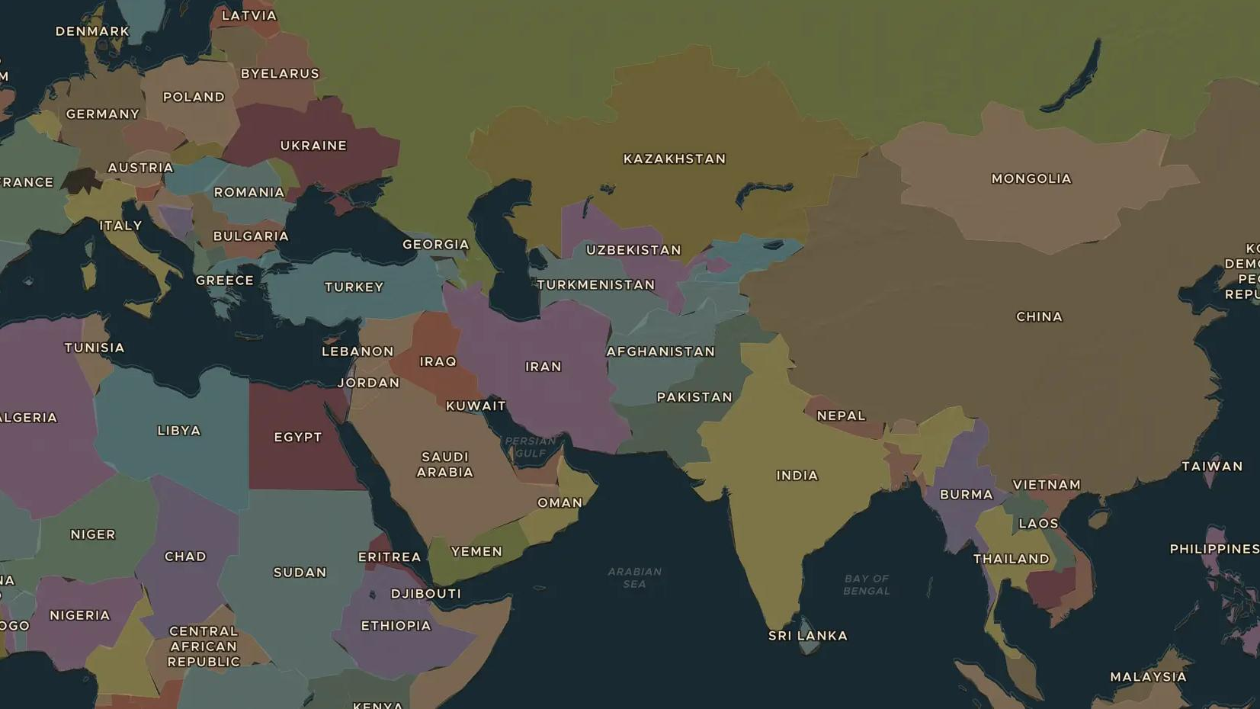
POST-COLD WAR · 1990-2010
A connected world: globalisation, 1990-2010
ChronoAtlas Classroom · Plate 516 · Ages 12-15 · 50 min
ChronoAtlas Classroom · chronoatlas.nl/classroom/lesson/globalisation-1990-2010

Slide 2
THIS LESSON
What students take from it
Shipping containers, the internet and open markets tied the world together as never before. A phone designed in California, built in China and sold in Rotterdam became normal. Students follow goods, money and ideas across the 2010 map and weigh who gained and who lost.
LENGTH
50 min
AGES
12-15
ON THE MAP
BY THE END, STUDENTS CAN
3 steps, AD 2010
Explain how containers, the internet and trade rules connected the world economy after 1990.
Locate key hubs of globalisation: Rotterdam, Shanghai, Geneva and Bangalore.
Weigh the gains and losses of globalisation for different groups of people.
QUIZ
7 rounds
ChronoAtlas Classroom · chronoatlas.nl/classroom/lesson/globalisation-1990-2010
2

Slide 3
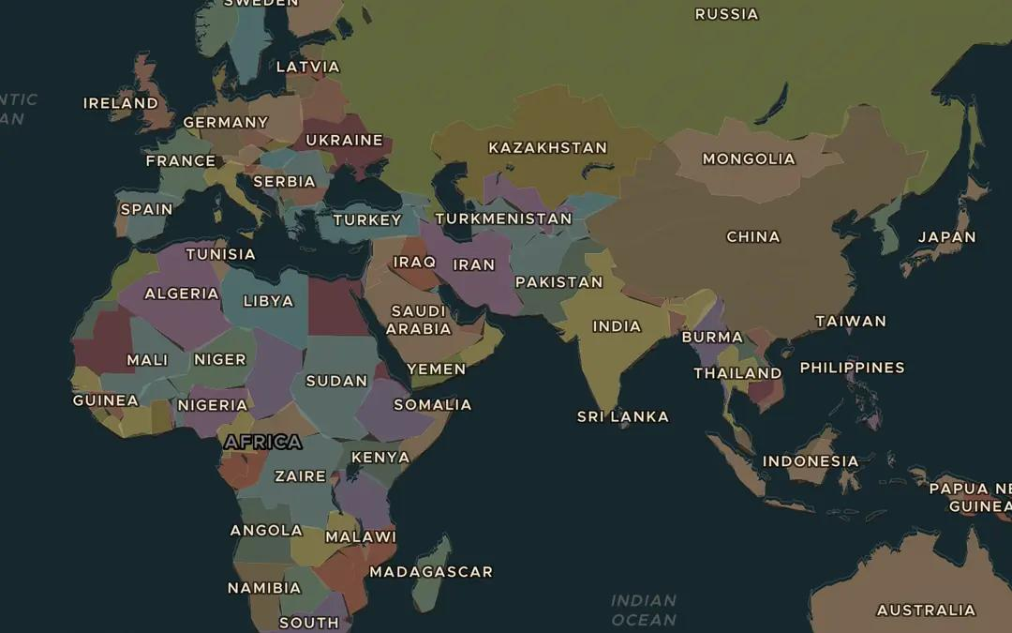
EXPLORE THE MAP · STEP A OF 3 · AD 2010
a
Ports
Open the map in 2010 and turn on the Cities layer. Find Rotterdam, the largest port in Europe, and Shanghai, the busiest container port in the world by 2010. Follow the sea route between them. Which canal shortens the voyage?
Open this view on the live map →
ChronoAtlas Classroom · chronoatlas.nl/classroom/lesson/globalisation-1990-2010
3
Notes:
Open the map in 2010 and turn on the Cities layer. Find Rotterdam, the largest port in Europe, and Shanghai, the busiest container port in the world by 2010. Follow the sea route between them. Which canal shortens the voyage?
https://chronoatlas.nl/?year=2010&lat=25&lng=60&zoom=2.5

Slide 4
CHRONOATLAS CLASSROOM
The rest of this deck comes with Classroom
19 more slides: the other map steps, the discussion questions, the quiz with its answers, and the worksheet.
Every lesson as a deck, every worksheet, every live lesson and homework.
€19 a month, cancel anytime. The free lesson, Rome at its height, comes whole.
https://chronoatlas.nl/pricing
ChronoAtlas Classroom · chronoatlas.nl/classroom/lesson/globalisation-1990-2010
4

