Slide 1
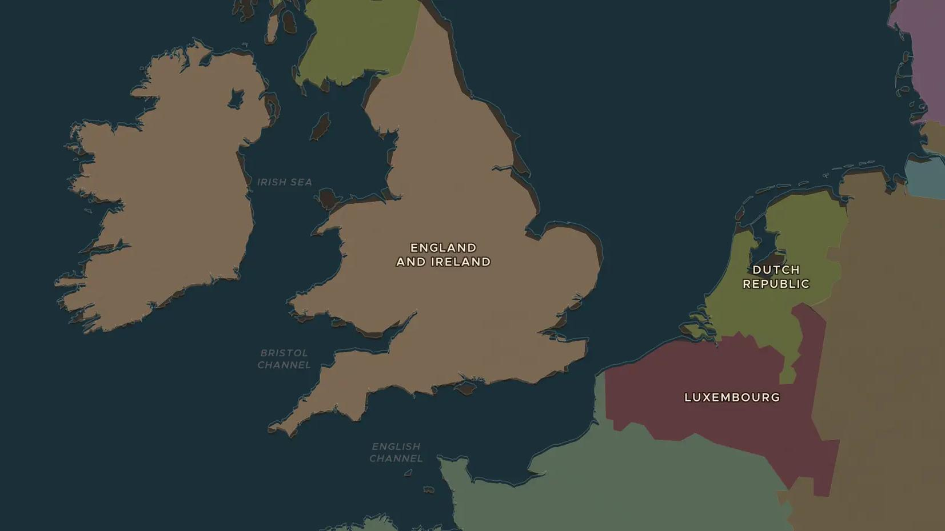
STUART ENGLAND · 1688-1689
The Glorious Revolution of 1688
ChronoAtlas Classroom · Plate 366 · Ages 13-16 · 45 min
ChronoAtlas Classroom · chronoatlas.nl/classroom/lesson/glorious-revolution-1688

Slide 2
THIS LESSON
What students take from it
A Dutch prince sails to England with a large fleet and an army, and the king flees. Students follow William of Orange from Hellevoetsluis to Torbay and discuss the Bill of Rights, which limited royal power for good.
LENGTH
45 min
AGES
13-16
ON THE MAP
BY THE END, STUDENTS CAN
3 steps, AD 1690
Explain why leading English politicians invited William of Orange in 1688.
Trace William's invasion route on the map.
Name three things the Bill of Rights of 1689 decided and explain why they still matter.
QUIZ
7 rounds
ChronoAtlas Classroom · chronoatlas.nl/classroom/lesson/glorious-revolution-1688
2

Slide 3
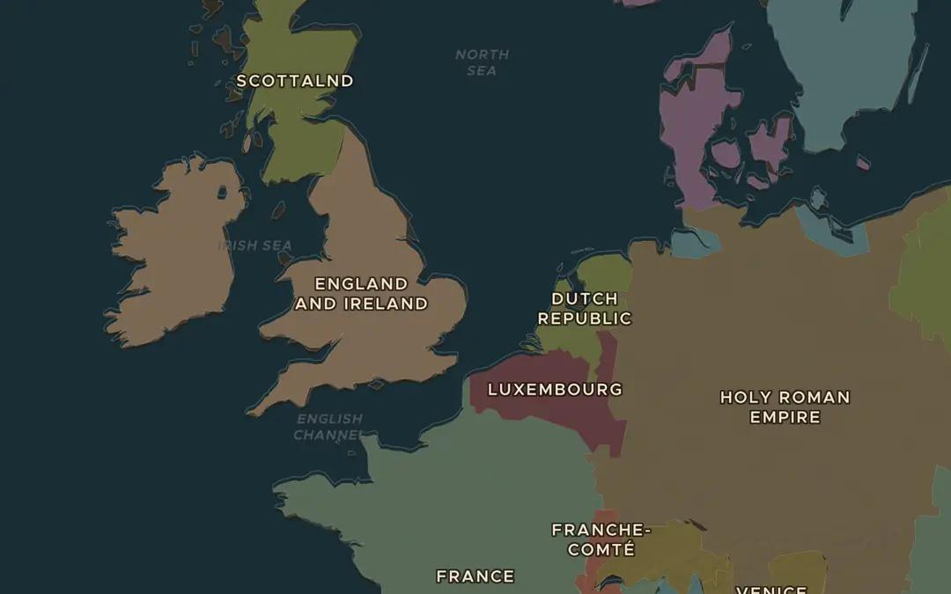
EXPLORE THE MAP · STEP A OF 3 · AD 1690
a
Across the North Sea
Open the map in 1690 and zoom in on the North Sea. Find the Dutch Republic and England. Why might the Dutch want England on their side against Louis XIV's France?
Open this view on the live map →
ChronoAtlas Classroom · chronoatlas.nl/classroom/lesson/glorious-revolution-1688
3
Notes:
Open the map in 1690 and zoom in on the North Sea. Find the Dutch Republic and England. Why might the Dutch want England on their side against Louis XIV's France?
https://chronoatlas.nl/?year=1690&lat=52.5&lng=2&zoom=5

Slide 4
CHRONOATLAS CLASSROOM
The rest of this deck comes with Classroom
19 more slides: the other map steps, the discussion questions, the quiz with its answers, and the worksheet.
Every lesson as a deck, every worksheet, every live lesson and homework.
€19 a month, cancel anytime. The free lesson, Rome at its height, comes whole.
https://chronoatlas.nl/pricing
ChronoAtlas Classroom · chronoatlas.nl/classroom/lesson/glorious-revolution-1688
4

