Slide 1
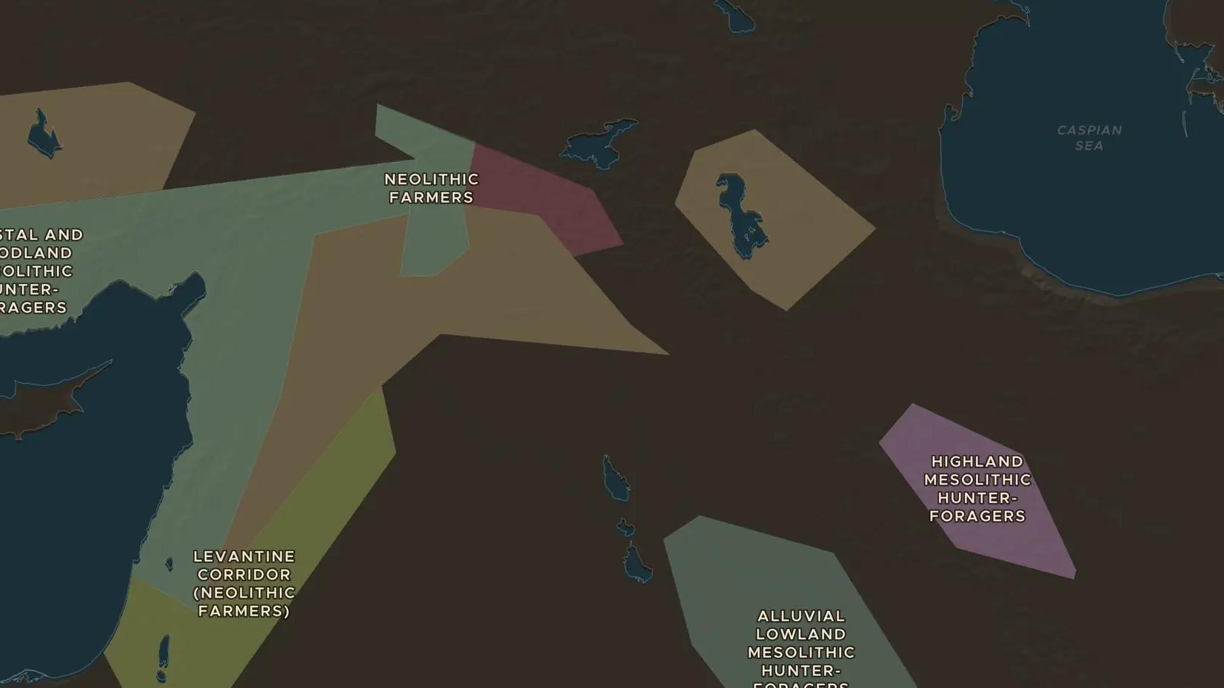
EARLY NEOLITHIC · ABOUT 9500-8000 BC
Göbekli Tepe: the first monuments
ChronoAtlas Classroom · Plate 7 · Ages 12-15 · 45 min
ChronoAtlas Classroom · chronoatlas.nl/classroom/lesson/gobekli-tepe

Slide 2
THIS LESSON
What students take from it
About 11,500 years ago people raised rings of giant carved pillars on a hilltop in southeastern Anatolia. Students find out who built Göbekli Tepe, and why it changed ideas about how farming and towns began.
LENGTH
45 min
AGES
12-15
ON THE MAP
BY THE END, STUDENTS CAN
3 steps, 9,500 BC
Locate Göbekli Tepe and place it on a timeline with later monuments.
Describe the T-shaped pillars and their carvings.
Explain why Göbekli Tepe changed ideas about the start of farming.
QUIZ
7 rounds
ChronoAtlas Classroom · chronoatlas.nl/classroom/lesson/gobekli-tepe
2

Slide 3
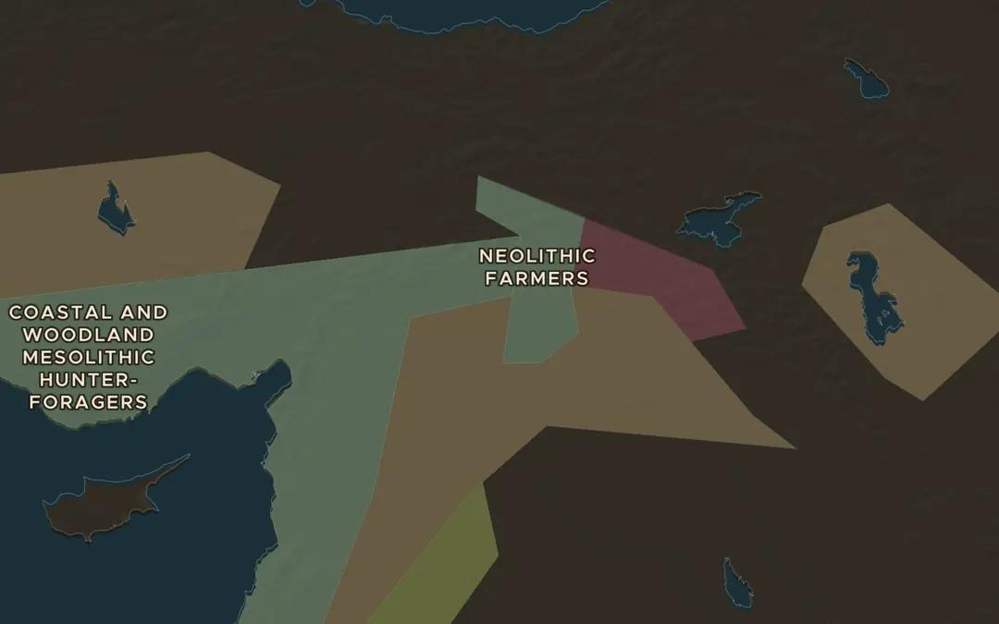
EXPLORE THE MAP · STEP A OF 3 · 9,500 BC
a
The hills of the north
Open the map in 9500 BC and zoom in on southeastern Anatolia, north of the Syrian plain. Göbekli Tepe sits on a hilltop near Şanlıurfa. Which two great rivers flow to the west and east?
Open this view on the live map →
ChronoAtlas Classroom · chronoatlas.nl/classroom/lesson/gobekli-tepe
3
Notes:
Open the map in 9500 BC and zoom in on southeastern Anatolia, north of the Syrian plain. Göbekli Tepe sits on a hilltop near Şanlıurfa. Which two great rivers flow to the west and east?
https://chronoatlas.nl/?year=-9500&lat=37.5&lng=39.5&zoom=6

Slide 4
CHRONOATLAS CLASSROOM
The rest of this deck comes with Classroom
19 more slides: the other map steps, the discussion questions, the quiz with its answers, and the worksheet.
Every lesson as a deck, every worksheet, every live lesson and homework.
€19 a month, cancel anytime. The free lesson, Rome at its height, comes whole.
https://chronoatlas.nl/pricing
ChronoAtlas Classroom · chronoatlas.nl/classroom/lesson/gobekli-tepe
4

