Slide 1
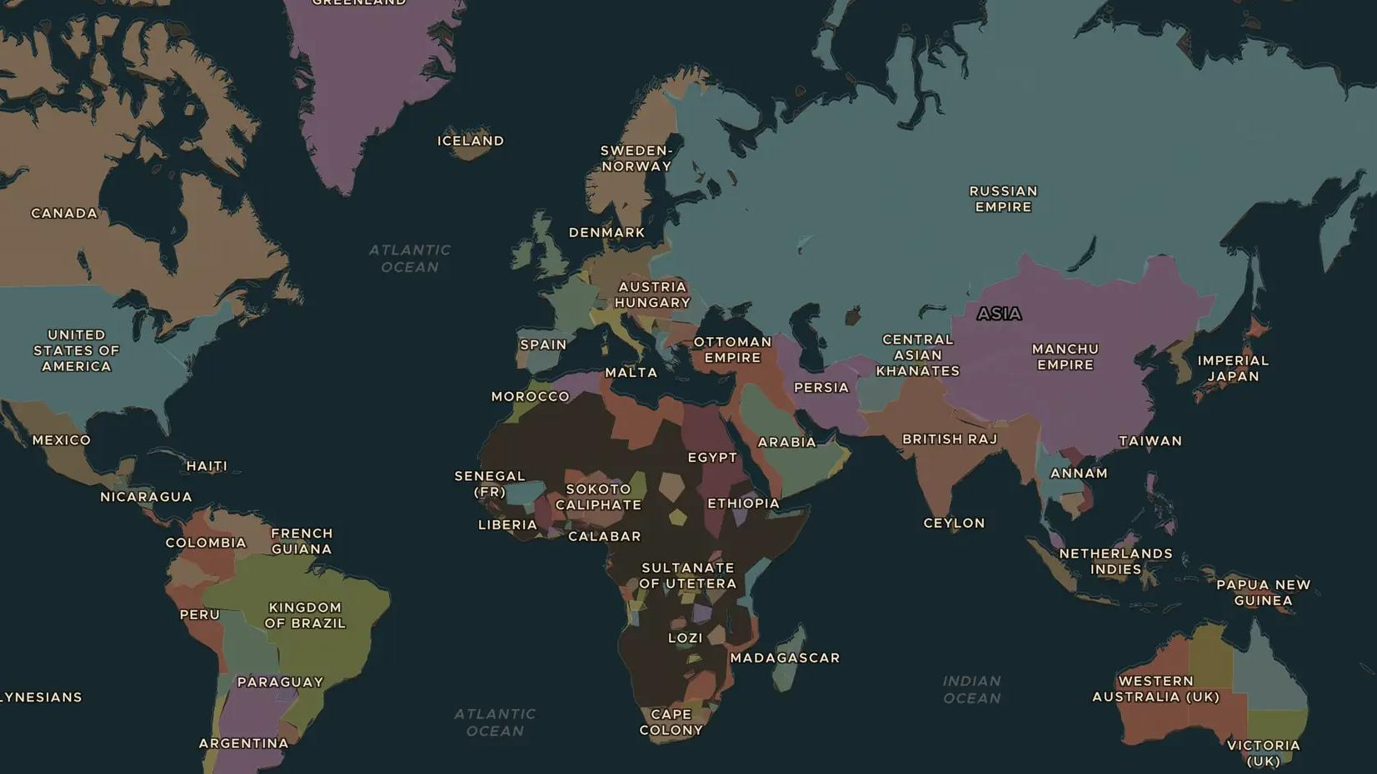
US EXPANSION · 1848-1869
Gold rush and the railroad west
ChronoAtlas Classroom · Plate 439 · Ages 11-14 · 50 min
ChronoAtlas Classroom · chronoatlas.nl/classroom/lesson/gold-rush-railroad-west

Slide 2
THIS LESSON
What students take from it
Gold in California brings people from every continent in 1849. Twenty years later a railroad joins the Atlantic and the Pacific. Students follow the forty-niners and the railway builders and ask who paid the price for the race west.
LENGTH
50 min
AGES
11-14
ON THE MAP
BY THE END, STUDENTS CAN
3 steps, AD 1880
Describe the California gold rush and the routes people took to get there.
Explain how the first transcontinental railroad was built and who built it.
Explain how the gold rush and the railroad affected Native peoples and immigrants.
QUIZ
7 rounds
ChronoAtlas Classroom · chronoatlas.nl/classroom/lesson/gold-rush-railroad-west
2

Slide 3
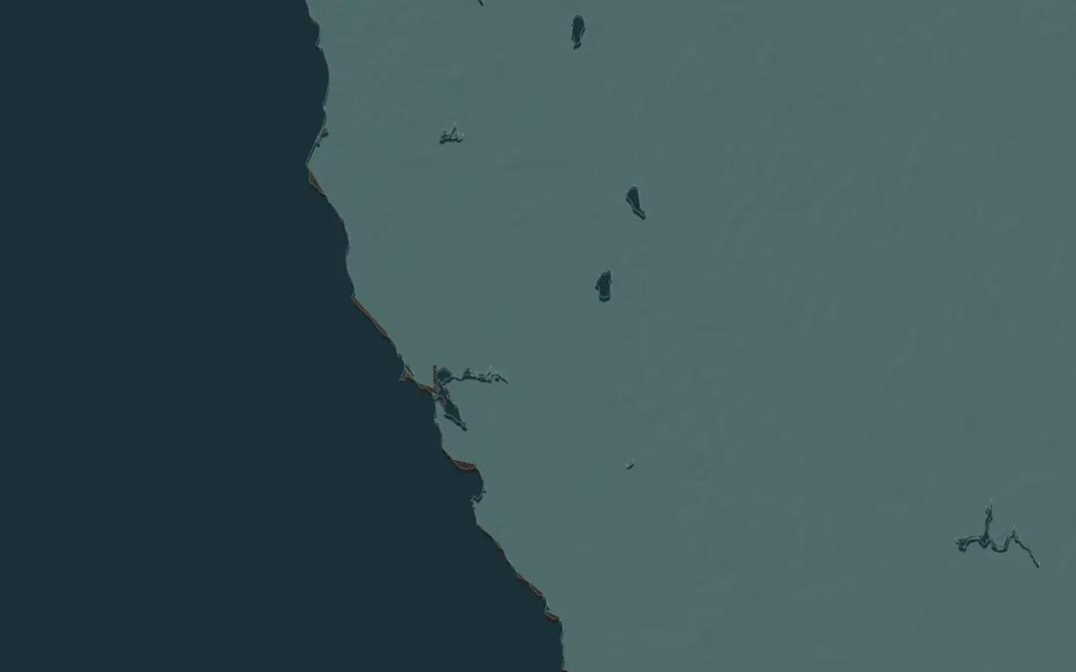
EXPLORE THE MAP · STEP A OF 3 · AD 1880
a
California
Open the map in 1880 and zoom in on California. Find San Francisco Bay and follow the rivers east to the foothills of the Sierra Nevada, where gold was found in 1848.
Open this view on the live map →
ChronoAtlas Classroom · chronoatlas.nl/classroom/lesson/gold-rush-railroad-west
3
Notes:
Open the map in 1880 and zoom in on California. Find San Francisco Bay and follow the rivers east to the foothills of the Sierra Nevada, where gold was found in 1848.
https://chronoatlas.nl/?year=1880&lat=38.5&lng=-121&zoom=6

Slide 4
CHRONOATLAS CLASSROOM
The rest of this deck comes with Classroom
19 more slides: the other map steps, the discussion questions, the quiz with its answers, and the worksheet.
Every lesson as a deck, every worksheet, every live lesson and homework.
€19 a month, cancel anytime. The free lesson, Rome at its height, comes whole.
https://chronoatlas.nl/pricing
ChronoAtlas Classroom · chronoatlas.nl/classroom/lesson/gold-rush-railroad-west
4

