Slide 1
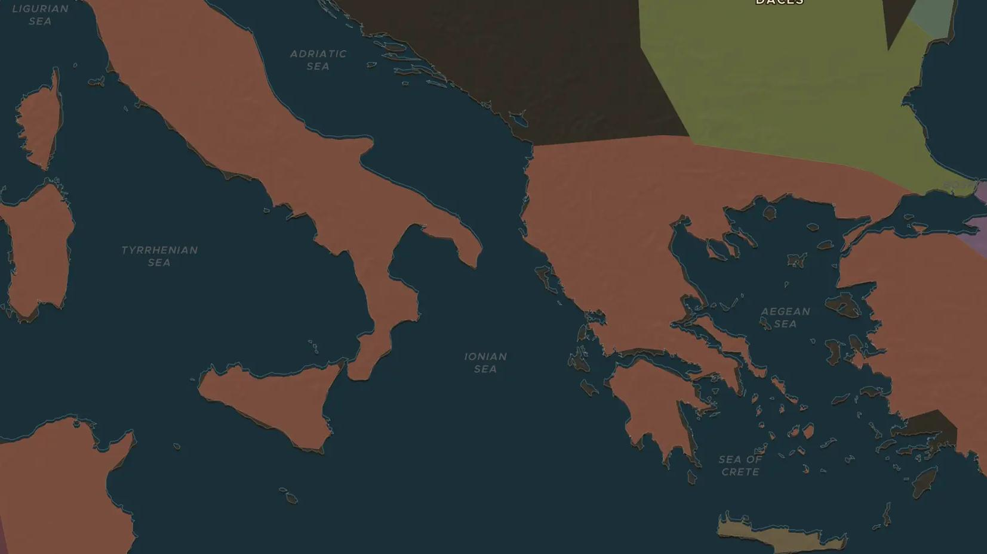
ROMAN REPUBLIC · 133-121 BC
The Gracchi: land, reform and violence
ChronoAtlas Classroom · Plate 112 · Ages 13-16 · 50 min
ChronoAtlas Classroom · chronoatlas.nl/classroom/lesson/gracchi-brothers

Slide 2
THIS LESSON
What students take from it
Tiberius and Gaius Gracchus tried to give land to poor Romans, and both died in political violence. Students explore how Rome's success abroad caused trouble at home.
LENGTH
50 min
AGES
13-16
ON THE MAP
BY THE END, STUDENTS CAN
3 steps, 133 BC
Explain why many small farmers in Italy lost their land in the 2nd century BC.
Describe the reforms of Tiberius (133 BC) and Gaius Gracchus (123-121 BC) and how each brother died.
Discuss why the killing of Tiberius Gracchus is often seen as the start of the Republic's crisis.
QUIZ
7 rounds
ChronoAtlas Classroom · chronoatlas.nl/classroom/lesson/gracchi-brothers
2

Slide 3
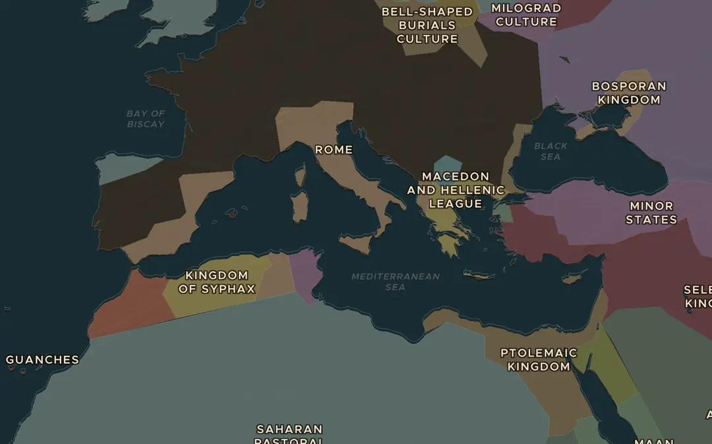
EXPLORE THE MAP · STEP A OF 3 · 133 BC
a
A Republic of provinces
Open the map in 133 BC. Rome now rules lands from Hispania to Greece and Africa. Count the regions under Rome outside Italy. What did all these wars mean for farmers who served as soldiers?
Open this view on the live map →
ChronoAtlas Classroom · chronoatlas.nl/classroom/lesson/gracchi-brothers
3
Notes:
Open the map in 133 BC. Rome now rules lands from Hispania to Greece and Africa. Count the regions under Rome outside Italy. What did all these wars mean for farmers who served as soldiers?
https://chronoatlas.nl/?year=-133&lat=39&lng=14&zoom=4

Slide 4
CHRONOATLAS CLASSROOM
The rest of this deck comes with Classroom
19 more slides: the other map steps, the discussion questions, the quiz with its answers, and the worksheet.
Every lesson as a deck, every worksheet, every live lesson and homework.
€19 a month, cancel anytime. The free lesson, Rome at its height, comes whole.
https://chronoatlas.nl/pricing
ChronoAtlas Classroom · chronoatlas.nl/classroom/lesson/gracchi-brothers
4

