Slide 1
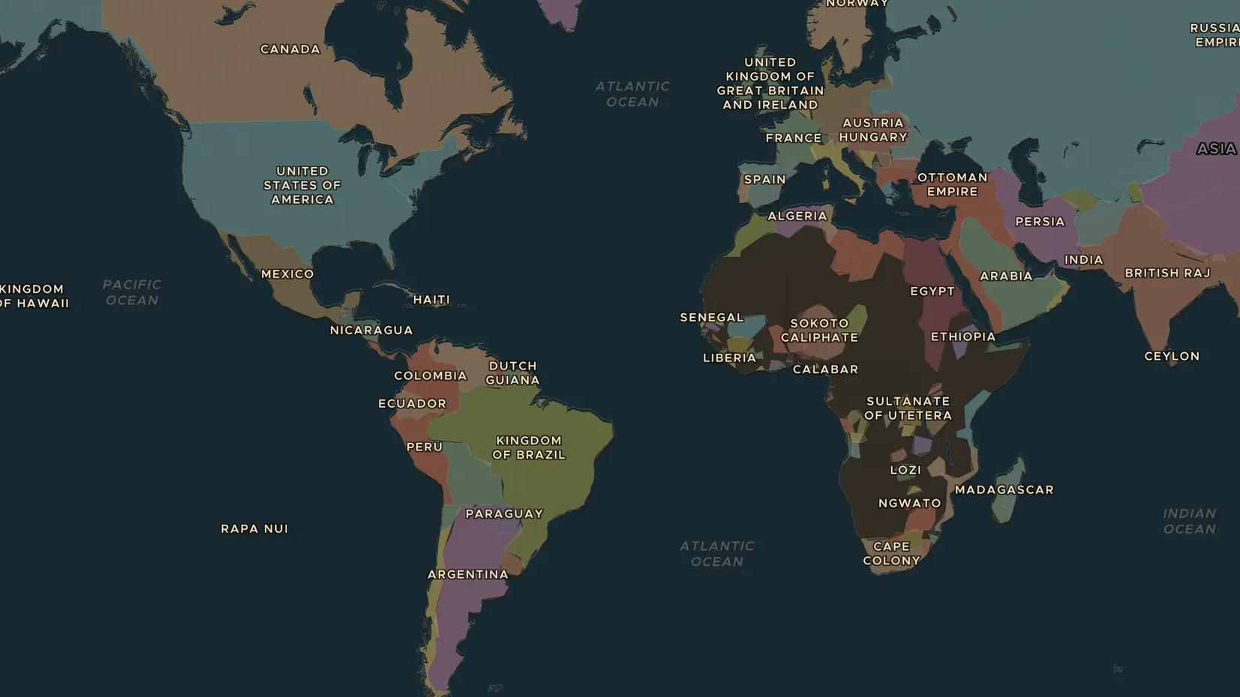
AGE OF MASS MIGRATION · 1880-1914
Across the ocean: the great migration
ChronoAtlas Classroom · Plate 448 · Ages 11-14 · 45 min
ChronoAtlas Classroom · chronoatlas.nl/classroom/lesson/great-atlantic-migration

Slide 2
THIS LESSON
What students take from it
Between 1880 and 1914 tens of millions of Europeans cross the oceans in steamships to the Americas and beyond, while Asian migrants face new barriers. Students follow emigrants from village to port to Ellis Island and Buenos Aires, and ask why people leave home.
LENGTH
45 min
AGES
11-14
ON THE MAP
BY THE END, STUDENTS CAN
3 steps, AD 1900
Explain the push and pull factors behind mass migration from Europe after 1880.
Trace emigrant routes from European ports to the Americas on the map.
Compare how different groups of migrants were welcomed or shut out.
QUIZ
7 rounds
ChronoAtlas Classroom · chronoatlas.nl/classroom/lesson/great-atlantic-migration
2

Slide 3
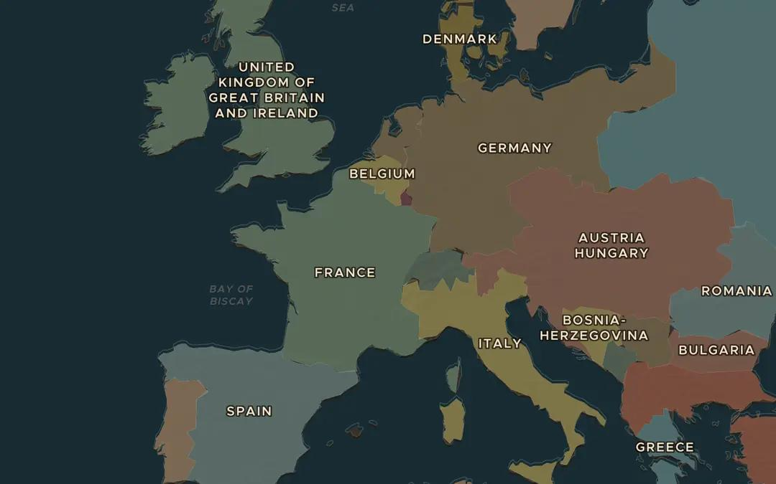
EXPLORE THE MAP · STEP A OF 3 · AD 1900
a
Ports of departure
Open the map in 1900 and zoom in on Western Europe. Find Liverpool, Hamburg, Bremen, Rotterdam and Naples. Why would emigrants from inland villages travel to these ports?
Open this view on the live map →
ChronoAtlas Classroom · chronoatlas.nl/classroom/lesson/great-atlantic-migration
3
Notes:
Open the map in 1900 and zoom in on Western Europe. Find Liverpool, Hamburg, Bremen, Rotterdam and Naples. Why would emigrants from inland villages travel to these ports?
https://chronoatlas.nl/?year=1900&lat=48&lng=5&zoom=4.4

Slide 4
CHRONOATLAS CLASSROOM
The rest of this deck comes with Classroom
19 more slides: the other map steps, the discussion questions, the quiz with its answers, and the worksheet.
Every lesson as a deck, every worksheet, every live lesson and homework.
€19 a month, cancel anytime. The free lesson, Rome at its height, comes whole.
https://chronoatlas.nl/pricing
ChronoAtlas Classroom · chronoatlas.nl/classroom/lesson/great-atlantic-migration
4

