Slide 1
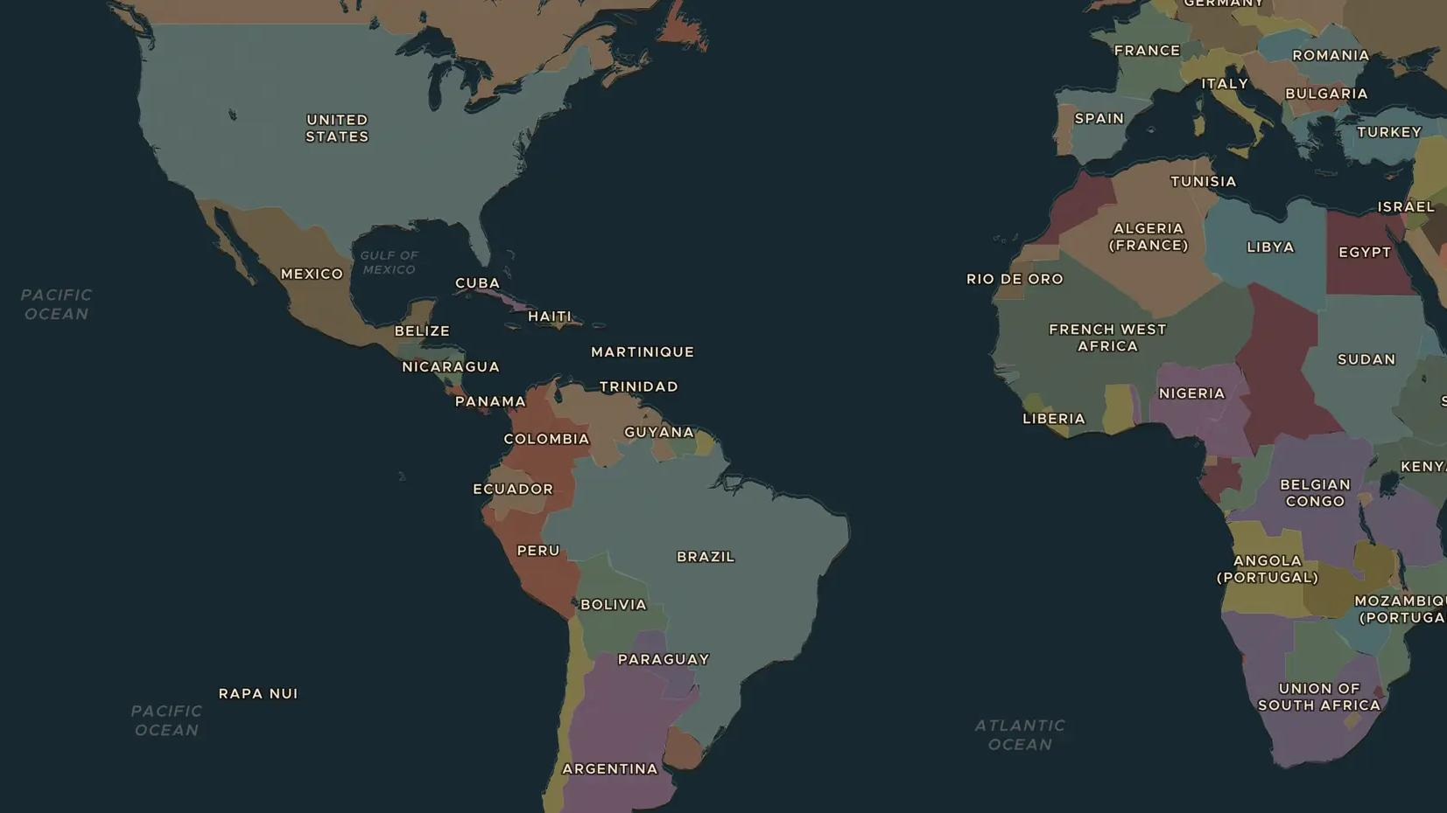
INTERWAR YEARS · 1929-1939
1929: the crash and the Great Depression
ChronoAtlas Classroom · Plate 468 · Ages 12-15 · 50 min
ChronoAtlas Classroom · chronoatlas.nl/classroom/lesson/great-depression-1929

Slide 2
THIS LESSON
What students take from it
In October 1929 share prices on Wall Street crashed. Within three years factories, banks and farms failed around the world, and millions lost their jobs. Students follow the crisis from New York to Berlin and Brazil, and compare how governments responded.
LENGTH
50 min
AGES
12-15
ON THE MAP
BY THE END, STUDENTS CAN
3 steps, AD 1930
Explain what happened on Wall Street in October 1929.
Describe how the crisis spread from the United States to Europe and the rest of the world.
Compare two responses to the Depression, such as the New Deal and the rise of extremist parties.
QUIZ
7 rounds
ChronoAtlas Classroom · chronoatlas.nl/classroom/lesson/great-depression-1929
2

Slide 3

EXPLORE THE MAP · STEP A OF 3 · AD 1930
a
Where it began
Open the map in 1930 and find New York on the east coast of the United States. Ask the atlas: "What happened on Wall Street in October 1929?"
Open this view on the live map →
ChronoAtlas Classroom · chronoatlas.nl/classroom/lesson/great-depression-1929
3
Notes:
Open the map in 1930 and find New York on the east coast of the United States. Ask the atlas: "What happened on Wall Street in October 1929?"
https://chronoatlas.nl/?year=1930&lat=40.7&lng=-74&zoom=6

Slide 4
CHRONOATLAS CLASSROOM
The rest of this deck comes with Classroom
19 more slides: the other map steps, the discussion questions, the quiz with its answers, and the worksheet.
Every lesson as a deck, every worksheet, every live lesson and homework.
€19 a month, cancel anytime. The free lesson, Rome at its height, comes whole.
https://chronoatlas.nl/pricing
ChronoAtlas Classroom · chronoatlas.nl/classroom/lesson/great-depression-1929
4

