Slide 1
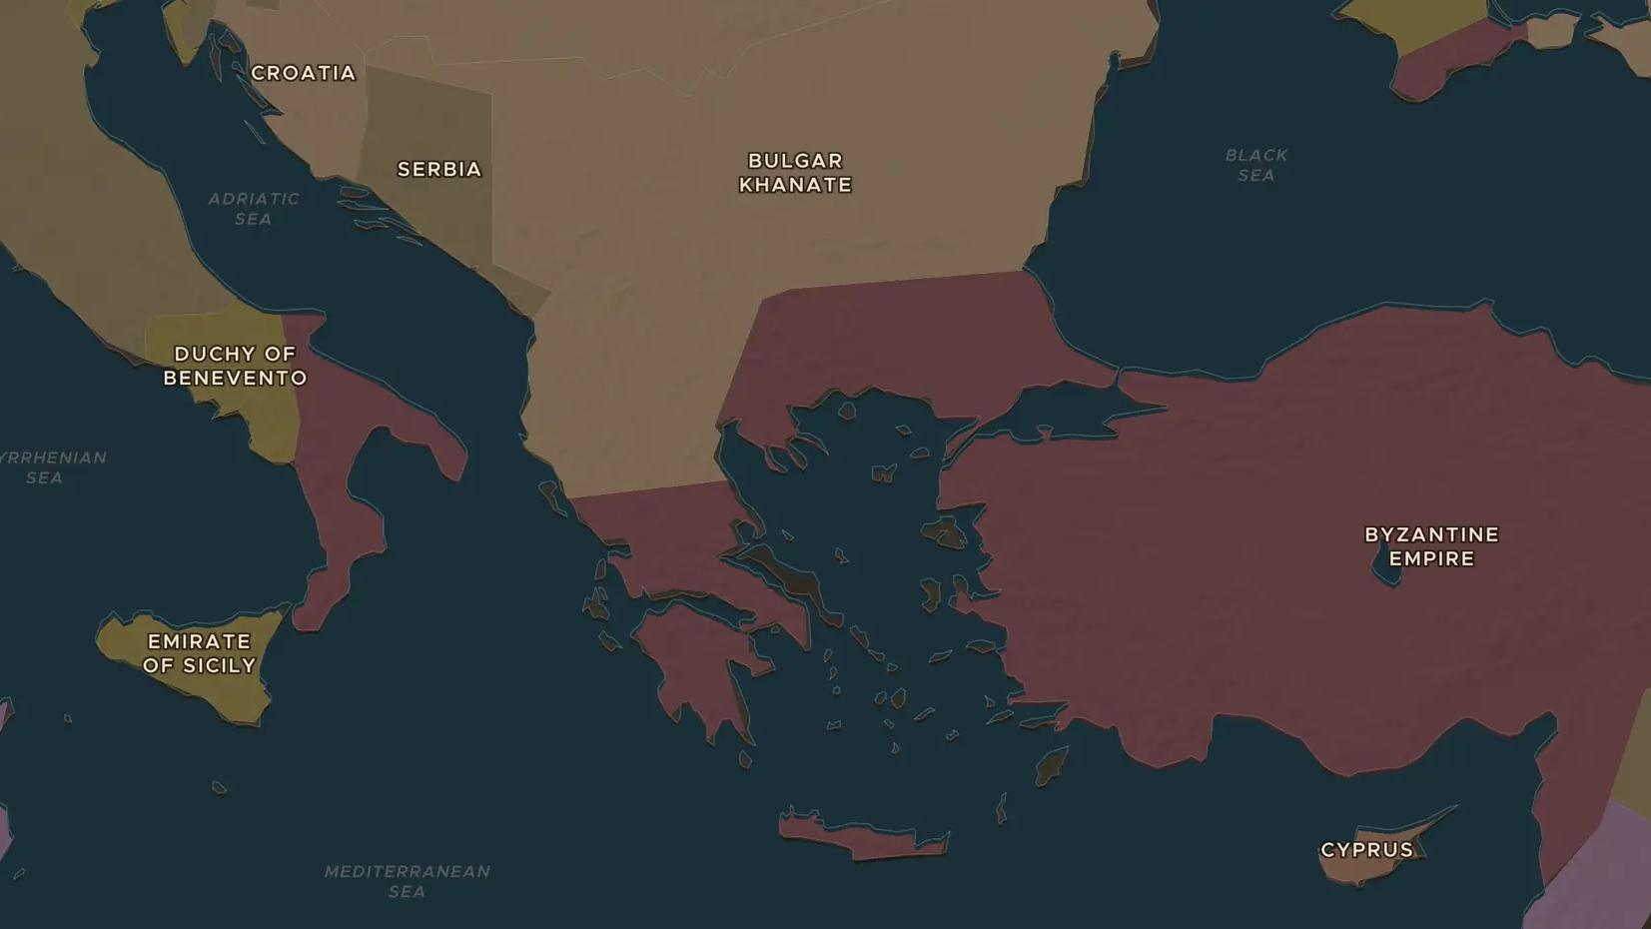
MEDIEVAL CHURCH · 1054
1054: the split between East and West
ChronoAtlas Classroom · Plate 215 · Ages 13-16 · 45 min
ChronoAtlas Classroom · chronoatlas.nl/classroom/lesson/great-schism-1054

Slide 2
THIS LESSON
What students take from it
In July 1054 papal envoys lay a document of excommunication on the altar of Hagia Sophia. Students explore the differences that had grown between the Latin West and the Greek East, and ask whether 1054 was a sudden break or a slow parting.
LENGTH
45 min
AGES
13-16
ON THE MAP
BY THE END, STUDENTS CAN
3 steps, AD 1054
Describe what happened in Constantinople in July 1054.
Explain at least three differences between the Latin and the Greek churches.
Evaluate whether the schism was a single event or a long process.
QUIZ
7 rounds
ChronoAtlas Classroom · chronoatlas.nl/classroom/lesson/great-schism-1054
2

Slide 3
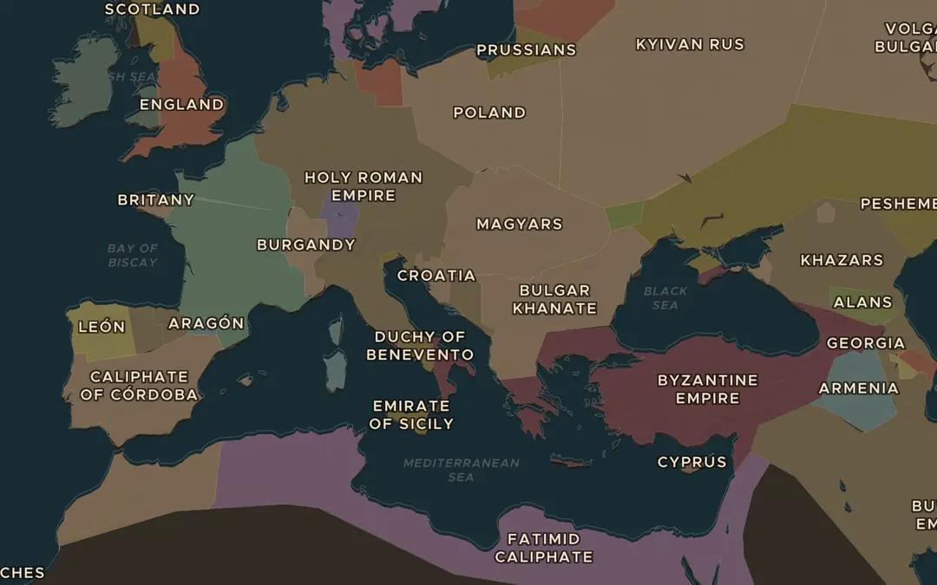
EXPLORE THE MAP · STEP A OF 3 · AD 1054
a
Two halves of Christendom
Open the map in 1054. Find the Holy Roman Empire and the Byzantine Empire. Imagine a line between the lands of Latin and Greek Christians. Where does it run?
Open this view on the live map →
ChronoAtlas Classroom · chronoatlas.nl/classroom/lesson/great-schism-1054
3
Notes:
Open the map in 1054. Find the Holy Roman Empire and the Byzantine Empire. Imagine a line between the lands of Latin and Greek Christians. Where does it run?
https://chronoatlas.nl/?year=1054&lat=44&lng=18&zoom=4

Slide 4
CHRONOATLAS CLASSROOM
The rest of this deck comes with Classroom
19 more slides: the other map steps, the discussion questions, the quiz with its answers, and the worksheet.
Every lesson as a deck, every worksheet, every live lesson and homework.
€19 a month, cancel anytime. The free lesson, Rome at its height, comes whole.
https://chronoatlas.nl/pricing
ChronoAtlas Classroom · chronoatlas.nl/classroom/lesson/great-schism-1054
4

