Slide 1
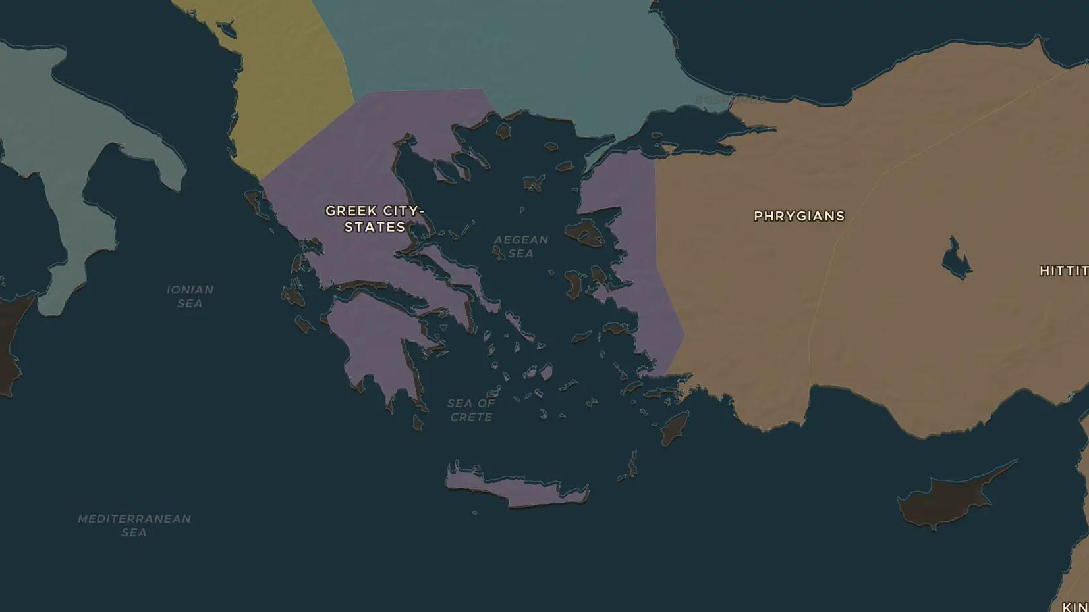
ARCHAIC GREECE · 800-500 BC
The polis: why Greece had hundreds of states
ChronoAtlas Classroom · Plate 49 · Ages 11-14 · 50 min
ChronoAtlas Classroom · chronoatlas.nl/classroom/lesson/greek-city-states

Slide 2
THIS LESSON
What students take from it
The Greeks shared a language, gods and the Olympic Games, yet they never formed one country. Students study how mountains and the sea split Greece into hundreds of city-states, each with its own laws, army and pride.
LENGTH
50 min
AGES
11-14
ON THE MAP
BY THE END, STUDENTS CAN
3 steps, 750 BC
Explain what a polis was and name three things every polis had (citizens, an agora, an acropolis or temple).
Use the map to show how Greece's mountains and coastline encouraged many small states.
Describe how a hoplite army of citizen-soldiers changed who had a say in the city.
QUIZ
7 rounds
ChronoAtlas Classroom · chronoatlas.nl/classroom/lesson/greek-city-states
2

Slide 3
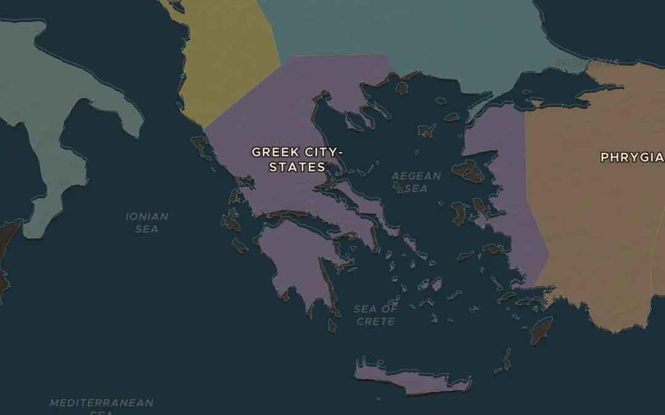
EXPLORE THE MAP · STEP A OF 3 · 750 BC
a
A land of mountains and bays
Open the map in 750 BC on Greece and zoom until you can see the shape of the coast. Count the bays, peninsulas and islands. Mountains cover most of the land between them. Why would farming valleys separated by ridges grow into separate states?
Open this view on the live map →
ChronoAtlas Classroom · chronoatlas.nl/classroom/lesson/greek-city-states
3
Notes:
Open the map in 750 BC on Greece and zoom until you can see the shape of the coast. Count the bays, peninsulas and islands. Mountains cover most of the land between them. Why would farming valleys separated by ridges grow into separate states?
https://chronoatlas.nl/?year=-750&lat=38.5&lng=23&zoom=6

Slide 4
CHRONOATLAS CLASSROOM
The rest of this deck comes with Classroom
19 more slides: the other map steps, the discussion questions, the quiz with its answers, and the worksheet.
Every lesson as a deck, every worksheet, every live lesson and homework.
€19 a month, cancel anytime. The free lesson, Rome at its height, comes whole.
https://chronoatlas.nl/pricing
ChronoAtlas Classroom · chronoatlas.nl/classroom/lesson/greek-city-states
4

