Slide 1
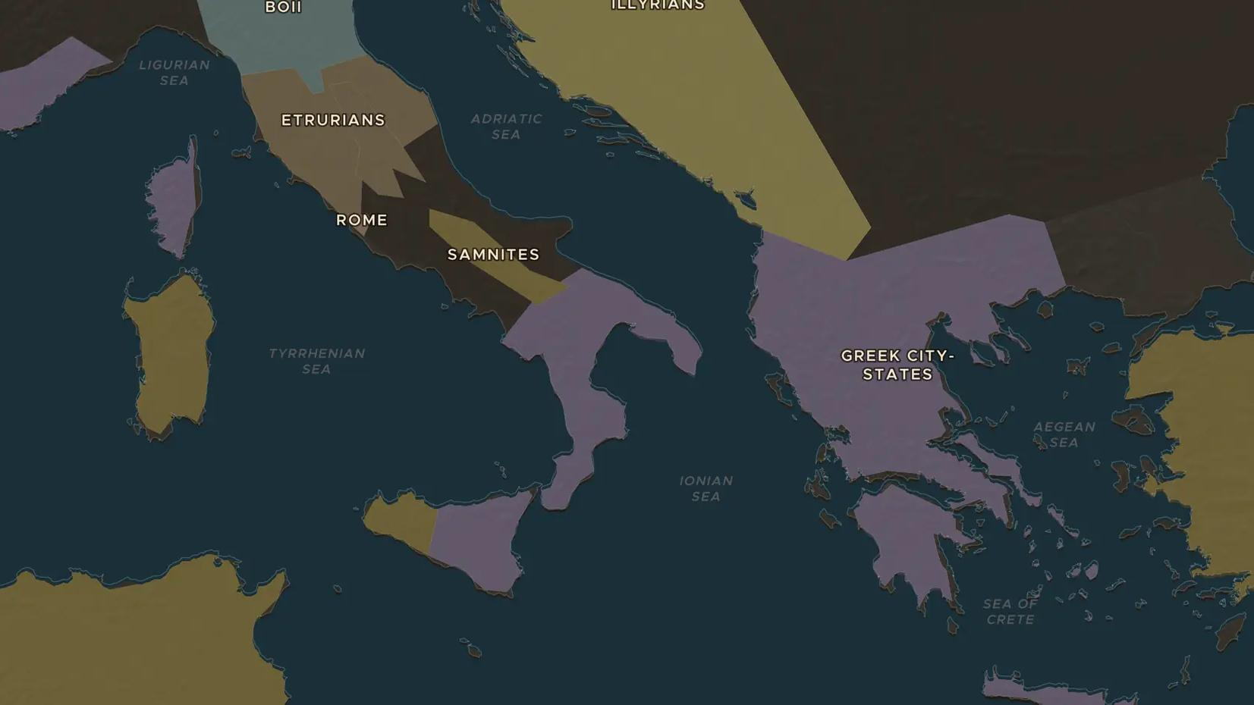
ARCHAIC GREECE · 750-550 BC
Greek colonies: a new city across the sea
ChronoAtlas Classroom · Plate 51 · Ages 10-13 · 50 min
ChronoAtlas Classroom · chronoatlas.nl/classroom/lesson/greek-colonies

Slide 2
THIS LESSON
What students take from it
In two centuries the Greeks founded hundreds of new cities, from Spain to the Black Sea. Students follow settlers from a crowded mother city to Syracuse, Massalia and Byzantium, and ask what a colony owed to home.
LENGTH
50 min
AGES
10-13
ON THE MAP
BY THE END, STUDENTS CAN
3 steps, 733 BC
Name three reasons Greek cities sent out colonies.
Locate Syracuse, Massalia (Marseille), Cyrene, Byzantium and Olbia and name their mother cities where known.
Explain how colonies spread Greek language and culture around the Mediterranean and Black Sea.
QUIZ
7 rounds
ChronoAtlas Classroom · chronoatlas.nl/classroom/lesson/greek-colonies
2

Slide 3
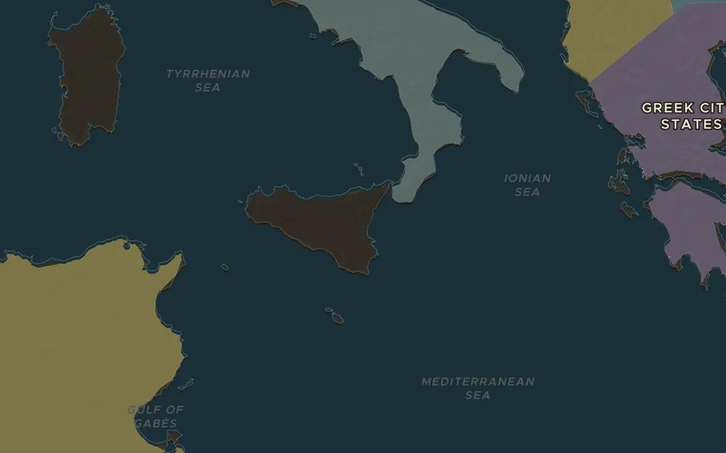
EXPLORE THE MAP · STEP A OF 3 · 733 BC
a
Sicily and Italy first
Open the map in 733 BC on Sicily. Settlers from Corinth founded Syracuse in 734 or 733 BC; others from Chalcis founded Naxos nearby a year earlier. Turn on the Cities layer. Why was Sicily, only a few days' sail from Greece, the first target?
Open this view on the live map →
ChronoAtlas Classroom · chronoatlas.nl/classroom/lesson/greek-colonies
3
Notes:
Open the map in 733 BC on Sicily. Settlers from Corinth founded Syracuse in 734 or 733 BC; others from Chalcis founded Naxos nearby a year earlier. Turn on the Cities layer. Why was Sicily, only a few days' sail from Greece, the first target?
https://chronoatlas.nl/?year=-733&lat=37.5&lng=15&zoom=6

Slide 4
CHRONOATLAS CLASSROOM
The rest of this deck comes with Classroom
19 more slides: the other map steps, the discussion questions, the quiz with its answers, and the worksheet.
Every lesson as a deck, every worksheet, every live lesson and homework.
€19 a month, cancel anytime. The free lesson, Rome at its height, comes whole.
https://chronoatlas.nl/pricing
ChronoAtlas Classroom · chronoatlas.nl/classroom/lesson/greek-colonies
4

