Slide 1
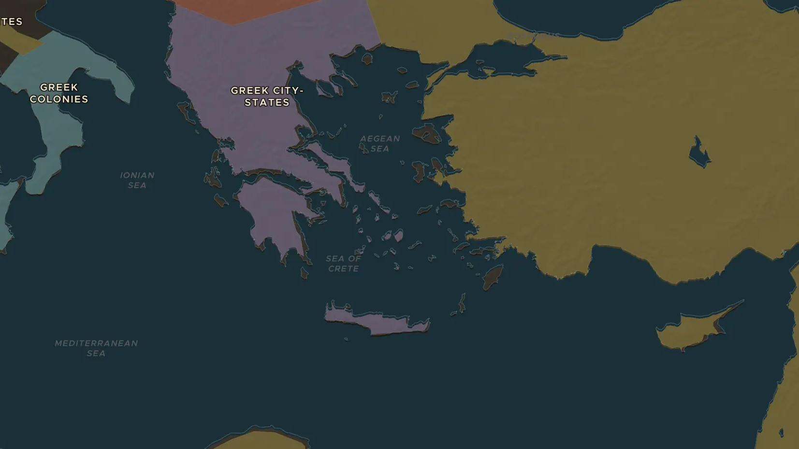
CLASSICAL GREECE · 585-335 BC
Asking why: Greek science and philosophy
ChronoAtlas Classroom · Plate 63 · Ages 12-15 · 50 min
ChronoAtlas Classroom · chronoatlas.nl/classroom/lesson/greek-science-and-philosophy

Slide 2
THIS LESSON
What students take from it
On the coast of Ionia a few men began explaining the world without gods: water, numbers, atoms. Students follow the idea from Miletus to the medical school of Kos and the schools of Plato and Aristotle in Athens, and try the Greek habit of asking why.
LENGTH
50 min
AGES
12-15
ON THE MAP
BY THE END, STUDENTS CAN
3 steps, 585 BC
Name three early Greek thinkers (for example Thales, Pythagoras, Hippocrates) and one idea of each.
Locate Miletus, Kos and Athens and explain why new ideas started on the edge of the Greek world.
Explain what Socrates, Plato and Aristotle each added and why Athens put Socrates on trial.
QUIZ
7 rounds
ChronoAtlas Classroom · chronoatlas.nl/classroom/lesson/greek-science-and-philosophy
2

Slide 3
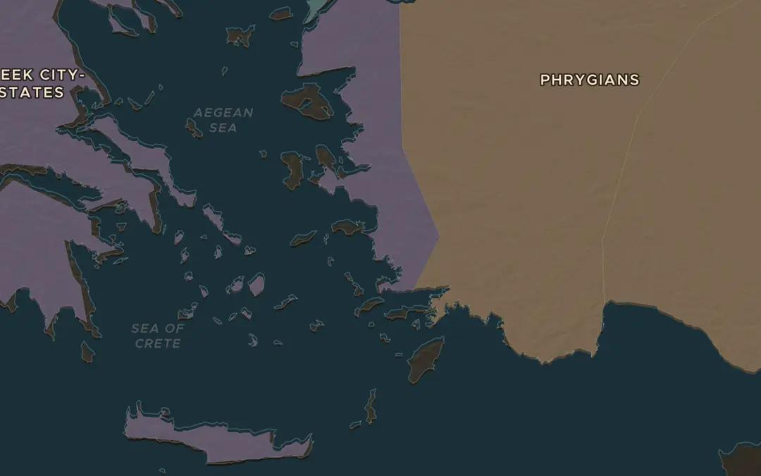
EXPLORE THE MAP · STEP A OF 3 · 585 BC
a
Miletus asks why
Open the map in 585 BC on Miletus, on the Ionian coast. Thales of Miletus said everything was made of water and, says Herodotus, predicted an eclipse that stopped a battle this year. Miletus traded with Egypt, Lydia and the Black Sea. Why might a port of many peoples breed new ideas?
Open this view on the live map →
ChronoAtlas Classroom · chronoatlas.nl/classroom/lesson/greek-science-and-philosophy
3
Notes:
Open the map in 585 BC on Miletus, on the Ionian coast. Thales of Miletus said everything was made of water and, says Herodotus, predicted an eclipse that stopped a battle this year. Miletus traded with Egypt, Lydia and the Black Sea. Why might a port of many peoples breed new ideas?
https://chronoatlas.nl/?year=-585&lat=37.6&lng=27.3&zoom=6.5

Slide 4
CHRONOATLAS CLASSROOM
The rest of this deck comes with Classroom
19 more slides: the other map steps, the discussion questions, the quiz with its answers, and the worksheet.
Every lesson as a deck, every worksheet, every live lesson and homework.
€19 a month, cancel anytime. The free lesson, Rome at its height, comes whole.
https://chronoatlas.nl/pricing
ChronoAtlas Classroom · chronoatlas.nl/classroom/lesson/greek-science-and-philosophy
4

