Slide 1
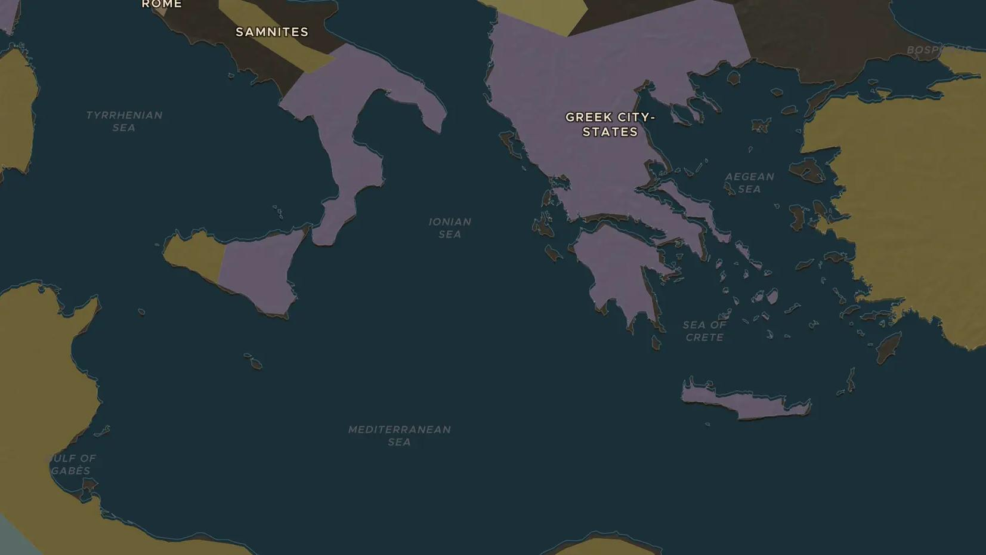
CLASSICAL GREECE · 472-330 BC
Greek theater: tragedy and comedy for the whole city
ChronoAtlas Classroom · Plate 76 · Ages 11-14 · 45 min
ChronoAtlas Classroom · chronoatlas.nl/classroom/lesson/greek-theater

Slide 2
THIS LESSON
What students take from it
Every spring, Athens stopped work for a festival of plays in honor of Dionysus. Students visit the theater below the Acropolis, meet Aeschylus, Sophocles, Euripides and Aristophanes, and work out why a democracy wanted its citizens to watch tragedies.
LENGTH
45 min
AGES
11-14
ON THE MAP
BY THE END, STUDENTS CAN
3 steps, 472 BC
Describe the City Dionysia festival and the parts of a Greek theater (orchestra, skene, seats).
Name the three great tragedians and one comic playwright, with one play each.
Explain why theater mattered to Athenian democracy.
QUIZ
7 rounds
ChronoAtlas Classroom · chronoatlas.nl/classroom/lesson/greek-theater
2

Slide 3
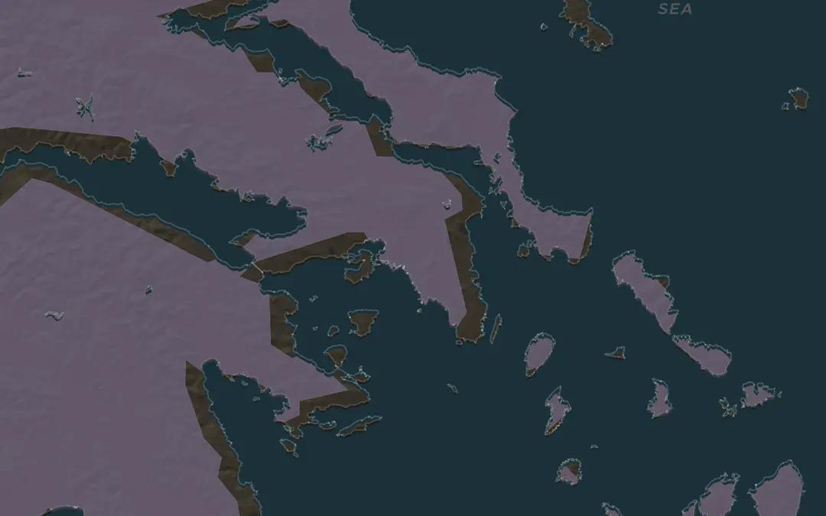
EXPLORE THE MAP · STEP A OF 3 · 472 BC
a
The theater of Dionysus
Open the map in 472 BC on Athens. On the south slope of the Acropolis lay the theater of Dionysus. That year Aeschylus, who had fought at Salamis, staged "The Persians", the oldest play that survives. Zoom in: the audience sat on the hillside looking south toward the sea.
Open this view on the live map →
ChronoAtlas Classroom · chronoatlas.nl/classroom/lesson/greek-theater
3
Notes:
Open the map in 472 BC on Athens. On the south slope of the Acropolis lay the theater of Dionysus. That year Aeschylus, who had fought at Salamis, staged "The Persians", the oldest play that survives. Zoom in: the audience sat on the hillside looking south toward the sea.
https://chronoatlas.nl/?year=-472&lat=37.97&lng=23.73&zoom=8

Slide 4
CHRONOATLAS CLASSROOM
The rest of this deck comes with Classroom
19 more slides: the other map steps, the discussion questions, the quiz with its answers, and the worksheet.
Every lesson as a deck, every worksheet, every live lesson and homework.
€19 a month, cancel anytime. The free lesson, Rome at its height, comes whole.
https://chronoatlas.nl/pricing
ChronoAtlas Classroom · chronoatlas.nl/classroom/lesson/greek-theater
4

