Slide 1
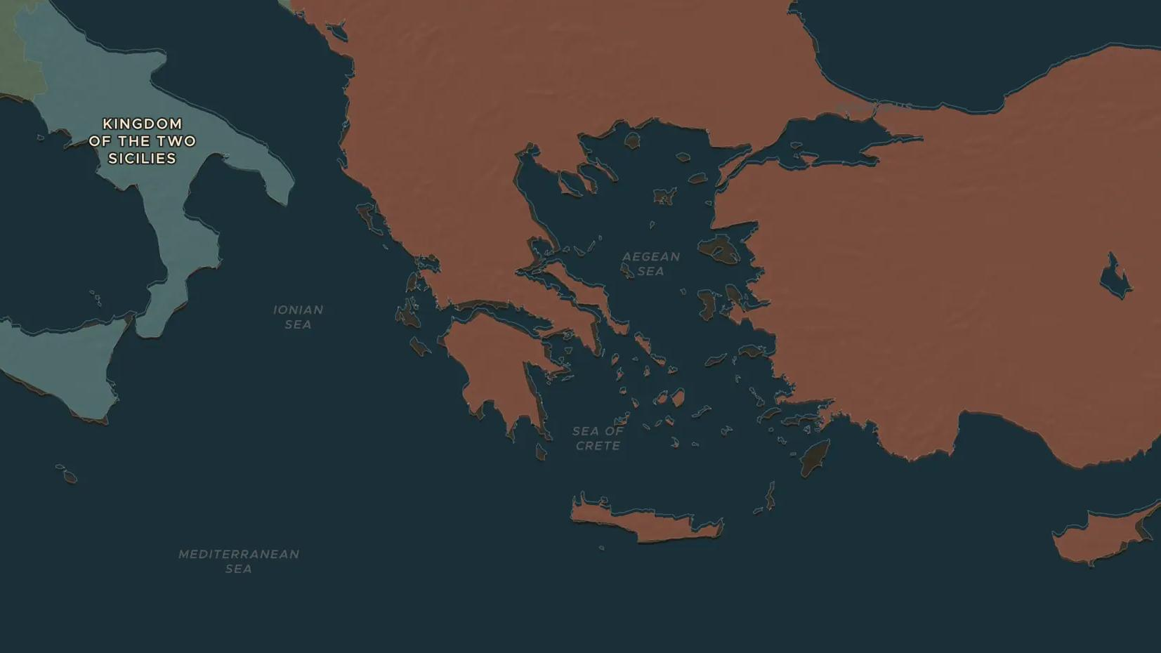
OTTOMAN EUROPE · 1821-1832
Greece breaks free
ChronoAtlas Classroom · Plate 411 · Ages 12-15 · 45 min
ChronoAtlas Classroom · chronoatlas.nl/classroom/lesson/greek-war-of-independence

Slide 2
THIS LESSON
What students take from it
In 1821 Greeks rise against Ottoman rule. Poets, painters and volunteers across Europe take up their cause, and in 1827 three great powers destroy the Ottoman fleet. Students follow the birth of the first fully independent state carved out of the Ottoman Empire in Europe.
LENGTH
45 min
AGES
12-15
ON THE MAP
BY THE END, STUDENTS CAN
3 steps, AD 1815
Explain why Greeks rose against Ottoman rule in 1821.
Describe the role of the great powers, including the Battle of Navarino (1827).
Explain why so many Europeans supported the Greek cause.
QUIZ
7 rounds
ChronoAtlas Classroom · chronoatlas.nl/classroom/lesson/greek-war-of-independence
2

Slide 3
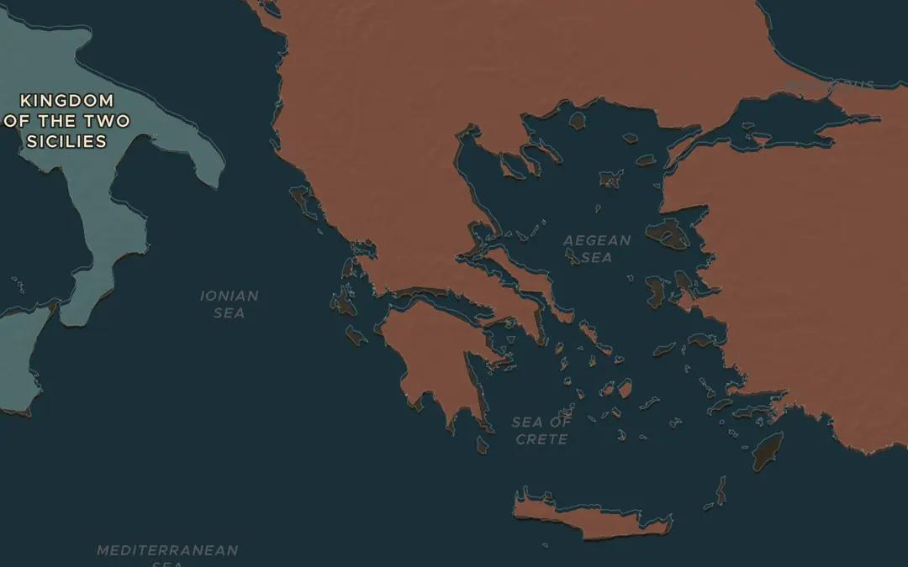
EXPLORE THE MAP · STEP A OF 3 · AD 1815
a
Ottoman Greece
Open the map in 1815 and zoom in on Greece. Which empire rules it? Find the Peloponnese, the large peninsula in the south.
Open this view on the live map →
ChronoAtlas Classroom · chronoatlas.nl/classroom/lesson/greek-war-of-independence
3
Notes:
Open the map in 1815 and zoom in on Greece. Which empire rules it? Find the Peloponnese, the large peninsula in the south.
https://chronoatlas.nl/?year=1815&lat=38.5&lng=22.5&zoom=6

Slide 4
CHRONOATLAS CLASSROOM
The rest of this deck comes with Classroom
19 more slides: the other map steps, the discussion questions, the quiz with its answers, and the worksheet.
Every lesson as a deck, every worksheet, every live lesson and homework.
€19 a month, cancel anytime. The free lesson, Rome at its height, comes whole.
https://chronoatlas.nl/pricing
ChronoAtlas Classroom · chronoatlas.nl/classroom/lesson/greek-war-of-independence
4

