Slide 1
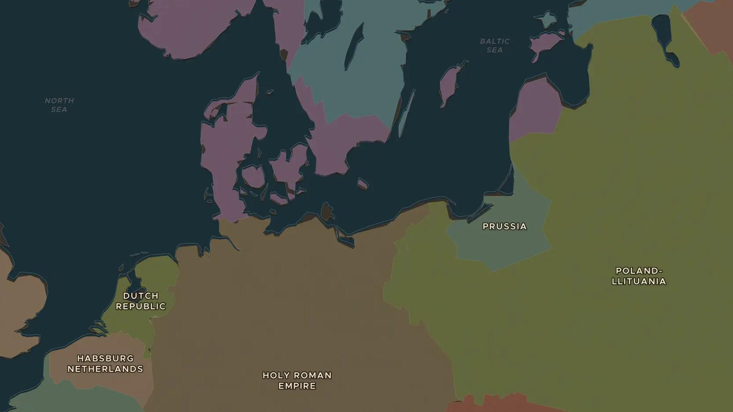
THIRTY YEARS' WAR · 1630-1635
Gustavus Adolphus and Sweden at war
ChronoAtlas Classroom · Plate 351 · Ages 13-16 · 45 min
ChronoAtlas Classroom · chronoatlas.nl/classroom/lesson/gustavus-adolphus-sweden-war

Slide 2
THIS LESSON
What students take from it
In 1630 the king of Sweden lands in Germany with a modern army. Students follow Gustavus Adolphus from the Baltic coast to victory at Breitenfeld and death at Lützen, and discuss what the war meant for the people in its path.
LENGTH
45 min
AGES
13-16
ON THE MAP
BY THE END, STUDENTS CAN
3 steps, AD 1630
Explain why Sweden, a Lutheran Baltic power, entered the war in 1630.
Locate Breitenfeld and Lützen and describe what happened there.
Describe how the war affected civilians in Germany.
QUIZ
7 rounds
ChronoAtlas Classroom · chronoatlas.nl/classroom/lesson/gustavus-adolphus-sweden-war
2

Slide 3
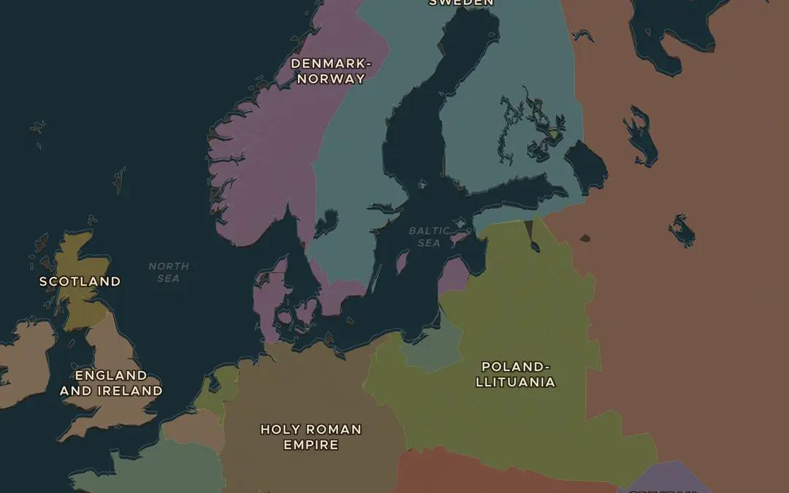
EXPLORE THE MAP · STEP A OF 3 · AD 1630
a
A Baltic power
Open the map in 1630 and zoom in on the Baltic Sea. Find Sweden and the lands it holds across the sea. Why would Sweden fear an emperor whose armies had reached the Baltic coast?
Open this view on the live map →
ChronoAtlas Classroom · chronoatlas.nl/classroom/lesson/gustavus-adolphus-sweden-war
3
Notes:
Open the map in 1630 and zoom in on the Baltic Sea. Find Sweden and the lands it holds across the sea. Why would Sweden fear an emperor whose armies had reached the Baltic coast?
https://chronoatlas.nl/?year=1630&lat=58&lng=18&zoom=4.2

Slide 4
CHRONOATLAS CLASSROOM
The rest of this deck comes with Classroom
19 more slides: the other map steps, the discussion questions, the quiz with its answers, and the worksheet.
Every lesson as a deck, every worksheet, every live lesson and homework.
€19 a month, cancel anytime. The free lesson, Rome at its height, comes whole.
https://chronoatlas.nl/pricing
ChronoAtlas Classroom · chronoatlas.nl/classroom/lesson/gustavus-adolphus-sweden-war
4

