Slide 1
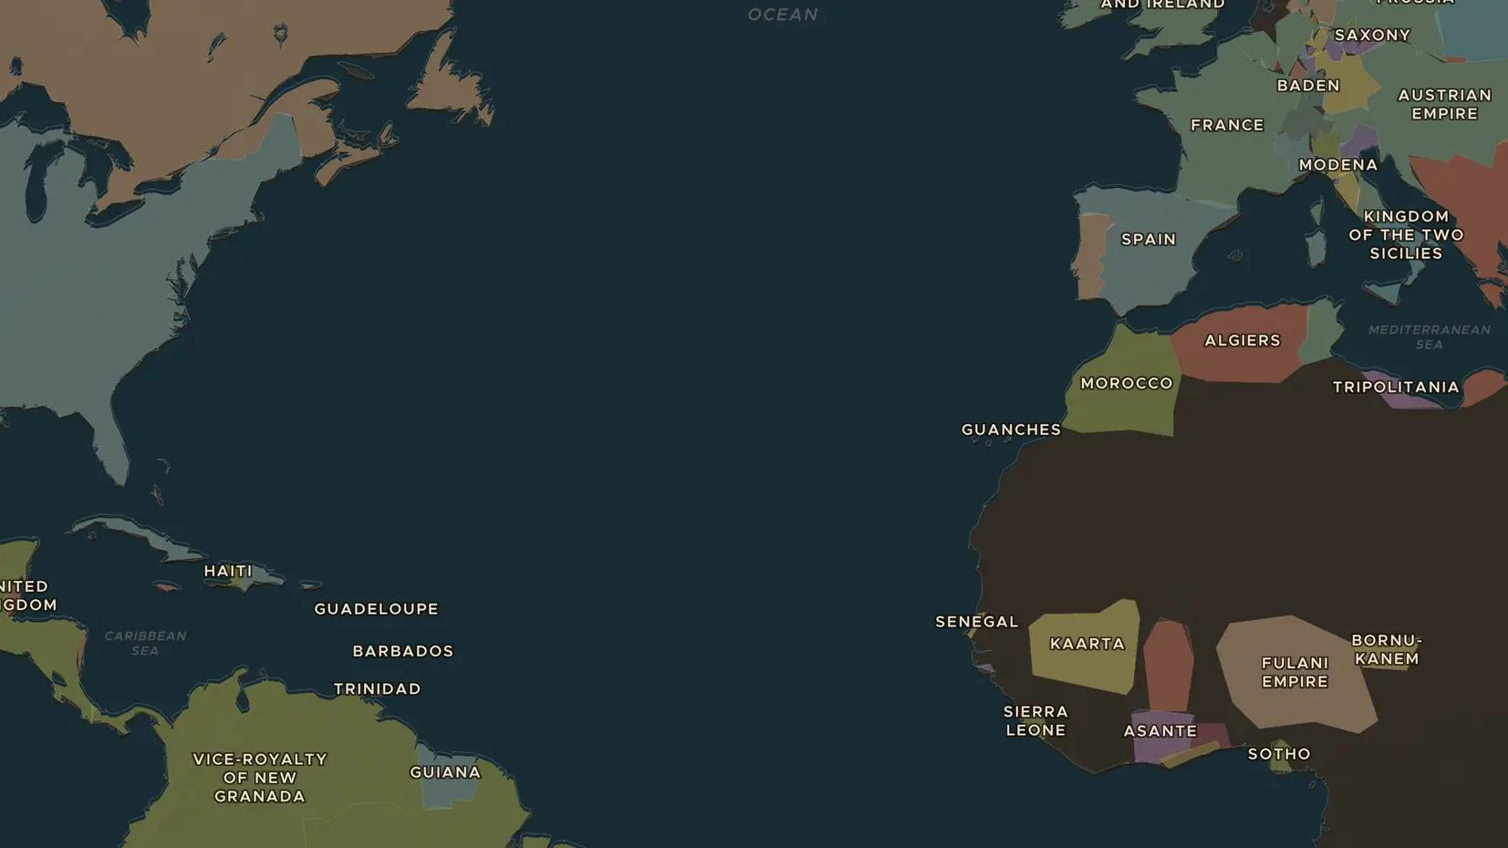
ATLANTIC REVOLUTIONS · 1791-1804
Haiti: the revolution of the enslaved
ChronoAtlas Classroom · Plate 397 · Ages 12-15 · 50 min
ChronoAtlas Classroom · chronoatlas.nl/classroom/lesson/haitian-revolution

Slide 2
THIS LESSON
What students take from it
In France's richest colony, enslaved people rise up, defeat the armies of three empires and found Haiti, the first nation born from a successful revolt of the enslaved. Students follow Toussaint Louverture and Dessalines.
LENGTH
50 min
AGES
12-15
ON THE MAP
BY THE END, STUDENTS CAN
3 steps, AD 1789
Explain why Saint-Domingue was so valuable to France and what life was like for the enslaved majority.
Describe the roles of Toussaint Louverture and Jean-Jacques Dessalines.
Explain how the Haitian Revolution affected France, the United States and Latin America.
QUIZ
7 rounds
ChronoAtlas Classroom · chronoatlas.nl/classroom/lesson/haitian-revolution
2

Slide 3
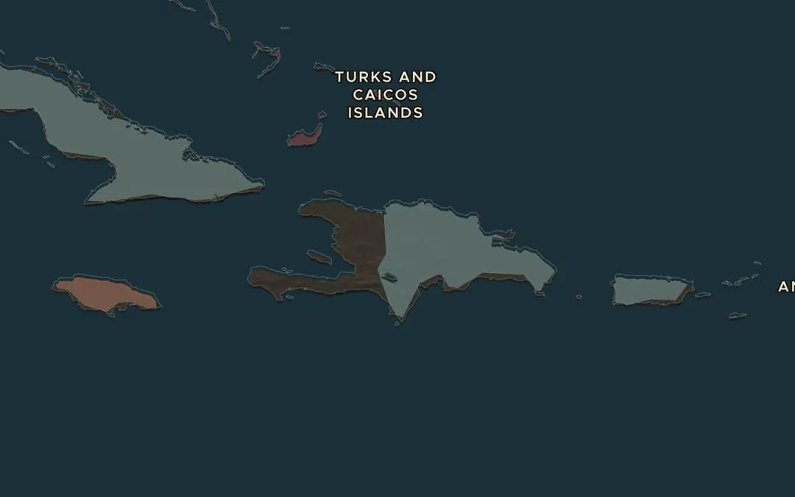
EXPLORE THE MAP · STEP A OF 3 · AD 1789
a
The richest colony
Open the map in 1789 and zoom in on the island of Hispaniola. The west was French Saint-Domingue, the east Spanish Santo Domingo. Turn on Trade Routes: which route linked these plantations to Africa and Europe?
Open this view on the live map →
ChronoAtlas Classroom · chronoatlas.nl/classroom/lesson/haitian-revolution
3
Notes:
Open the map in 1789 and zoom in on the island of Hispaniola. The west was French Saint-Domingue, the east Spanish Santo Domingo. Turn on Trade Routes: which route linked these plantations to Africa and Europe?
https://chronoatlas.nl/?year=1789&lat=19&lng=-71.5&zoom=6

Slide 4
CHRONOATLAS CLASSROOM
The rest of this deck comes with Classroom
19 more slides: the other map steps, the discussion questions, the quiz with its answers, and the worksheet.
Every lesson as a deck, every worksheet, every live lesson and homework.
€19 a month, cancel anytime. The free lesson, Rome at its height, comes whole.
https://chronoatlas.nl/pricing
ChronoAtlas Classroom · chronoatlas.nl/classroom/lesson/haitian-revolution
4

