Slide 1
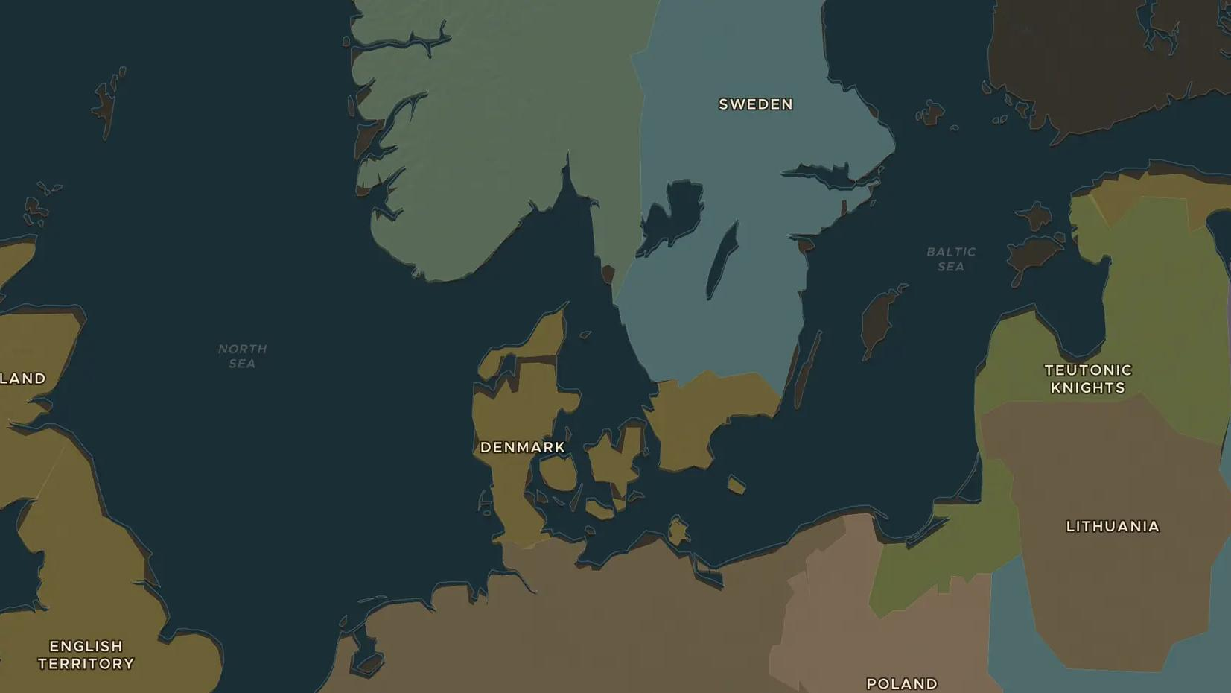
HANSEATIC LEAGUE · 1159-1400
The Hanseatic League: merchants of the North
ChronoAtlas Classroom · Plate 263 · Ages 11-14 · 45 min
ChronoAtlas Classroom · chronoatlas.nl/classroom/lesson/hanseatic-league

Slide 2
THIS LESSON
What students take from it
From Lübeck, German merchant towns build a trading network that stretches from London and Bruges to Bergen and Novgorod. Students follow the Hanseatic trade route, load a cog with herring, furs and grain, and see how merchants without a king could beat a kingdom.
LENGTH
45 min
AGES
11-14
ON THE MAP
BY THE END, STUDENTS CAN
3 steps, AD 1300
Trace the main Hanseatic trade route on the map and name its four great foreign offices.
Describe the goods traded across the North Sea and the Baltic, and the ships that carried them.
Explain how a league of towns could defend its interests against kings, as in the war with Denmark of 1367-1370.
QUIZ
7 rounds
ChronoAtlas Classroom · chronoatlas.nl/classroom/lesson/hanseatic-league
2

Slide 3
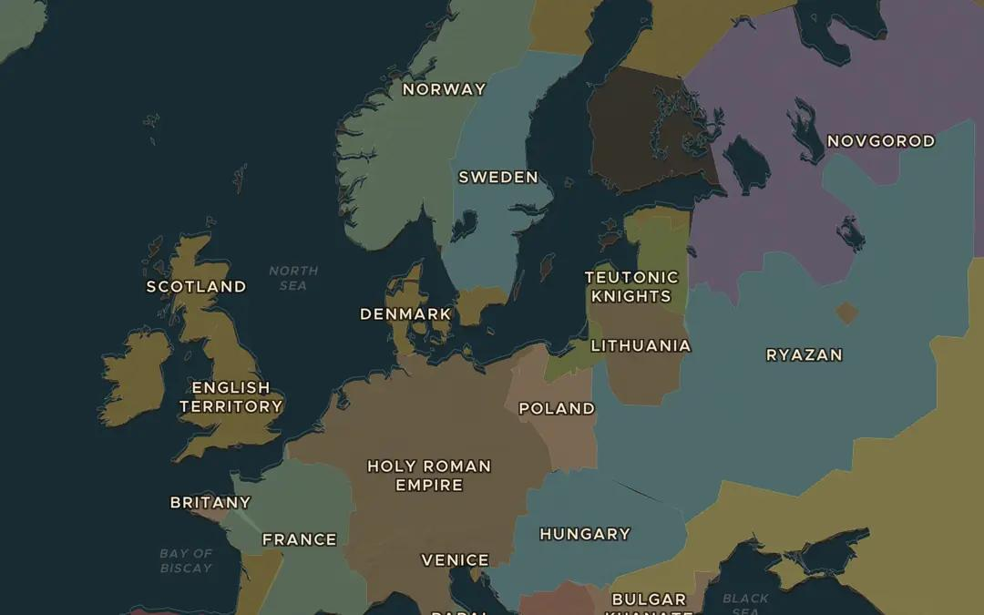
EXPLORE THE MAP · STEP A OF 3 · AD 1300
a
The trade route
Open the map in 1300 and turn on Trade Routes. Follow the Hanseatic League route from Novgorod to London. Which seas does it cross, and which towns lie on it?
Open this view on the live map →
ChronoAtlas Classroom · chronoatlas.nl/classroom/lesson/hanseatic-league
3
Notes:
Open the map in 1300 and turn on Trade Routes. Follow the Hanseatic League route from Novgorod to London. Which seas does it cross, and which towns lie on it?
https://chronoatlas.nl/?year=1300&lat=56&lng=15&zoom=4

Slide 4
CHRONOATLAS CLASSROOM
The rest of this deck comes with Classroom
19 more slides: the other map steps, the discussion questions, the quiz with its answers, and the worksheet.
Every lesson as a deck, every worksheet, every live lesson and homework.
€19 a month, cancel anytime. The free lesson, Rome at its height, comes whole.
https://chronoatlas.nl/pricing
ChronoAtlas Classroom · chronoatlas.nl/classroom/lesson/hanseatic-league
4

