Slide 1
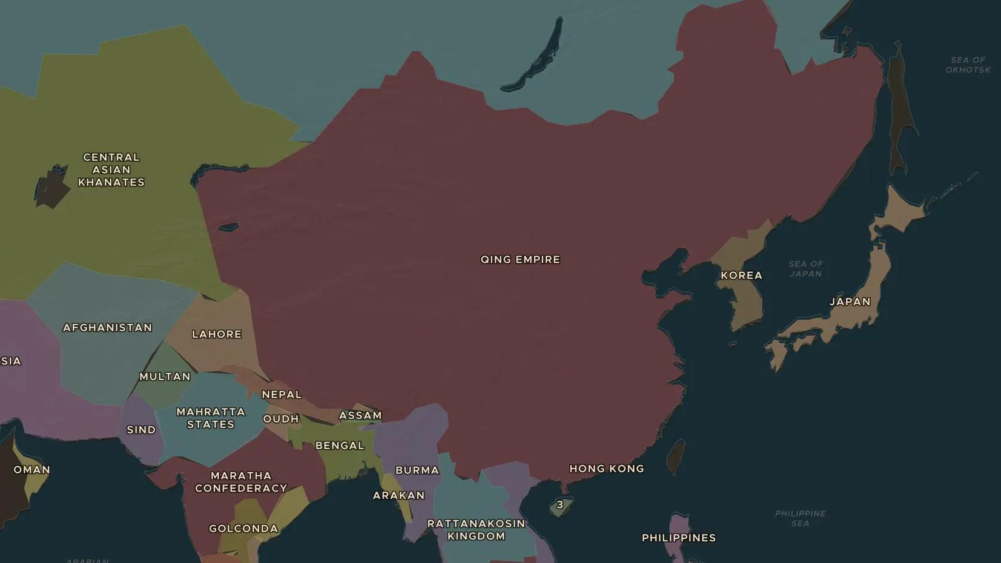
QING DYNASTY · 1661-1799
The High Qing: Kangxi to Qianlong
ChronoAtlas Classroom · Plate 394 · Ages 12-15 · 50 min
ChronoAtlas Classroom · chronoatlas.nl/classroom/lesson/high-qing-kangxi-qianlong

Slide 2
THIS LESSON
What students take from it
Under Kangxi, Yongzheng and Qianlong the Qing became the largest and richest state in Asia, and its population roughly doubled. Students explore the empire at its height and why Qianlong told a British envoy in 1793 that China needed nothing from Britain.
LENGTH
50 min
AGES
12-15
ON THE MAP
BY THE END, STUDENTS CAN
3 steps, AD 1783
Describe the growth of the Qing Empire under Kangxi, Yongzheng and Qianlong.
Explain how the Qing ruled an empire of many peoples.
Explain why the Qing limited trade with Europeans, using the Canton system and the Macartney mission.
QUIZ
7 rounds
ChronoAtlas Classroom · chronoatlas.nl/classroom/lesson/high-qing-kangxi-qianlong
2

Slide 3
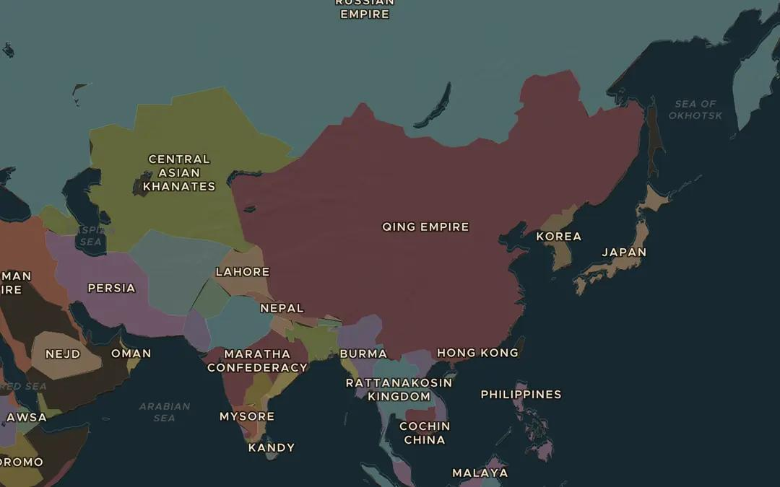
EXPLORE THE MAP · STEP A OF 3 · AD 1783
a
The Qing at its height
Open the map in 1783 and find the Qing Empire. Compare it with the Ming Empire in 1600. Which large regions did the Qing add to the north and west?
Open this view on the live map →
ChronoAtlas Classroom · chronoatlas.nl/classroom/lesson/high-qing-kangxi-qianlong
3
Notes:
Open the map in 1783 and find the Qing Empire. Compare it with the Ming Empire in 1600. Which large regions did the Qing add to the north and west?
https://chronoatlas.nl/?year=1783&lat=38&lng=100&zoom=3

Slide 4
CHRONOATLAS CLASSROOM
The rest of this deck comes with Classroom
19 more slides: the other map steps, the discussion questions, the quiz with its answers, and the worksheet.
Every lesson as a deck, every worksheet, every live lesson and homework.
€19 a month, cancel anytime. The free lesson, Rome at its height, comes whole.
https://chronoatlas.nl/pricing
ChronoAtlas Classroom · chronoatlas.nl/classroom/lesson/high-qing-kangxi-qianlong
4

