Slide 1
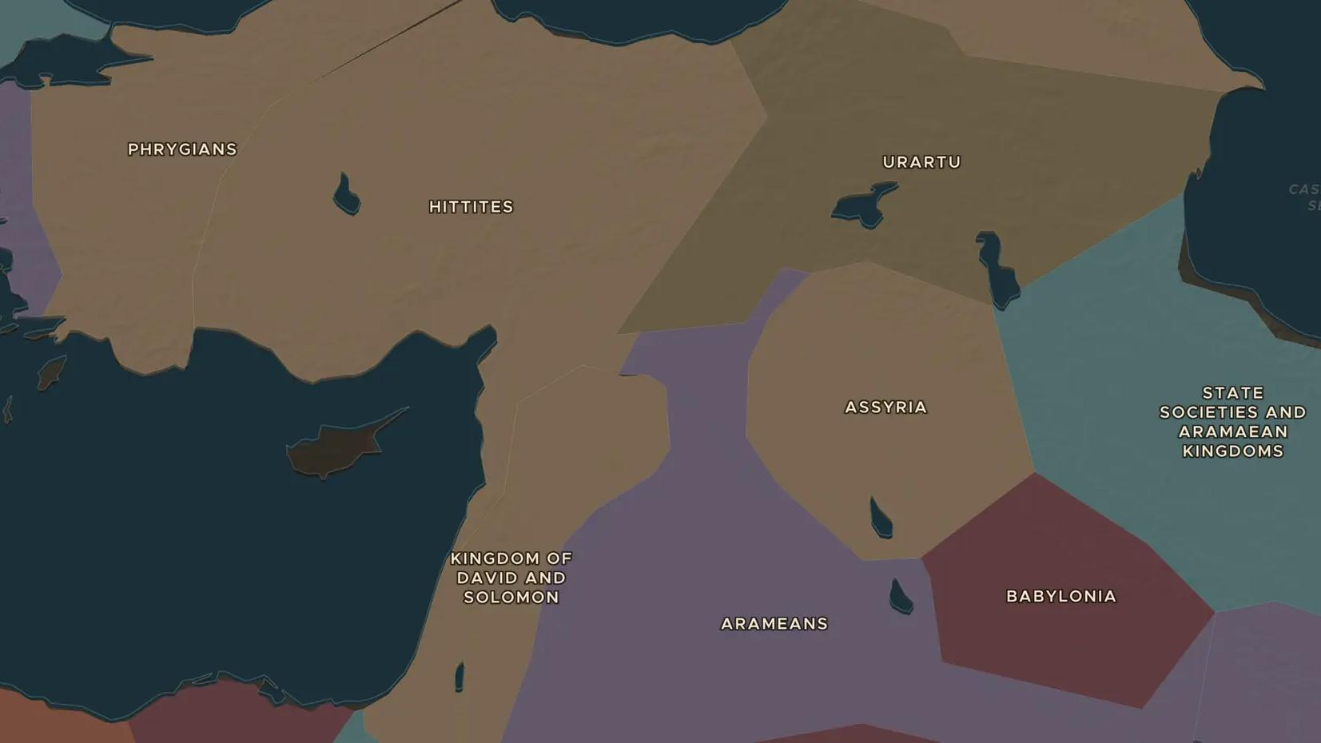
HITTITE EMPIRE · ABOUT 1650-1180 BC
The Hittites of Hattusa
ChronoAtlas Classroom · Plate 28 · Ages 12-15 · 45 min
ChronoAtlas Classroom · chronoatlas.nl/classroom/lesson/hittite-empire

Slide 2
THIS LESSON
What students take from it
From a fortress capital in central Anatolia, the Hittite kings raided Babylon, fought Egypt and wrote the oldest texts in the language family that includes English. Students explore Hattusa, meet Queen Puduhepa and test an old myth about Hittite iron.
LENGTH
45 min
AGES
12-15
ON THE MAP
BY THE END, STUDENTS CAN
3 steps, 1,500 BC
Locate Hattusa and the Hittite heartland and describe its geography.
Explain how the Hittites were rediscovered and their language deciphered.
Describe the Hittites' relations with Babylon and Egypt.
QUIZ
7 rounds
ChronoAtlas Classroom · chronoatlas.nl/classroom/lesson/hittite-empire
2

Slide 3
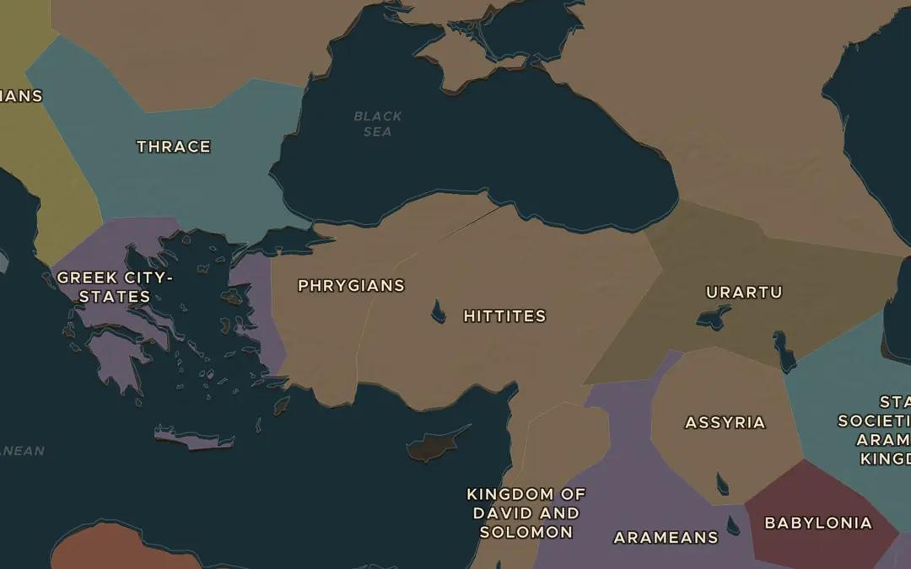
EXPLORE THE MAP · STEP A OF 3 · 1,500 BC
a
The Anatolian plateau
Open the map in 1500 BC and find the area labeled Hittites in central Anatolia. Look at the mountains around the high plateau. How would they help defend a kingdom?
Open this view on the live map →
ChronoAtlas Classroom · chronoatlas.nl/classroom/lesson/hittite-empire
3
Notes:
Open the map in 1500 BC and find the area labeled Hittites in central Anatolia. Look at the mountains around the high plateau. How would they help defend a kingdom?
https://chronoatlas.nl/?year=-1500&lat=39.5&lng=34&zoom=5

Slide 4
CHRONOATLAS CLASSROOM
The rest of this deck comes with Classroom
19 more slides: the other map steps, the discussion questions, the quiz with its answers, and the worksheet.
Every lesson as a deck, every worksheet, every live lesson and homework.
€19 a month, cancel anytime. The free lesson, Rome at its height, comes whole.
https://chronoatlas.nl/pricing
ChronoAtlas Classroom · chronoatlas.nl/classroom/lesson/hittite-empire
4

