Slide 1
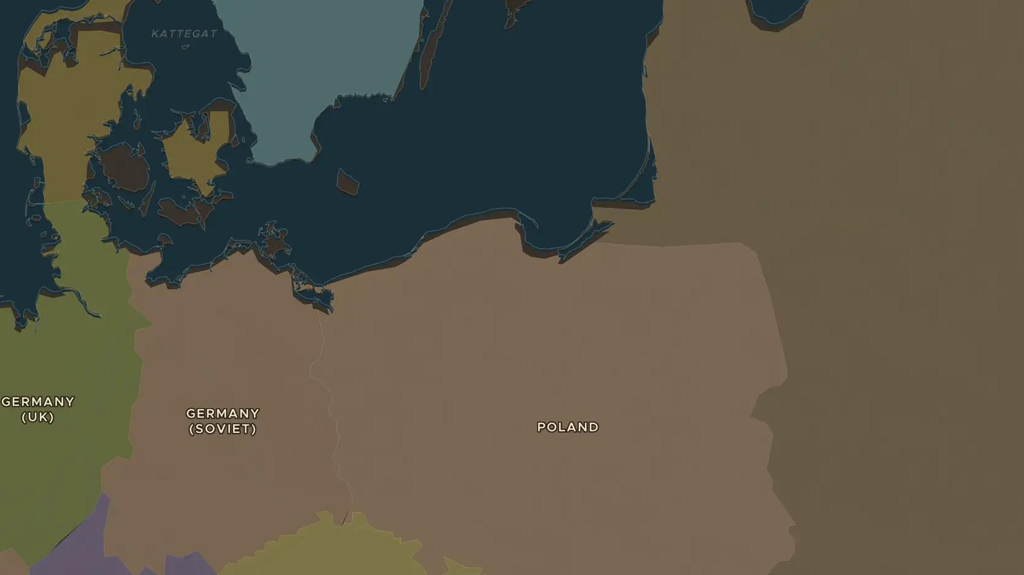
SECOND WORLD WAR · 1933-1945
The Holocaust: persecution, rescue and resistance
ChronoAtlas Classroom · Plate 485 · Ages 13-16 · 50 min
ChronoAtlas Classroom · chronoatlas.nl/classroom/lesson/holocaust-rescue-resistance

Slide 2
THIS LESSON
What students take from it
Between 1933 and 1945 Nazi Germany moved step by step from excluding Jews to murdering about six million of them. Students learn how persecution grew, and use the map to find places where people resisted and rescued. Written with care for students aged 13 and older.
LENGTH
50 min
AGES
13-16
ON THE MAP
BY THE END, STUDENTS CAN
3 steps, AD 1938
Describe the steps by which Nazi Germany moved from discrimination to the murder of Europe's Jews.
Locate places of rescue and resistance, such as Denmark, Kaunas and Warsaw.
Explain why people made different choices: perpetrators, bystanders, rescuers and resisters.
QUIZ
7 rounds
ChronoAtlas Classroom · chronoatlas.nl/classroom/lesson/holocaust-rescue-resistance
2

Slide 3
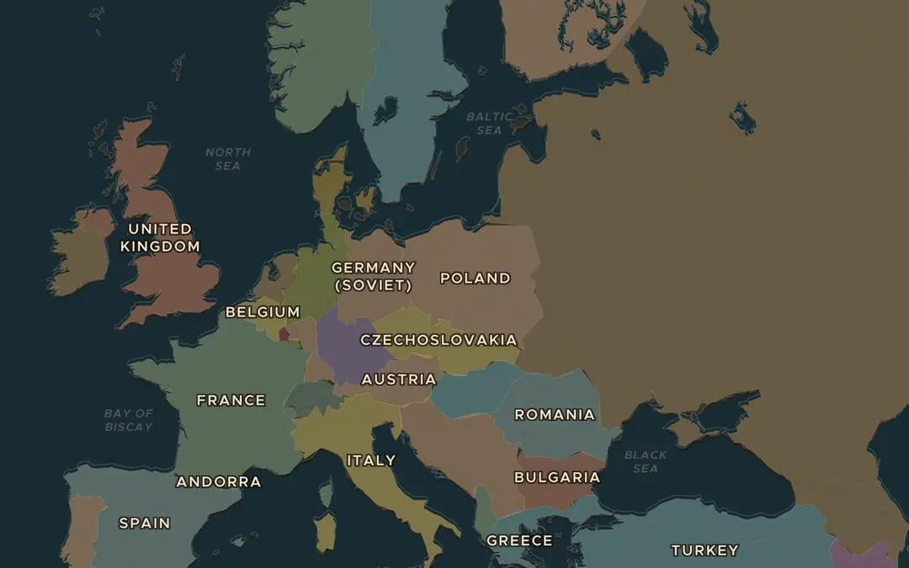
EXPLORE THE MAP · STEP A OF 3 · AD 1938
a
Jewish Europe in 1938
Open the map in 1938 and look at Europe from the Netherlands to the Soviet Union. Ask the atlas: "Where did most Jews in Europe live before the Second World War?"
Open this view on the live map →
ChronoAtlas Classroom · chronoatlas.nl/classroom/lesson/holocaust-rescue-resistance
3
Notes:
Open the map in 1938 and look at Europe from the Netherlands to the Soviet Union. Ask the atlas: "Where did most Jews in Europe live before the Second World War?"
https://chronoatlas.nl/?year=1938&lat=52&lng=18&zoom=4

Slide 4
CHRONOATLAS CLASSROOM
The rest of this deck comes with Classroom
19 more slides: the other map steps, the discussion questions, the quiz with its answers, and the worksheet.
Every lesson as a deck, every worksheet, every live lesson and homework.
€19 a month, cancel anytime. The free lesson, Rome at its height, comes whole.
https://chronoatlas.nl/pricing
ChronoAtlas Classroom · chronoatlas.nl/classroom/lesson/holocaust-rescue-resistance
4

