Slide 1
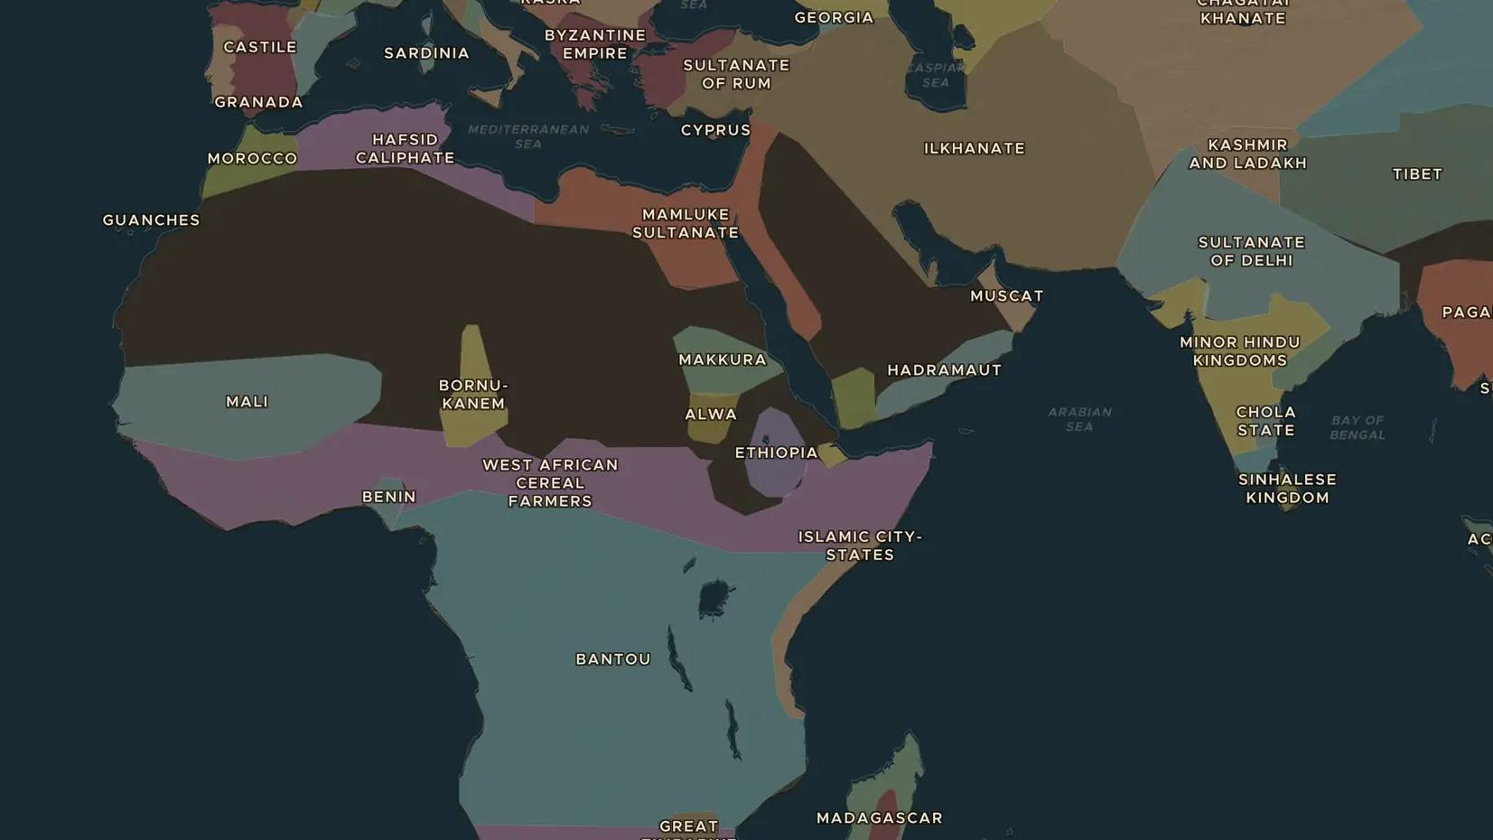
MEDIEVAL ISLAMIC WORLD · 1325-1354
Ibn Battuta: 29 years on the road
ChronoAtlas Classroom · Plate 271 · Ages 11-14 · 50 min
ChronoAtlas Classroom · chronoatlas.nl/classroom/lesson/ibn-battuta-rihla-journey

Slide 2
THIS LESSON
What students take from it
A young scholar from Tangier set out for Mecca in 1325 and spent most of the next 29 years on the road, from China to West Africa. Students follow Ibn Battuta's journey on the map and test his story like historians.
LENGTH
50 min
AGES
11-14
ON THE MAP
BY THE END, STUDENTS CAN
3 steps, AD 1325
Follow Ibn Battuta's route on the map and name at least six places he visited.
Explain how a shared faith, law and language helped him travel and find work.
Evaluate how reliable a travel account like the Rihla is.
QUIZ
7 rounds
ChronoAtlas Classroom · chronoatlas.nl/classroom/lesson/ibn-battuta-rihla-journey
2

Slide 3
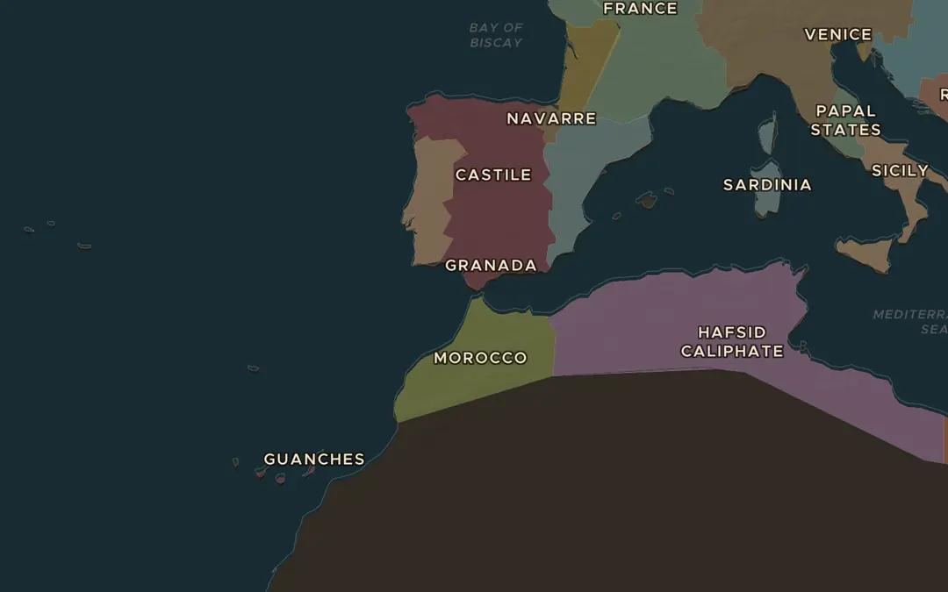
EXPLORE THE MAP · STEP A OF 3 · AD 1325
a
Setting out
Open Stories and choose Ibn Battuta under Travel with. Watch the first steps from Tangier to Mecca. Why did one pilgrimage turn into a journey of almost thirty years?
Open this view on the live map →
ChronoAtlas Classroom · chronoatlas.nl/classroom/lesson/ibn-battuta-rihla-journey
3
Notes:
Open Stories and choose Ibn Battuta under Travel with. Watch the first steps from Tangier to Mecca. Why did one pilgrimage turn into a journey of almost thirty years?
https://chronoatlas.nl/?year=1325&lat=35.78&lng=-5.8&zoom=4.4

Slide 4
CHRONOATLAS CLASSROOM
The rest of this deck comes with Classroom
19 more slides: the other map steps, the discussion questions, the quiz with its answers, and the worksheet.
Every lesson as a deck, every worksheet, every live lesson and homework.
€19 a month, cancel anytime. The free lesson, Rome at its height, comes whole.
https://chronoatlas.nl/pricing
ChronoAtlas Classroom · chronoatlas.nl/classroom/lesson/ibn-battuta-rihla-journey
4

