Slide 1
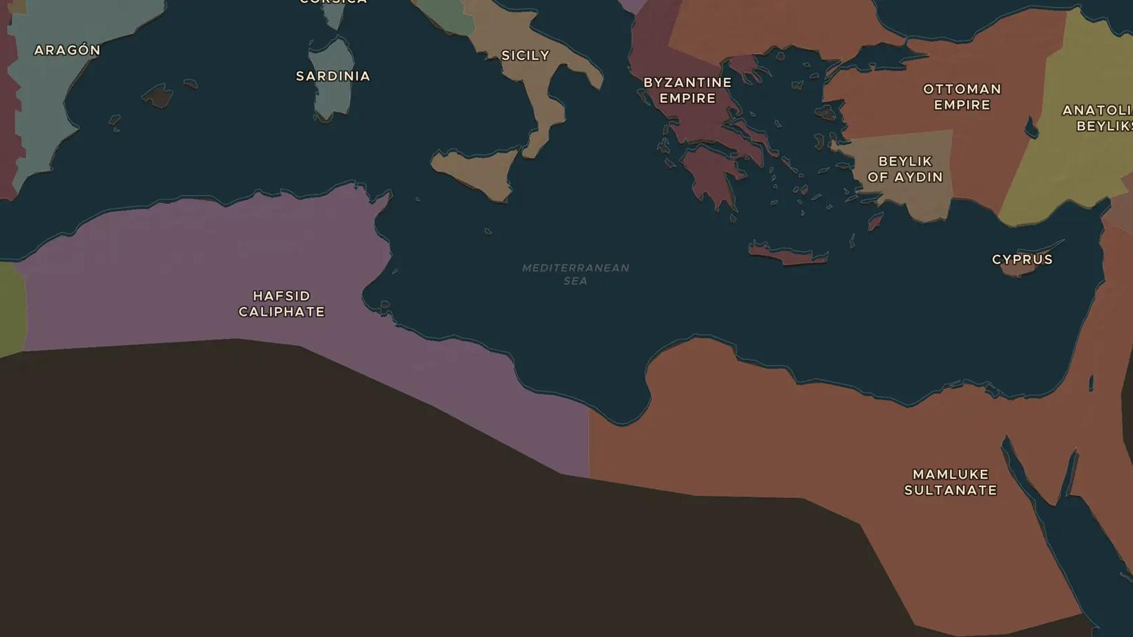
MEDIEVAL NORTH AFRICA · 1332-1406
Ibn Khaldun and the rise and fall of dynasties
ChronoAtlas Classroom · Plate 273 · Ages 13-16 · 50 min
ChronoAtlas Classroom · chronoatlas.nl/classroom/lesson/ibn-khaldun-rise-and-fall-of-dynasties

Slide 2
THIS LESSON
What students take from it
Born in Tunis and shaped by the Black Death, Ibn Khaldun asked why dynasties rise and fall. Students follow his life from Tunis to Cairo, meet his idea of group solidarity and test it on empires they know.
LENGTH
50 min
AGES
13-16
ON THE MAP
BY THE END, STUDENTS CAN
3 steps, AD 1332
Follow Ibn Khaldun's life from Tunis to Cairo on the map.
Explain his idea of asabiyya, group solidarity, in their own words.
Apply his cycle of rise and fall to one dynasty and judge whether it fits.
QUIZ
7 rounds
ChronoAtlas Classroom · chronoatlas.nl/classroom/lesson/ibn-khaldun-rise-and-fall-of-dynasties
2

Slide 3
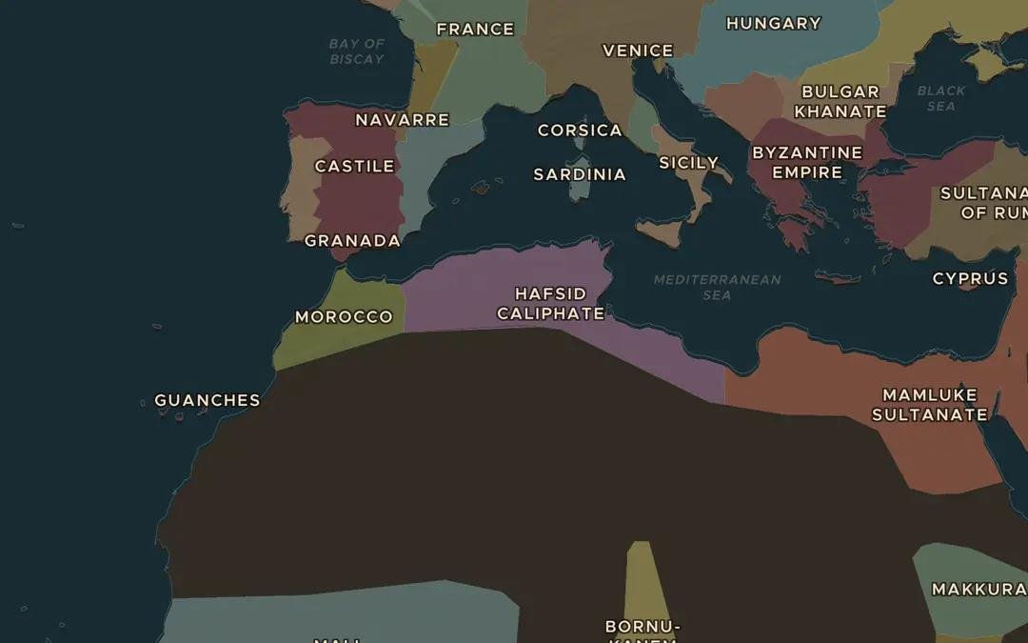
EXPLORE THE MAP · STEP A OF 3 · AD 1332
a
Born in Tunis
Open the map in 1332. Find the Hafsid state centered on Tunis, where Ibn Khaldun was born this year. Which other states share North Africa with it?
Open this view on the live map →
ChronoAtlas Classroom · chronoatlas.nl/classroom/lesson/ibn-khaldun-rise-and-fall-of-dynasties
3
Notes:
Open the map in 1332. Find the Hafsid state centered on Tunis, where Ibn Khaldun was born this year. Which other states share North Africa with it?
https://chronoatlas.nl/?year=1332&lat=33&lng=5&zoom=4

Slide 4
CHRONOATLAS CLASSROOM
The rest of this deck comes with Classroom
19 more slides: the other map steps, the discussion questions, the quiz with its answers, and the worksheet.
Every lesson as a deck, every worksheet, every live lesson and homework.
€19 a month, cancel anytime. The free lesson, Rome at its height, comes whole.
https://chronoatlas.nl/pricing
ChronoAtlas Classroom · chronoatlas.nl/classroom/lesson/ibn-khaldun-rise-and-fall-of-dynasties
4

