Slide 1
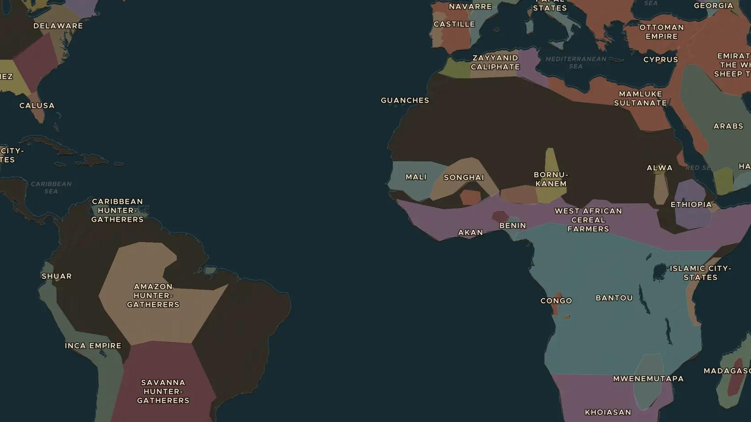
INCA EMPIRE · 1438-1533
Qhapaq Ñan: the Inca road system
ChronoAtlas Classroom · Plate 304 · Ages 10-13 · 45 min
ChronoAtlas Classroom · chronoatlas.nl/classroom/lesson/inca-roads-qhapaq-nan

Slide 2
THIS LESSON
What students take from it
Roads of some 30,000 to 40,000 km tied the Inca Empire together, across deserts, mountain passes and gorges. Students follow the roads, the relay runners who raced along them and the grass bridges that are still rebuilt every year.
LENGTH
45 min
AGES
10-13
ON THE MAP
BY THE END, STUDENTS CAN
3 steps, AD 1500
Describe the Inca road system and explain what it was used for.
Explain how chasqui relay runners and tambo way stations moved messages and goods.
Locate Quito, Cusco and the Q'eswachaka bridge on the map.
QUIZ
7 rounds
ChronoAtlas Classroom · chronoatlas.nl/classroom/lesson/inca-roads-qhapaq-nan
2

Slide 3
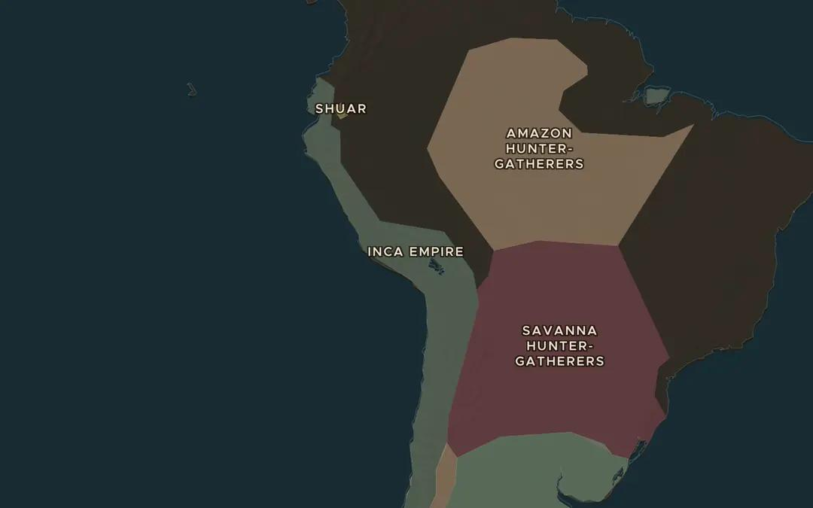
EXPLORE THE MAP · STEP A OF 3 · AD 1500
a
One empire, one network
Open the map in 1500 and zoom out over the Inca Empire. Two main roads ran north to south, one along the coast and one through the mountains. Trace both with your finger. Which was harder to build?
Open this view on the live map →
ChronoAtlas Classroom · chronoatlas.nl/classroom/lesson/inca-roads-qhapaq-nan
3
Notes:
Open the map in 1500 and zoom out over the Inca Empire. Two main roads ran north to south, one along the coast and one through the mountains. Trace both with your finger. Which was harder to build?
https://chronoatlas.nl/?year=1500&lat=-15&lng=-72&zoom=3.8

Slide 4
CHRONOATLAS CLASSROOM
The rest of this deck comes with Classroom
19 more slides: the other map steps, the discussion questions, the quiz with its answers, and the worksheet.
Every lesson as a deck, every worksheet, every live lesson and homework.
€19 a month, cancel anytime. The free lesson, Rome at its height, comes whole.
https://chronoatlas.nl/pricing
ChronoAtlas Classroom · chronoatlas.nl/classroom/lesson/inca-roads-qhapaq-nan
4

