Slide 1
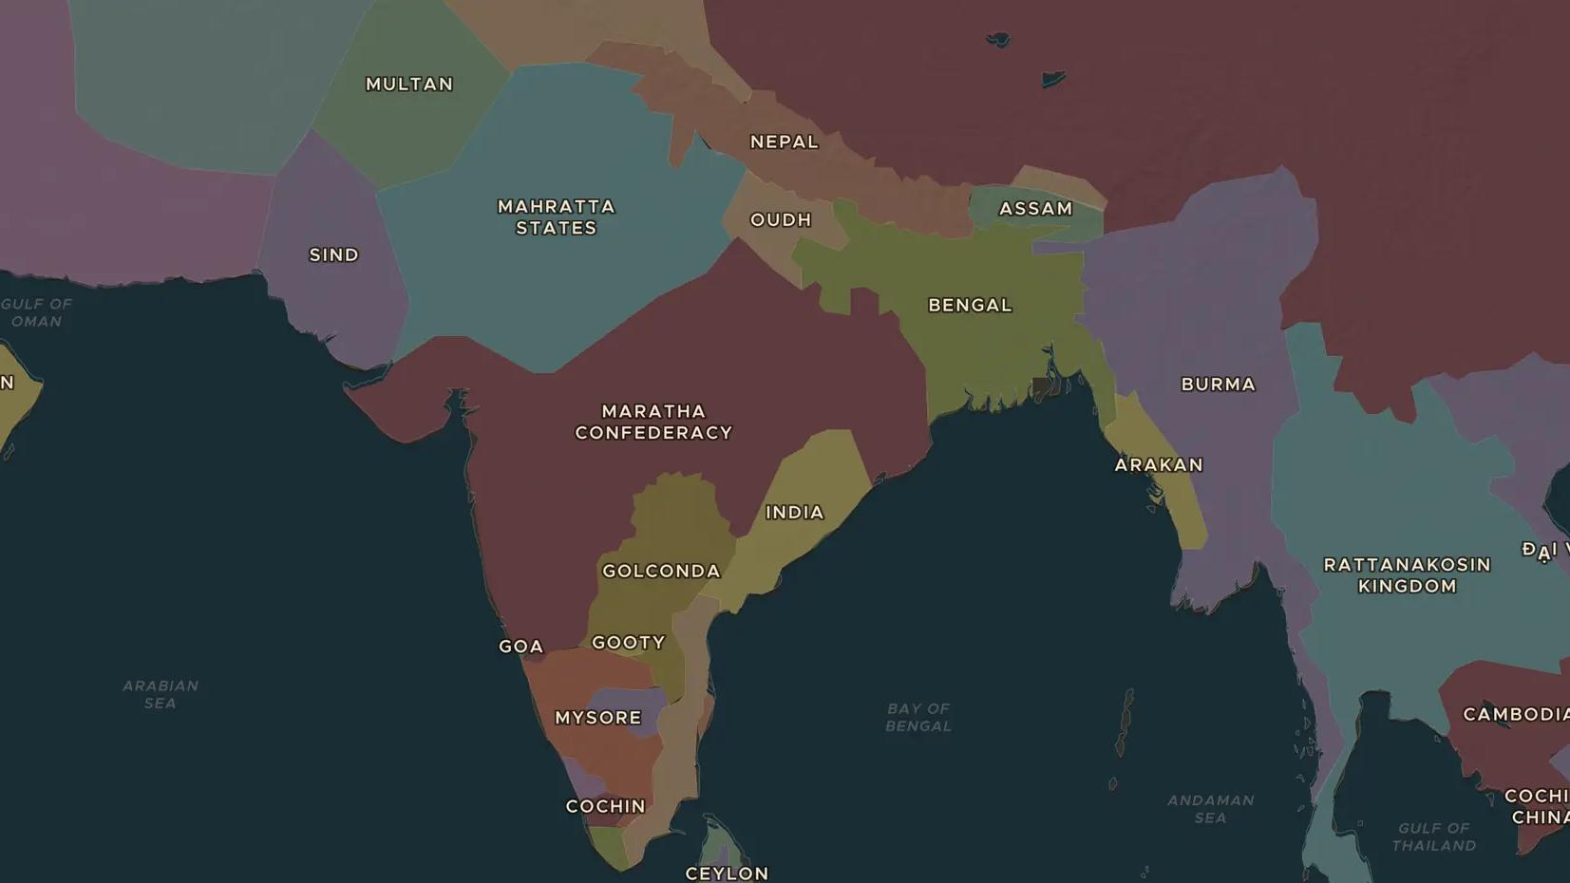
INDIA · 1707-1799
India in the 1700s: new powers rise
ChronoAtlas Classroom · Plate 392 · Ages 13-16 · 50 min
ChronoAtlas Classroom · chronoatlas.nl/classroom/lesson/india-eighteenth-century

Slide 2
THIS LESSON
What students take from it
After Aurangzeb died in 1707, the Mughal Empire broke into many states. Marathas, Afghans, Mysore and a British trading company fought for India. Students follow the century on the map and ask how a company came to rule Bengal.
LENGTH
50 min
AGES
13-16
ON THE MAP
BY THE END, STUDENTS CAN
3 steps, AD 1783
Explain why the Mughal Empire broke into successor states after 1707.
Describe the rise of the Marathas, Mysore and the East India Company.
Explain how the Battle of Plassey in 1757 began Company rule in Bengal.
QUIZ
7 rounds
ChronoAtlas Classroom · chronoatlas.nl/classroom/lesson/india-eighteenth-century
2

Slide 3
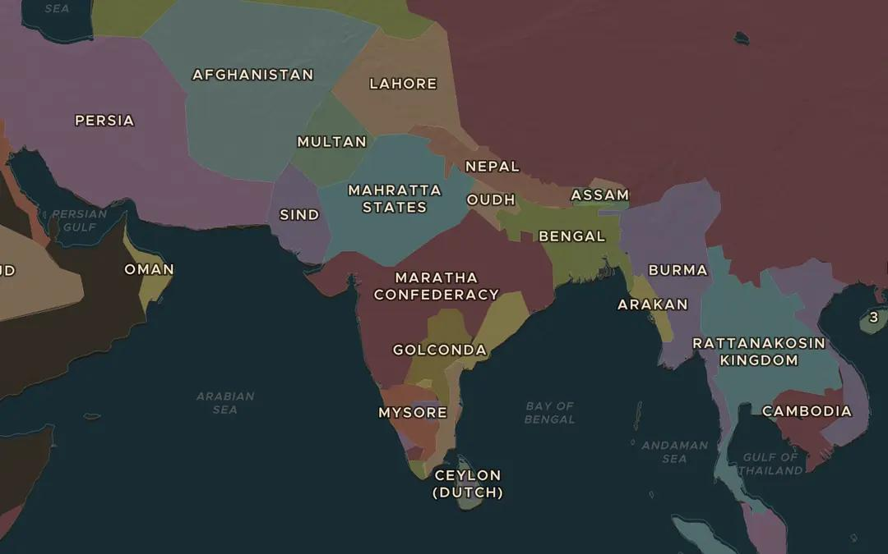
EXPLORE THE MAP · STEP A OF 3 · AD 1783
a
Many successors
Open the map in 1783 and look at India. How many states can you count where the Mughal Empire once ruled? Which one is the largest?
Open this view on the live map →
ChronoAtlas Classroom · chronoatlas.nl/classroom/lesson/india-eighteenth-century
3
Notes:
Open the map in 1783 and look at India. How many states can you count where the Mughal Empire once ruled? Which one is the largest?
https://chronoatlas.nl/?year=1783&lat=22&lng=79&zoom=4

Slide 4
CHRONOATLAS CLASSROOM
The rest of this deck comes with Classroom
19 more slides: the other map steps, the discussion questions, the quiz with its answers, and the worksheet.
Every lesson as a deck, every worksheet, every live lesson and homework.
€19 a month, cancel anytime. The free lesson, Rome at its height, comes whole.
https://chronoatlas.nl/pricing
ChronoAtlas Classroom · chronoatlas.nl/classroom/lesson/india-eighteenth-century
4

