Slide 1
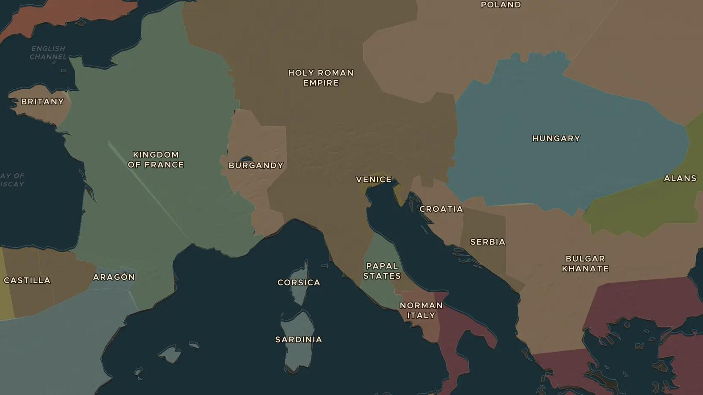
HOLY ROMAN EMPIRE · 1075-1122
Pope against emperor: the road to Canossa
ChronoAtlas Classroom · Plate 217 · Ages 13-16 · 50 min
ChronoAtlas Classroom · chronoatlas.nl/classroom/lesson/investiture-controversy-canossa

Slide 2
THIS LESSON
What students take from it
In January 1077 the king of Germany waits for three days in the snow outside a castle in Italy, begging the pope for forgiveness. Students unpack the struggle over who had the right to choose bishops, and why it shook medieval Europe.
LENGTH
50 min
AGES
13-16
ON THE MAP
BY THE END, STUDENTS CAN
3 steps, AD 1077
Explain what "investiture" means and why both pope and emperor wanted control of it.
Describe the events at Canossa in 1077 and assess who really won there.
Explain the compromise of the Concordat of Worms in 1122.
QUIZ
7 rounds
ChronoAtlas Classroom · chronoatlas.nl/classroom/lesson/investiture-controversy-canossa
2

Slide 3
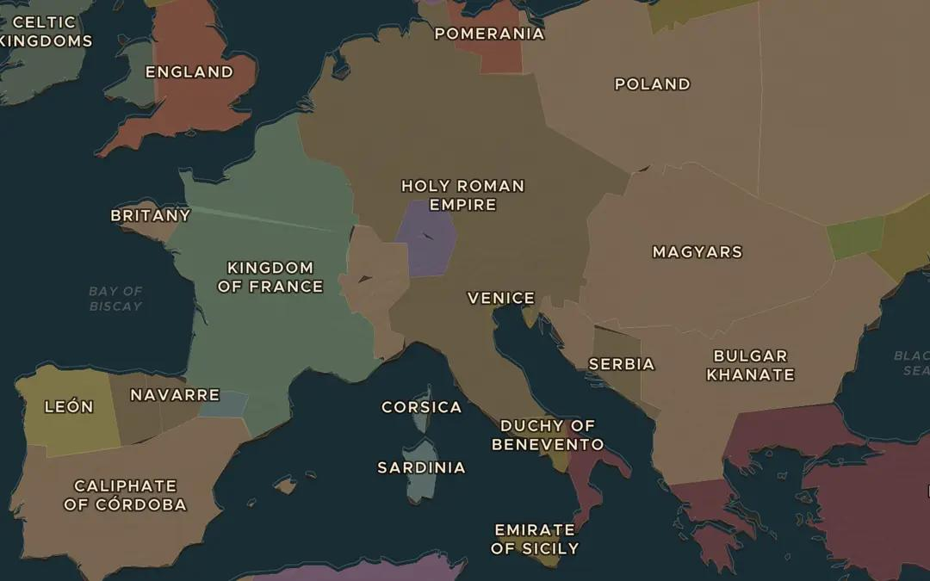
EXPLORE THE MAP · STEP A OF 3 · AD 1077
a
Empire and papacy
Open the map in 1077. Find the Holy Roman Empire and the Papal States. How much of Italy belongs to the empire?
Open this view on the live map →
ChronoAtlas Classroom · chronoatlas.nl/classroom/lesson/investiture-controversy-canossa
3
Notes:
Open the map in 1077. Find the Holy Roman Empire and the Papal States. How much of Italy belongs to the empire?
https://chronoatlas.nl/?year=1077&lat=46&lng=11&zoom=4.6

Slide 4
CHRONOATLAS CLASSROOM
The rest of this deck comes with Classroom
19 more slides: the other map steps, the discussion questions, the quiz with its answers, and the worksheet.
Every lesson as a deck, every worksheet, every live lesson and homework.
€19 a month, cancel anytime. The free lesson, Rome at its height, comes whole.
https://chronoatlas.nl/pricing
ChronoAtlas Classroom · chronoatlas.nl/classroom/lesson/investiture-controversy-canossa
4

