Slide 1
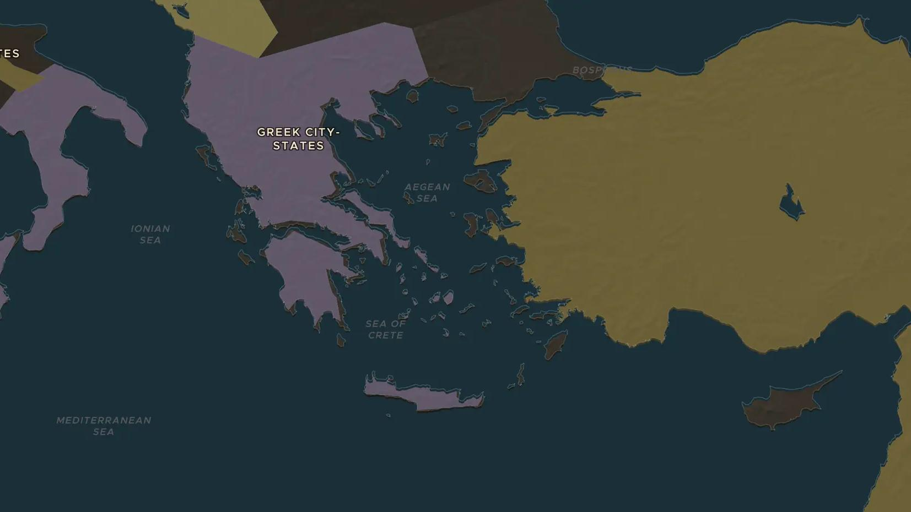
PERSIAN WARS · 499-490 BC
Marathon: Persia reaches Greece
ChronoAtlas Classroom · Plate 72 · Ages 11-14 · 50 min
ChronoAtlas Classroom · chronoatlas.nl/classroom/lesson/ionian-revolt-and-marathon

Slide 2
THIS LESSON
What students take from it
When the Greek cities of Ionia rebelled against Persia, Athens sent twenty ships to help. The revolt failed, and in 490 BC King Darius sent a fleet to punish Athens. Students follow the chain of events to the plain of Marathon, where an outnumbered army of citizens charged.
LENGTH
50 min
AGES
11-14
ON THE MAP
BY THE END, STUDENTS CAN
3 steps, 499 BC
Explain how the Ionian Revolt (499-494 BC) led to the Persian expedition of 490 BC.
Locate Miletus, Eretria and Marathon and describe what happened at each.
Describe the battle of Marathon and explain why it mattered so much to the Athenians.
QUIZ
7 rounds
ChronoAtlas Classroom · chronoatlas.nl/classroom/lesson/ionian-revolt-and-marathon
2

Slide 3
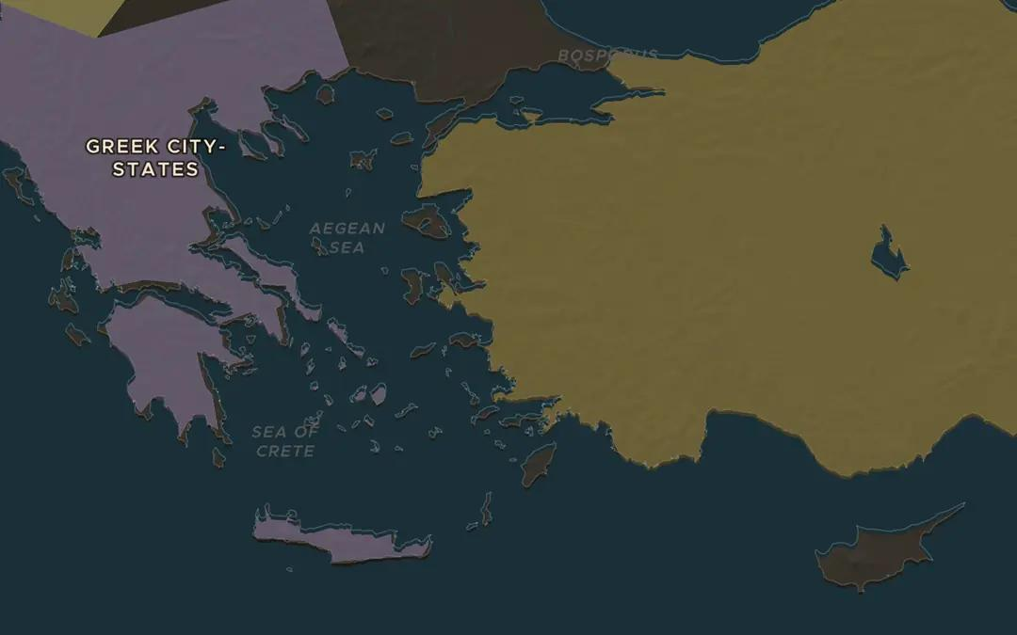
EXPLORE THE MAP · STEP A OF 3 · 499 BC
a
Ionia rises
Open the map in 499 BC on the west coast of Anatolia. The Greek cities of Ionia, led by Miletus, were inside the Persian Empire and rebelled. Athens and Eretria sent ships, and in 498 BC the rebels burned the Persian provincial capital Sardis. Find Miletus and Sardis with the Cities layer on.
Open this view on the live map →
ChronoAtlas Classroom · chronoatlas.nl/classroom/lesson/ionian-revolt-and-marathon
3
Notes:
Open the map in 499 BC on the west coast of Anatolia. The Greek cities of Ionia, led by Miletus, were inside the Persian Empire and rebelled. Athens and Eretria sent ships, and in 498 BC the rebels burned the Persian provincial capital Sardis. Find Miletus and Sardis with the Cities layer on.
https://chronoatlas.nl/?year=-499&lat=38&lng=27.5&zoom=6

Slide 4
CHRONOATLAS CLASSROOM
The rest of this deck comes with Classroom
19 more slides: the other map steps, the discussion questions, the quiz with its answers, and the worksheet.
Every lesson as a deck, every worksheet, every live lesson and homework.
€19 a month, cancel anytime. The free lesson, Rome at its height, comes whole.
https://chronoatlas.nl/pricing
ChronoAtlas Classroom · chronoatlas.nl/classroom/lesson/ionian-revolt-and-marathon
4

