Slide 1
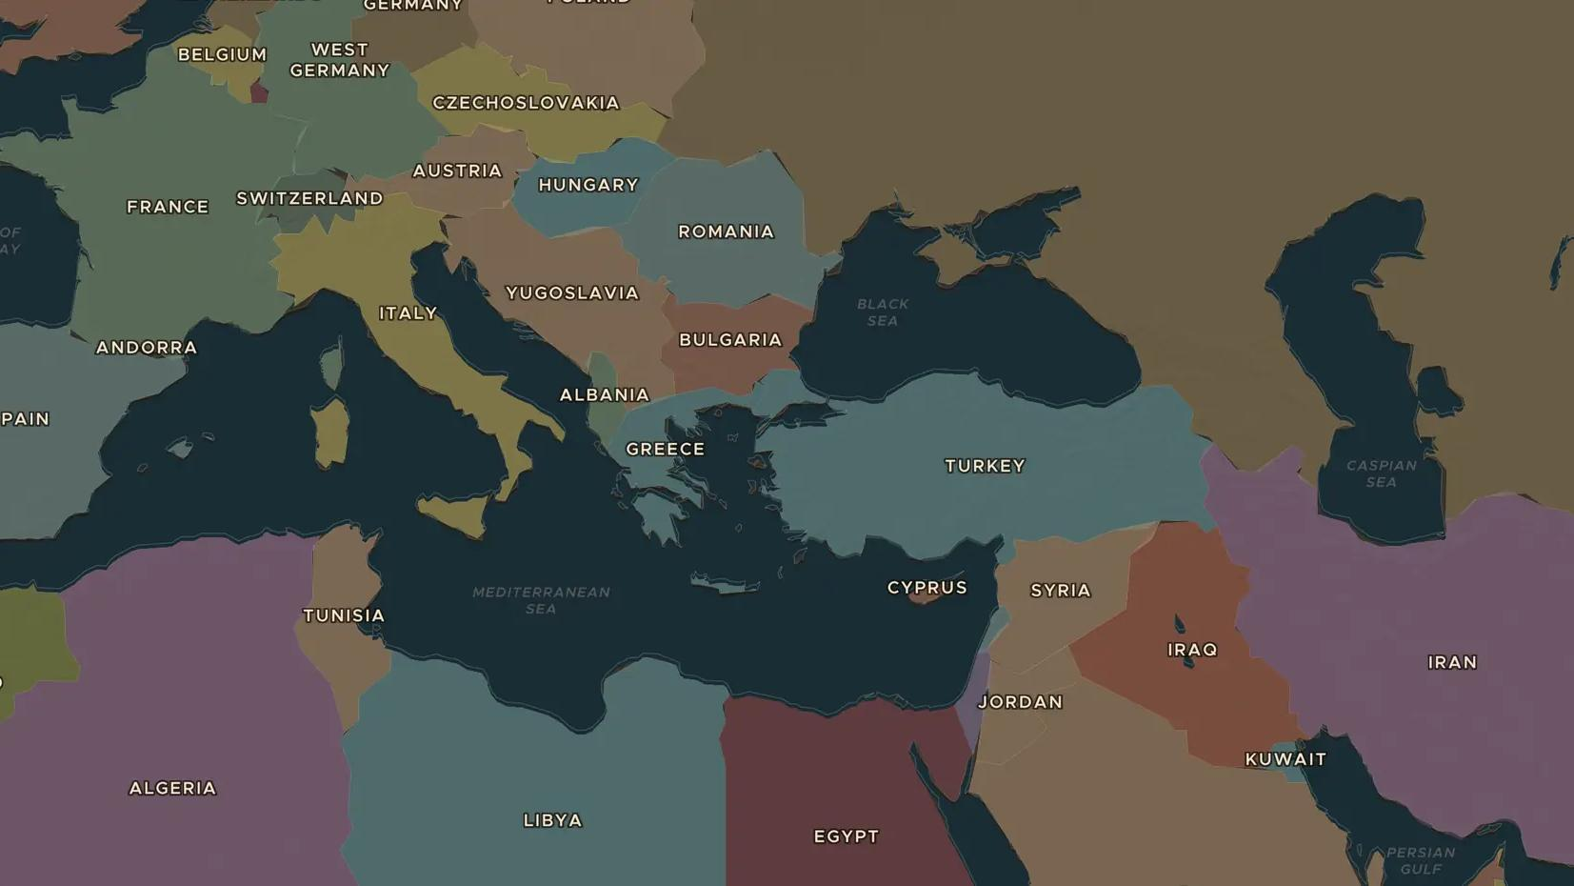
MIDDLE EAST · 1953-1981
1979: the Iranian Revolution
ChronoAtlas Classroom · Plate 499 · Ages 13-16 · 50 min
ChronoAtlas Classroom · chronoatlas.nl/classroom/lesson/iranian-revolution-1979

Slide 2
THIS LESSON
What students take from it
In 1979 huge protests drove the Shah of Iran from his throne, and Ayatollah Khomeini returned from exile to build an Islamic republic. Students trace the story back to the coup of 1953, follow the revolution on the map and see how the hostage crisis changed Iran's relations with the West.
LENGTH
50 min
AGES
13-16
ON THE MAP
BY THE END, STUDENTS CAN
3 steps, AD 1960
Explain why many Iranians turned against the Shah in the 1970s.
Describe how the revolution of 1978-1979 unfolded and who led it.
Explain how the hostage crisis of 1979-1981 changed relations between Iran and the United States.
QUIZ
7 rounds
ChronoAtlas Classroom · chronoatlas.nl/classroom/lesson/iranian-revolution-1979
2

Slide 3
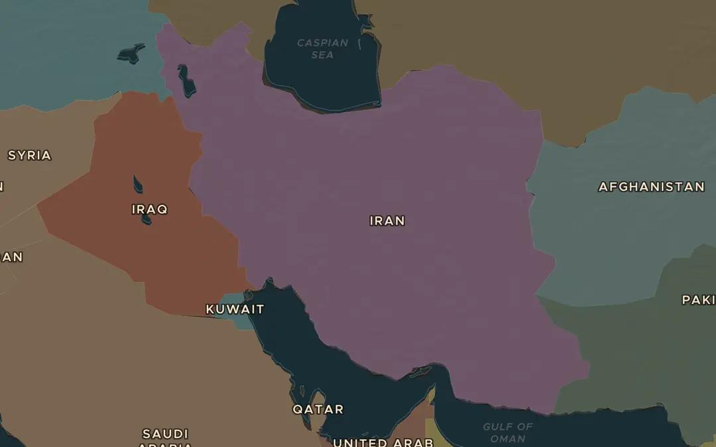
EXPLORE THE MAP · STEP A OF 3 · AD 1960
a
Oil and power
Open the map in 1960 and find Iran, between the Caspian Sea and the Persian Gulf. Find Abadan on the Gulf, home to a giant oil refinery. Why did foreign powers care so much about Iran?
Open this view on the live map →
ChronoAtlas Classroom · chronoatlas.nl/classroom/lesson/iranian-revolution-1979
3
Notes:
Open the map in 1960 and find Iran, between the Caspian Sea and the Persian Gulf. Find Abadan on the Gulf, home to a giant oil refinery. Why did foreign powers care so much about Iran?
https://chronoatlas.nl/?year=1960&lat=32.5&lng=53&zoom=5

Slide 4
CHRONOATLAS CLASSROOM
The rest of this deck comes with Classroom
19 more slides: the other map steps, the discussion questions, the quiz with its answers, and the worksheet.
Every lesson as a deck, every worksheet, every live lesson and homework.
€19 a month, cancel anytime. The free lesson, Rome at its height, comes whole.
https://chronoatlas.nl/pricing
ChronoAtlas Classroom · chronoatlas.nl/classroom/lesson/iranian-revolution-1979
4

