Slide 1
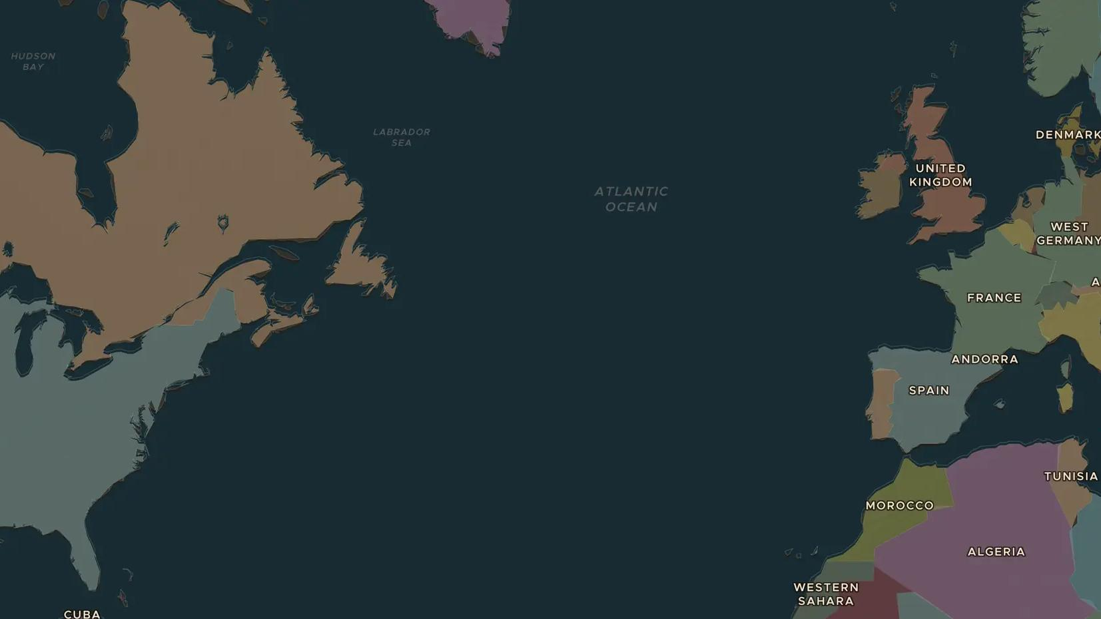
COLD WAR · 1946-1955
The Iron Curtain and the Marshall Plan
ChronoAtlas Classroom · Plate 507 · Ages 13-16 · 50 min
ChronoAtlas Classroom · chronoatlas.nl/classroom/lesson/iron-curtain-marshall-plan

Slide 2
THIS LESSON
What students take from it
In 1946 Churchill warned that an "iron curtain" had come down across Europe. America answered with the Marshall Plan and NATO; the Soviet Union with its own bloc and the Warsaw Pact. Students draw the line on the map and see how Europe split in two.
LENGTH
50 min
AGES
13-16
ON THE MAP
BY THE END, STUDENTS CAN
3 steps, AD 1960
Explain what Churchill meant by an "iron curtain" in 1946.
Describe the aims of the Marshall Plan and why Stalin rejected it.
Show on the map how Europe split into NATO and Warsaw Pact countries by 1955.
QUIZ
7 rounds
ChronoAtlas Classroom · chronoatlas.nl/classroom/lesson/iron-curtain-marshall-plan
2

Slide 3
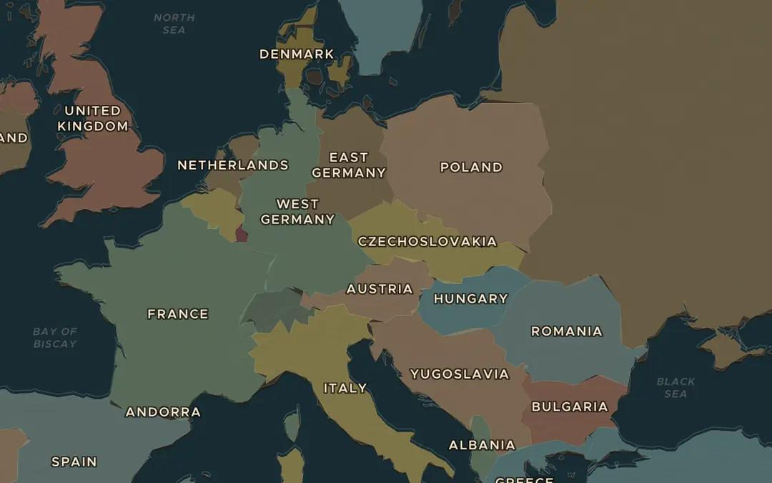
EXPLORE THE MAP · STEP A OF 3 · AD 1960
a
Stettin to Trieste
Open the map in 1960. Find Stettin (Szczecin) on the Baltic and Trieste on the Adriatic. Draw a line between them with your finger. Which countries lie east of it?
Open this view on the live map →
ChronoAtlas Classroom · chronoatlas.nl/classroom/lesson/iron-curtain-marshall-plan
3
Notes:
Open the map in 1960. Find Stettin (Szczecin) on the Baltic and Trieste on the Adriatic. Draw a line between them with your finger. Which countries lie east of it?
https://chronoatlas.nl/?year=1960&lat=49.5&lng=14.5&zoom=4.5

Slide 4
CHRONOATLAS CLASSROOM
The rest of this deck comes with Classroom
19 more slides: the other map steps, the discussion questions, the quiz with its answers, and the worksheet.
Every lesson as a deck, every worksheet, every live lesson and homework.
€19 a month, cancel anytime. The free lesson, Rome at its height, comes whole.
https://chronoatlas.nl/pricing
ChronoAtlas Classroom · chronoatlas.nl/classroom/lesson/iron-curtain-marshall-plan
4

