Slide 1
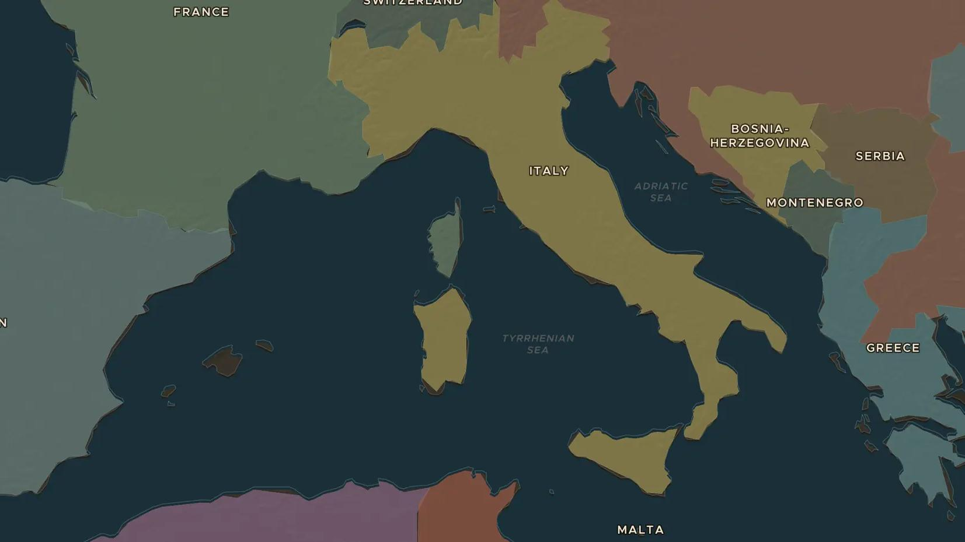
RISORGIMENTO · 1848-1871
Italy united: Cavour, Garibaldi and the Risorgimento
ChronoAtlas Classroom · Plate 426 · Ages 12-15 · 50 min
ChronoAtlas Classroom · chronoatlas.nl/classroom/lesson/italian-unification

Slide 2
THIS LESSON
What students take from it
In 1848 Italy is a patchwork of kingdoms, duchies and Austrian provinces. By 1871 it is one kingdom with Rome as its capital. Students follow Cavour's diplomacy, Garibaldi's Thousand and the popular votes that made Italy.
LENGTH
50 min
AGES
12-15
ON THE MAP
BY THE END, STUDENTS CAN
3 steps, AD 1848
Compare the map of Italy in 1848 and 1880 and name the states that disappeared.
Explain the roles of Cavour, Garibaldi, Mazzini and King Victor Emmanuel II.
Explain how war, diplomacy and popular votes combined to unite Italy.
QUIZ
7 rounds
ChronoAtlas Classroom · chronoatlas.nl/classroom/lesson/italian-unification
2

Slide 3
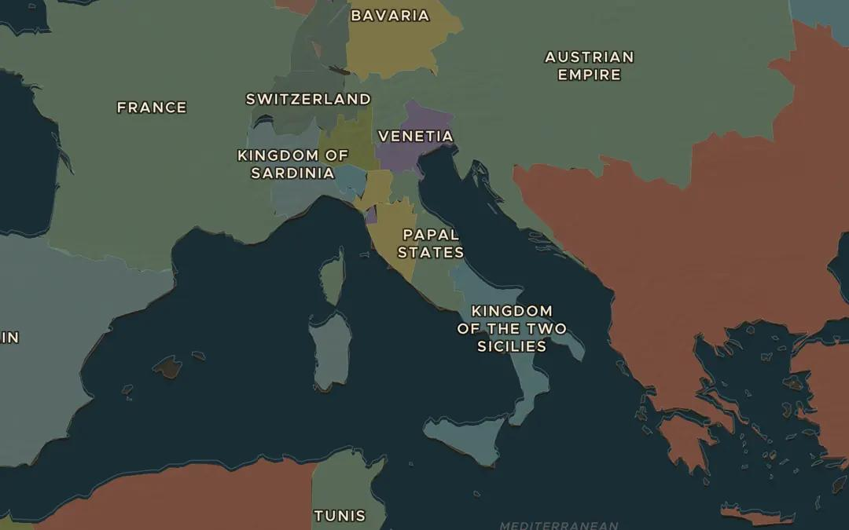
EXPLORE THE MAP · STEP A OF 3 · AD 1848
a
Italy before unification
Open the map in 1848 and zoom in on Italy. Count the states. Which parts of northern Italy belonged to Austria?
Open this view on the live map →
ChronoAtlas Classroom · chronoatlas.nl/classroom/lesson/italian-unification
3
Notes:
Open the map in 1848 and zoom in on Italy. Count the states. Which parts of northern Italy belonged to Austria?
https://chronoatlas.nl/?year=1848&lat=42.5&lng=12.5&zoom=5

Slide 4
CHRONOATLAS CLASSROOM
The rest of this deck comes with Classroom
19 more slides: the other map steps, the discussion questions, the quiz with its answers, and the worksheet.
Every lesson as a deck, every worksheet, every live lesson and homework.
€19 a month, cancel anytime. The free lesson, Rome at its height, comes whole.
https://chronoatlas.nl/pricing
ChronoAtlas Classroom · chronoatlas.nl/classroom/lesson/italian-unification
4

