Slide 1
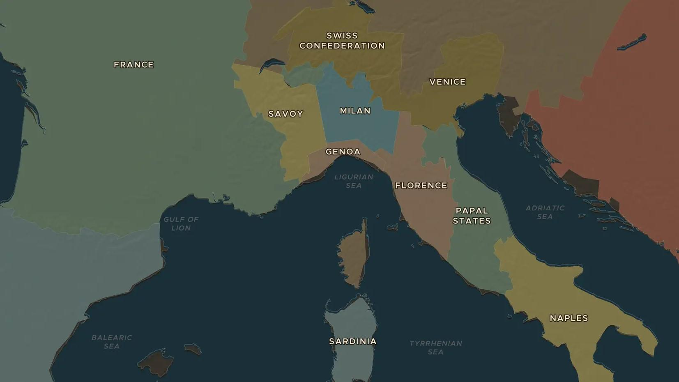
ITALIAN RENAISSANCE · 1494-1559
The Italian Wars and Machiavelli
ChronoAtlas Classroom · Plate 312 · Ages 13-16 · 50 min
ChronoAtlas Classroom · chronoatlas.nl/classroom/lesson/italian-wars-machiavelli

Slide 2
THIS LESSON
What students take from it
France and Spain fight over Italy for more than sixty years. In Florence an out-of-work official writes The Prince, a handbook on how rulers keep power. Students follow the armies on the map and test Machiavelli's advice.
LENGTH
50 min
AGES
13-16
ON THE MAP
BY THE END, STUDENTS CAN
3 steps, AD 1500
Explain why France and Spain fought over Italy between 1494 and 1559.
Locate three places where the Italian Wars were fought or decided.
Summarise one idea from Machiavelli's The Prince and judge whether it is good advice.
QUIZ
7 rounds
ChronoAtlas Classroom · chronoatlas.nl/classroom/lesson/italian-wars-machiavelli
2

Slide 3
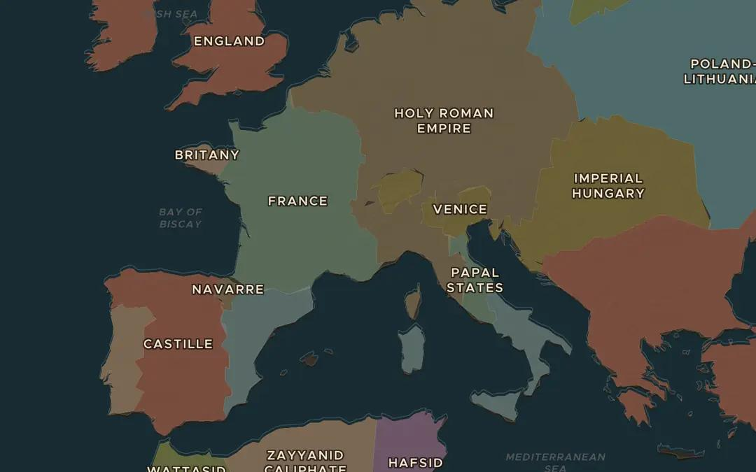
EXPLORE THE MAP · STEP A OF 3 · AD 1500
a
A divided prize
Open the map in 1500 and compare Italy with France. Is Italy one state? Why was a rich but divided Italy a tempting target?
Open this view on the live map →
ChronoAtlas Classroom · chronoatlas.nl/classroom/lesson/italian-wars-machiavelli
3
Notes:
Open the map in 1500 and compare Italy with France. Is Italy one state? Why was a rich but divided Italy a tempting target?
https://chronoatlas.nl/?year=1500&lat=45&lng=7&zoom=4.5

Slide 4
CHRONOATLAS CLASSROOM
The rest of this deck comes with Classroom
19 more slides: the other map steps, the discussion questions, the quiz with its answers, and the worksheet.
Every lesson as a deck, every worksheet, every live lesson and homework.
€19 a month, cancel anytime. The free lesson, Rome at its height, comes whole.
https://chronoatlas.nl/pricing
ChronoAtlas Classroom · chronoatlas.nl/classroom/lesson/italian-wars-machiavelli
4

