Slide 1
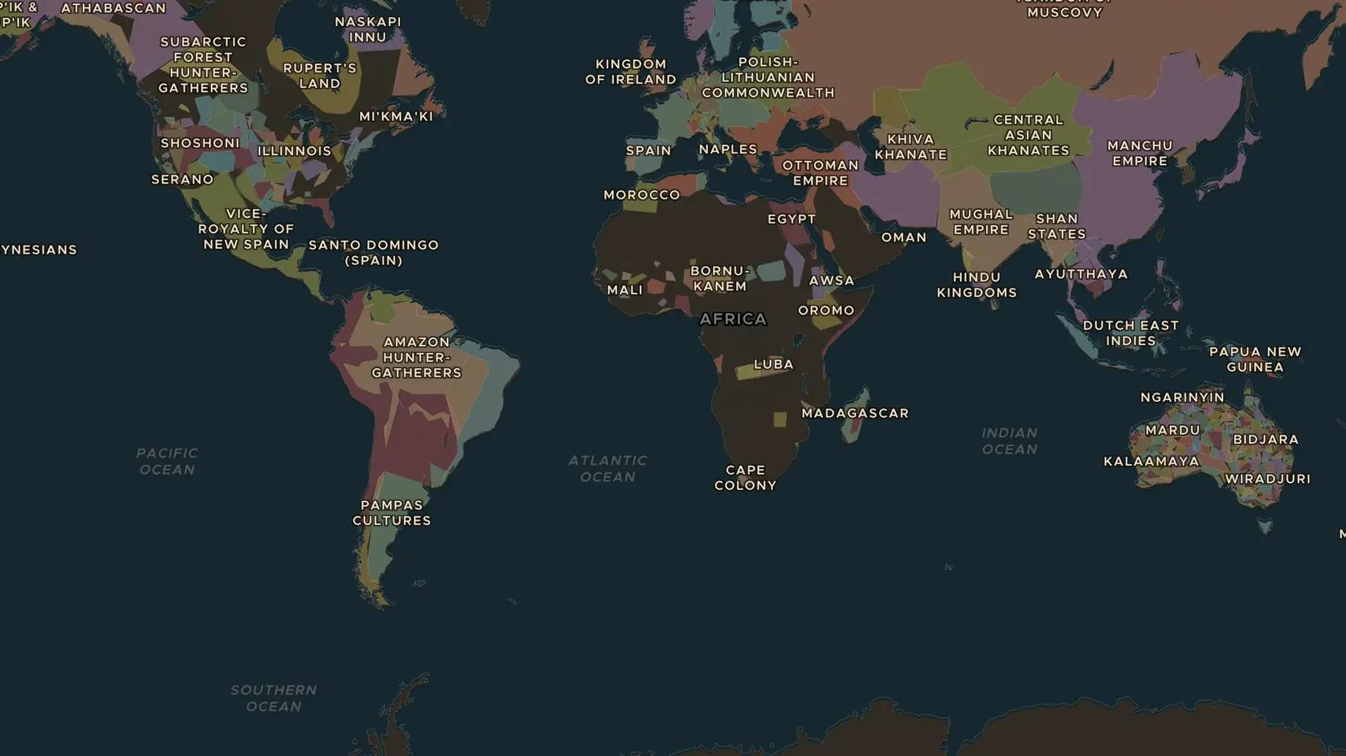
PACIFIC ENCOUNTERS · 1768-1779
James Cook and the Pacific
ChronoAtlas Classroom · Plate 390 · Ages 11-14 · 50 min
ChronoAtlas Classroom · chronoatlas.nl/classroom/lesson/james-cook-pacific-voyages

Slide 2
THIS LESSON
What students take from it
In three voyages James Cook charts more of the Pacific than any European before him. Students follow his ships from Tahiti to New Zealand, Australia and Hawai'i, meet the Pacific navigators and Indigenous peoples he encountered, and ask what these meetings meant for both sides.
LENGTH
50 min
AGES
11-14
ON THE MAP
BY THE END, STUDENTS CAN
3 steps, AD 1770
Trace Cook's voyages on the map and name three places he reached.
Explain the scientific aims of the voyages, such as observing the transit of Venus.
Describe the encounters from the point of view of Pacific peoples as well as Europeans.
QUIZ
7 rounds
ChronoAtlas Classroom · chronoatlas.nl/classroom/lesson/james-cook-pacific-voyages
2

Slide 3
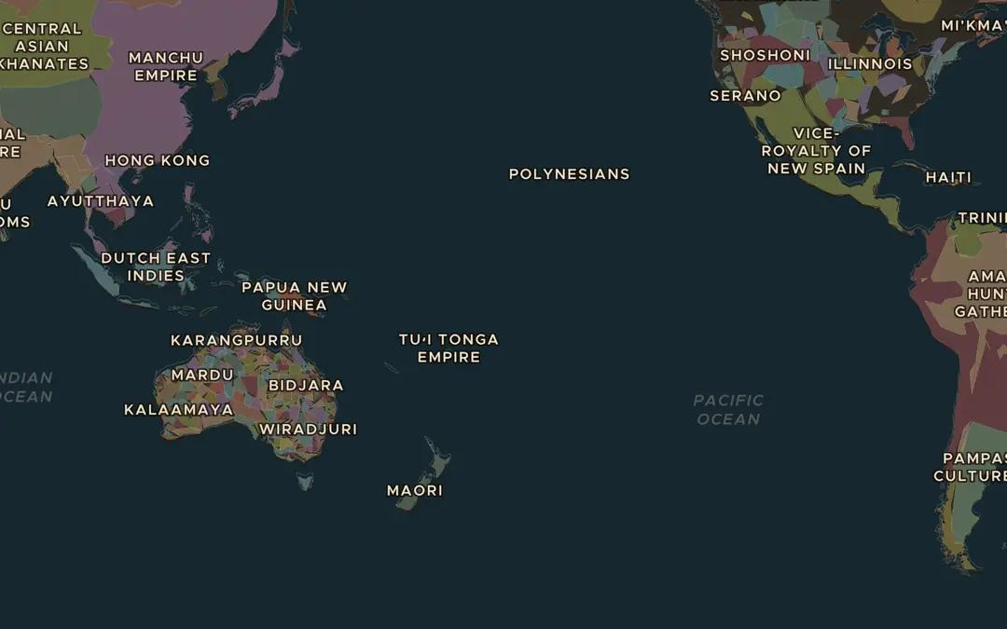
EXPLORE THE MAP · STEP A OF 3 · AD 1770
a
A sea of islands
Open the map in 1770 and zoom out over the Pacific Ocean. Find Tahiti, New Zealand, the east coast of Australia and Hawai'i. People had lived on all of them long before Cook. How did they get there?
Open this view on the live map →
ChronoAtlas Classroom · chronoatlas.nl/classroom/lesson/james-cook-pacific-voyages
3
Notes:
Open the map in 1770 and zoom out over the Pacific Ocean. Find Tahiti, New Zealand, the east coast of Australia and Hawai'i. People had lived on all of them long before Cook. How did they get there?
https://chronoatlas.nl/?year=1770&lat=-10&lng=-170&zoom=2.2

Slide 4
CHRONOATLAS CLASSROOM
The rest of this deck comes with Classroom
19 more slides: the other map steps, the discussion questions, the quiz with its answers, and the worksheet.
Every lesson as a deck, every worksheet, every live lesson and homework.
€19 a month, cancel anytime. The free lesson, Rome at its height, comes whole.
https://chronoatlas.nl/pricing
ChronoAtlas Classroom · chronoatlas.nl/classroom/lesson/james-cook-pacific-voyages
4

