Slide 1
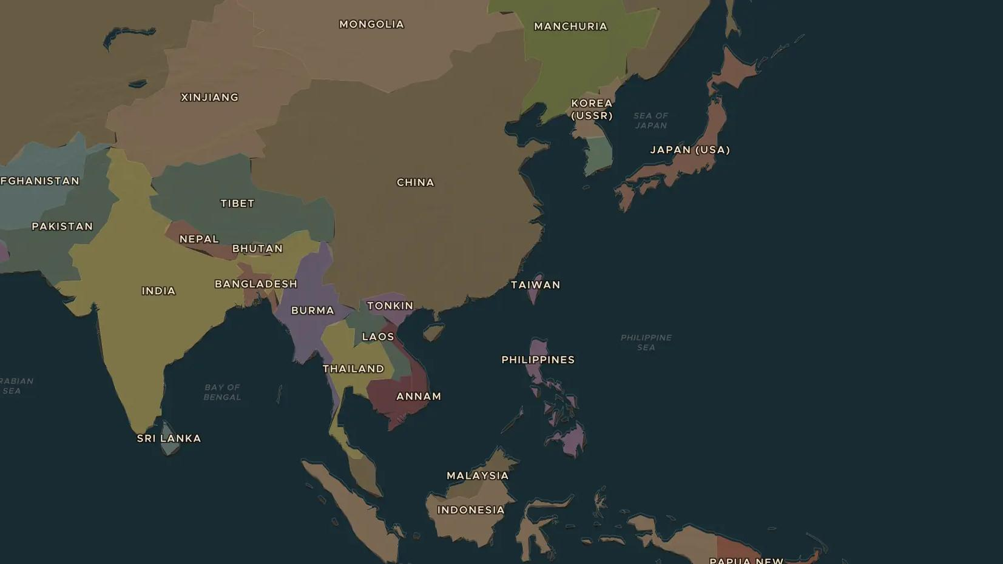
INTERWAR YEARS · 1931-1941
Japan's empire in Asia, 1931-1941
ChronoAtlas Classroom · Plate 481 · Ages 13-16 · 50 min
ChronoAtlas Classroom · chronoatlas.nl/classroom/lesson/japan-empire-asia

Slide 2
THIS LESSON
What students take from it
In 1931 the Japanese army seized Manchuria. Six years later Japan went to war with China, and by 1941 it looked south to the oil of Southeast Asia. Students compare the 1930 and 1938 maps and follow the path that led Japan to war with the United States.
LENGTH
50 min
AGES
13-16
ON THE MAP
BY THE END, STUDENTS CAN
3 steps, AD 1938
Explain why Japan's leaders wanted an empire on the Asian mainland.
Locate Manchuria, Beijing, Nanjing and Chongqing and order the main events of 1931-1941.
Explain how the war in China led to conflict between Japan and the United States.
QUIZ
7 rounds
ChronoAtlas Classroom · chronoatlas.nl/classroom/lesson/japan-empire-asia
2

Slide 3
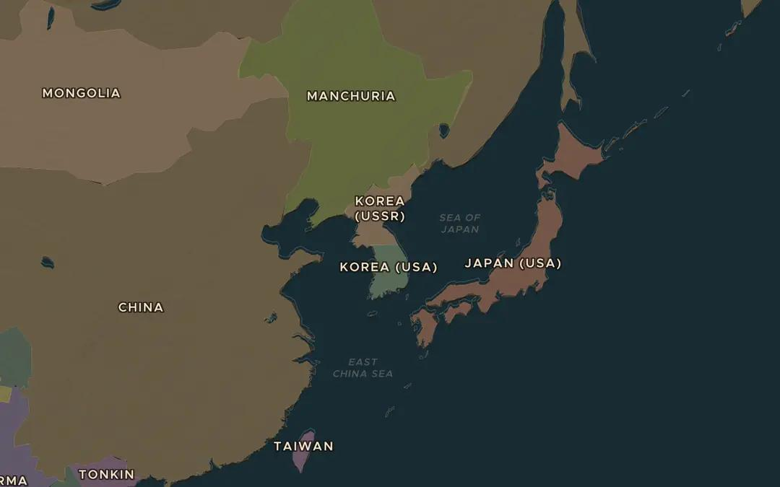
EXPLORE THE MAP · STEP A OF 3 · AD 1938
a
Japan's empire
Open the map in 1930. Find the Empire of Japan, including Korea and Taiwan. Then move to 1938. What has changed on the mainland in the north-east?
Open this view on the live map →
ChronoAtlas Classroom · chronoatlas.nl/classroom/lesson/japan-empire-asia
3
Notes:
Open the map in 1930. Find the Empire of Japan, including Korea and Taiwan. Then move to 1938. What has changed on the mainland in the north-east?
https://chronoatlas.nl/?year=1938&lat=38&lng=128&zoom=4

Slide 4
CHRONOATLAS CLASSROOM
The rest of this deck comes with Classroom
19 more slides: the other map steps, the discussion questions, the quiz with its answers, and the worksheet.
Every lesson as a deck, every worksheet, every live lesson and homework.
€19 a month, cancel anytime. The free lesson, Rome at its height, comes whole.
https://chronoatlas.nl/pricing
ChronoAtlas Classroom · chronoatlas.nl/classroom/lesson/japan-empire-asia
4

