Slide 1
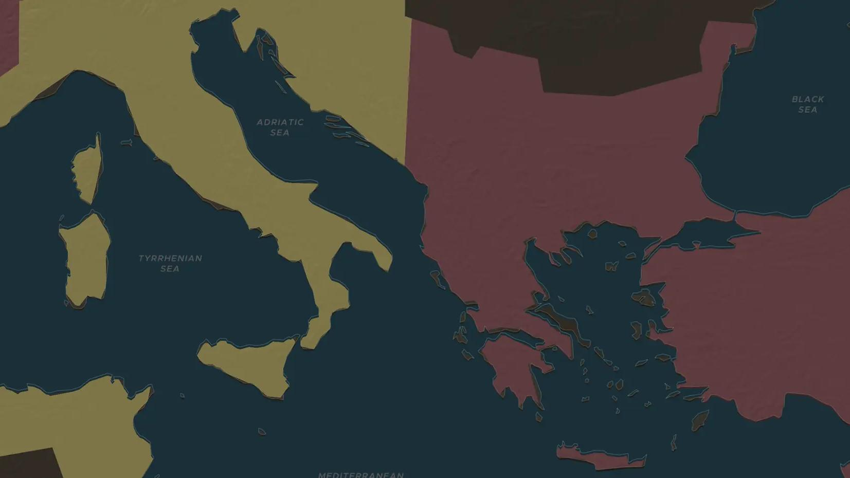
BYZANTINE EMPIRE · 527-565
Justinian and Theodora
ChronoAtlas Classroom · Plate 154 · Ages 12-15 · 50 min
ChronoAtlas Classroom · chronoatlas.nl/classroom/lesson/justinian-and-theodora

Slide 2
THIS LESSON
What students take from it
A peasant's nephew and a former actress rule the Eastern Roman Empire together. Students follow their law code, their wars to win back the West and the riot of 532 that almost ended their reign.
LENGTH
50 min
AGES
12-15
ON THE MAP
BY THE END, STUDENTS CAN
3 steps, AD 527
Describe how far the Eastern Roman Empire reached at the end of Justinian's reign, using the map.
Explain what the Corpus Juris Civilis was and why it still matters for law today.
Evaluate the role of Theodora during the Nika riots of 532.
QUIZ
7 rounds
ChronoAtlas Classroom · chronoatlas.nl/classroom/lesson/justinian-and-theodora
2

Slide 3
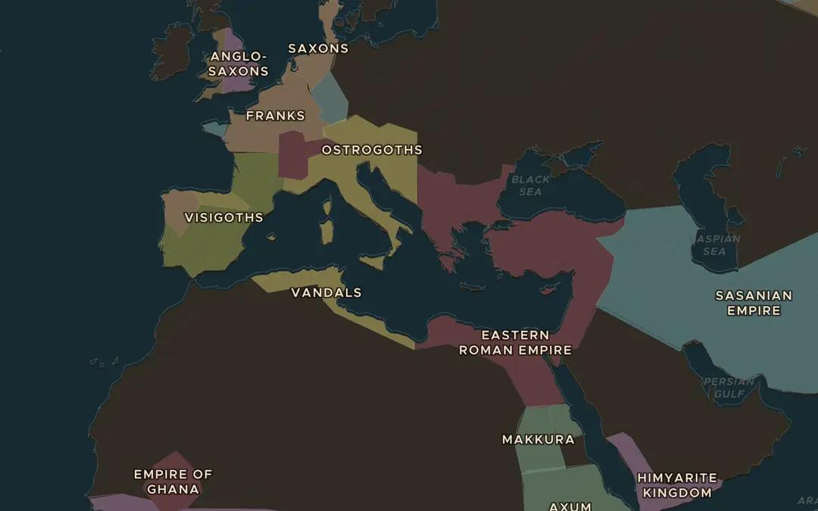
EXPLORE THE MAP · STEP A OF 3 · AD 527
a
An empire in the East
Open the map in 527, the year Justinian became emperor. Find the Eastern Roman Empire. Which lands around the Mediterranean does it not hold?
Open this view on the live map →
ChronoAtlas Classroom · chronoatlas.nl/classroom/lesson/justinian-and-theodora
3
Notes:
Open the map in 527, the year Justinian became emperor. Find the Eastern Roman Empire. Which lands around the Mediterranean does it not hold?
https://chronoatlas.nl/?year=527&lat=38&lng=18&zoom=3.5

Slide 4
CHRONOATLAS CLASSROOM
The rest of this deck comes with Classroom
19 more slides: the other map steps, the discussion questions, the quiz with its answers, and the worksheet.
Every lesson as a deck, every worksheet, every live lesson and homework.
€19 a month, cancel anytime. The free lesson, Rome at its height, comes whole.
https://chronoatlas.nl/pricing
ChronoAtlas Classroom · chronoatlas.nl/classroom/lesson/justinian-and-theodora
4

