Slide 1
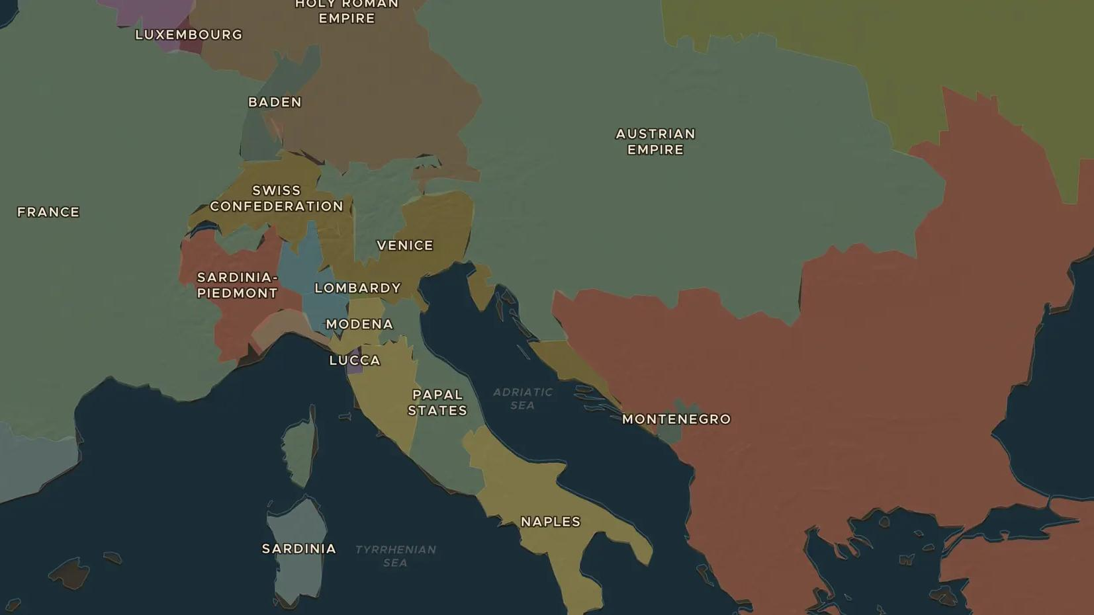
OTTOMAN EMPIRE · 1699-1730
Karlowitz, tulips and the first Ottoman press
ChronoAtlas Classroom · Plate 368 · Ages 13-16 · 45 min
ChronoAtlas Classroom · chronoatlas.nl/classroom/lesson/karlowitz-tulips-and-ottoman-printing

Slide 2
THIS LESSON
What students take from it
After losing Hungary in 1699, the Ottoman court looked anew at Europe: envoys went to Paris, tulip gardens bloomed and the first press printing in Ottoman Turkish opened in Istanbul. Students explore an empire adapting.
LENGTH
45 min
AGES
13-16
ON THE MAP
BY THE END, STUDENTS CAN
3 steps, AD 1700
Compare the Ottoman borders in Europe before 1683 and after the Treaty of Karlowitz in 1699.
Describe the Tulip Period and the embassy to Paris in 1720-1721.
Explain why printing in Ottoman Turkish began only in 1727-1729, and what it changed.
QUIZ
7 rounds
ChronoAtlas Classroom · chronoatlas.nl/classroom/lesson/karlowitz-tulips-and-ottoman-printing
2

Slide 3
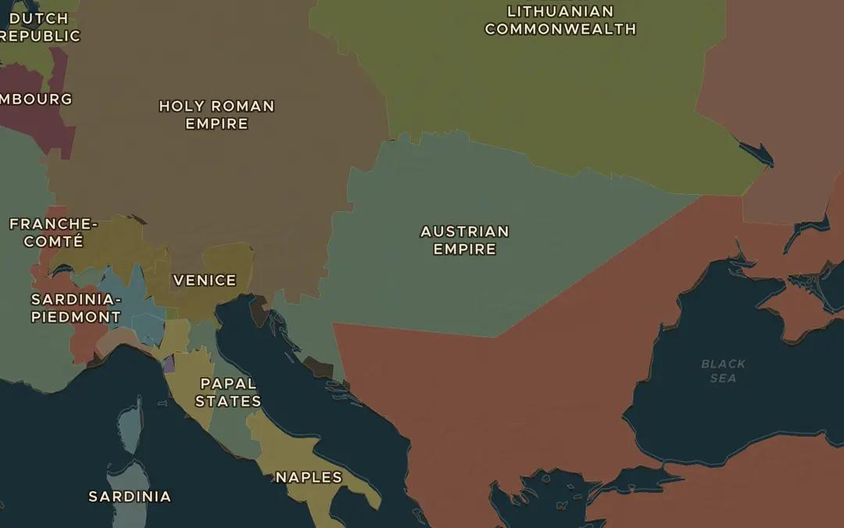
EXPLORE THE MAP · STEP A OF 3 · AD 1700
a
Lands lost
Open the map in 1683 and look at the Ottoman border in Hungary. Then jump to 1700. Which empire now holds Hungary?
Open this view on the live map →
ChronoAtlas Classroom · chronoatlas.nl/classroom/lesson/karlowitz-tulips-and-ottoman-printing
3
Notes:
Open the map in 1683 and look at the Ottoman border in Hungary. Then jump to 1700. Which empire now holds Hungary?
https://chronoatlas.nl/?year=1700&lat=46.5&lng=20&zoom=5

Slide 4
CHRONOATLAS CLASSROOM
The rest of this deck comes with Classroom
19 more slides: the other map steps, the discussion questions, the quiz with its answers, and the worksheet.
Every lesson as a deck, every worksheet, every live lesson and homework.
€19 a month, cancel anytime. The free lesson, Rome at its height, comes whole.
https://chronoatlas.nl/pricing
ChronoAtlas Classroom · chronoatlas.nl/classroom/lesson/karlowitz-tulips-and-ottoman-printing
4

