Slide 1
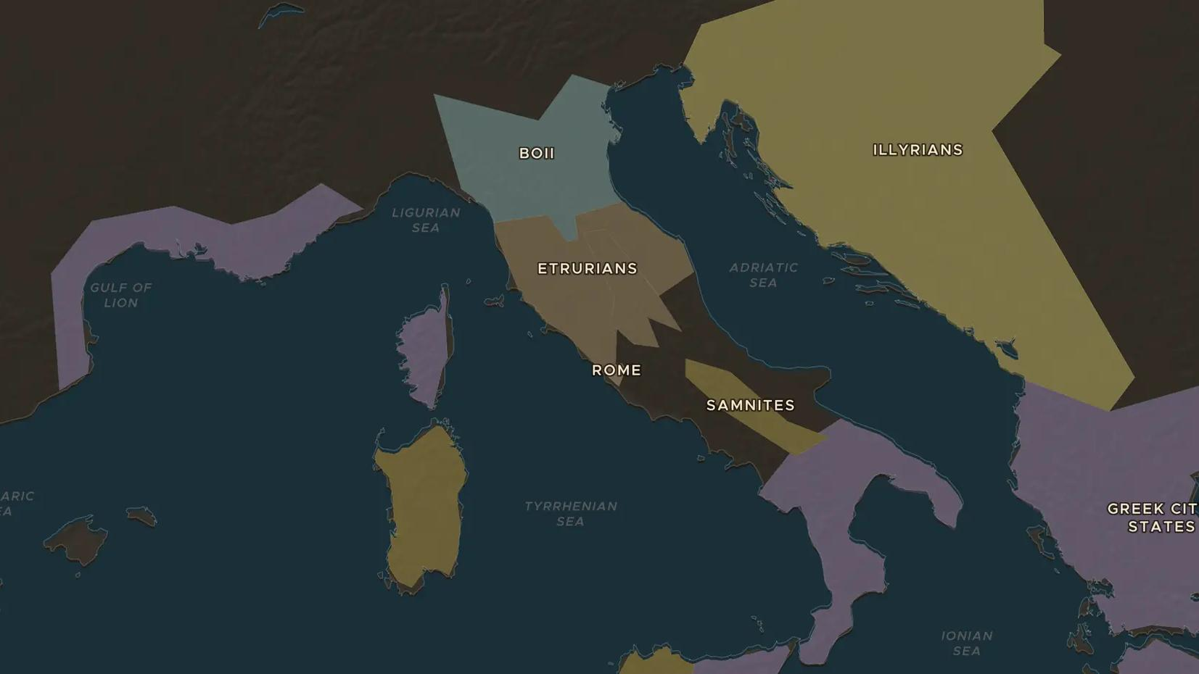
EARLY ROME · 753-509 BC
Seven kings and the Etruscans
ChronoAtlas Classroom · Plate 69 · Ages 11-14 · 50 min
ChronoAtlas Classroom · chronoatlas.nl/classroom/lesson/kings-of-rome-and-the-etruscans

Slide 2
THIS LESSON
What students take from it
Roman tradition counts seven kings before the Republic, the last three with Etruscan roots. Students meet Rome's powerful northern neighbors and find out what the Romans learned from them.
LENGTH
50 min
AGES
11-14
ON THE MAP
BY THE END, STUDENTS CAN
3 steps, 500 BC
Name at least three of the seven kings of Rome and one deed tradition gives each.
Locate Etruria and two Etruscan cities on the map.
Explain two things the Romans took over from the Etruscans.
QUIZ
7 rounds
ChronoAtlas Classroom · chronoatlas.nl/classroom/lesson/kings-of-rome-and-the-etruscans
2

Slide 3
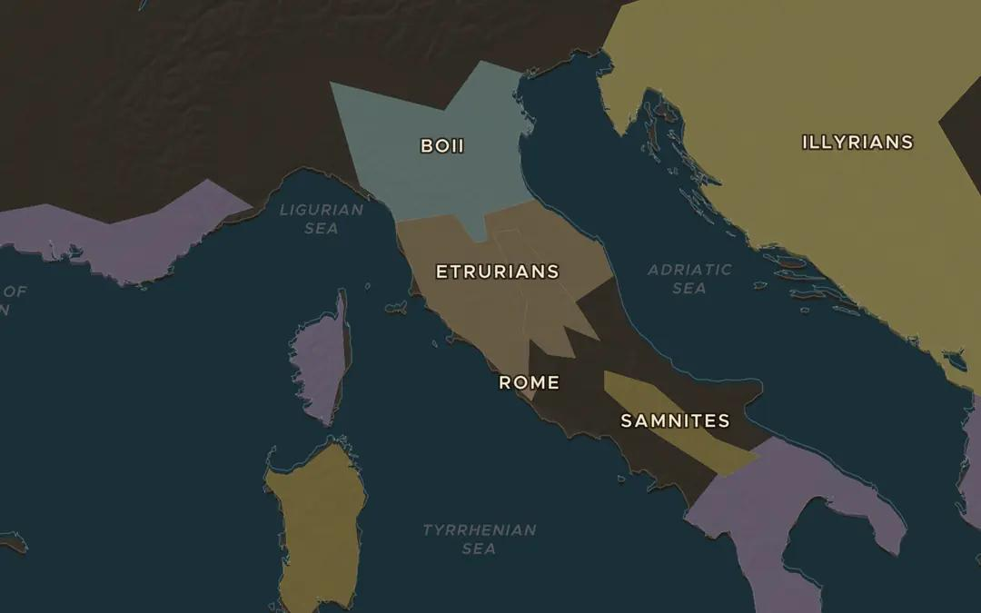
EXPLORE THE MAP · STEP A OF 3 · 500 BC
a
Etruria
Open the map in 500 BC and find the Etruscans, north of Rome between the rivers Arno and Tiber. Compare their land with Rome's. Who looks stronger?
Open this view on the live map →
ChronoAtlas Classroom · chronoatlas.nl/classroom/lesson/kings-of-rome-and-the-etruscans
3
Notes:
Open the map in 500 BC and find the Etruscans, north of Rome between the rivers Arno and Tiber. Compare their land with Rome's. Who looks stronger?
https://chronoatlas.nl/?year=-500&lat=42.8&lng=11.8&zoom=6

Slide 4
CHRONOATLAS CLASSROOM
The rest of this deck comes with Classroom
19 more slides: the other map steps, the discussion questions, the quiz with its answers, and the worksheet.
Every lesson as a deck, every worksheet, every live lesson and homework.
€19 a month, cancel anytime. The free lesson, Rome at its height, comes whole.
https://chronoatlas.nl/pricing
ChronoAtlas Classroom · chronoatlas.nl/classroom/lesson/kings-of-rome-and-the-etruscans
4

