Slide 1
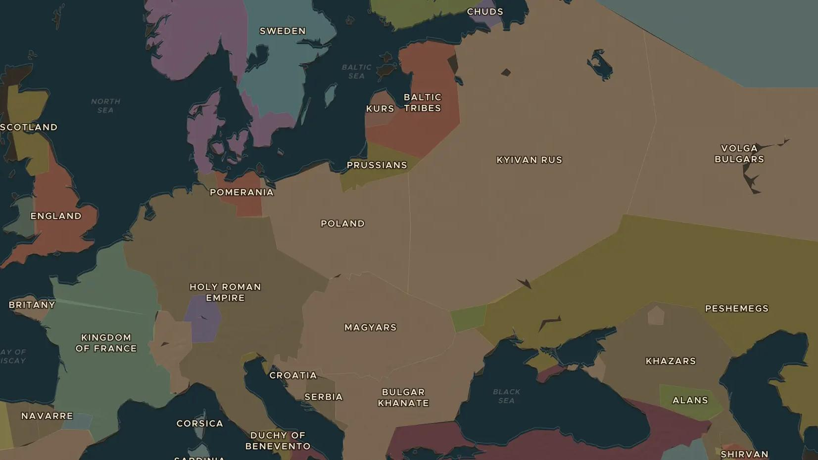
KYIVAN RUS · 957-1054
988: Kyiv chooses a faith
ChronoAtlas Classroom · Plate 203 · Ages 12-15 · 50 min
ChronoAtlas Classroom · chronoatlas.nl/classroom/lesson/kyivan-rus-conversion

Slide 2
THIS LESSON
What students take from it
Around 988 Prince Vladimir of Kyiv is baptized and orders his people into the waters of the Dnieper. Students explore why he chose the Christianity of Constantinople and how that choice shaped Kyivan Rus under his son Yaroslav the Wise.
LENGTH
50 min
AGES
12-15
ON THE MAP
BY THE END, STUDENTS CAN
3 steps, AD 1000
Locate Kyivan Rus on the map of 1000 and name its main cities and rivers.
Explain the political and religious reasons behind Vladimir's choice of Byzantine Christianity.
Describe the achievements of Yaroslav the Wise in law, building and diplomacy.
QUIZ
7 rounds
ChronoAtlas Classroom · chronoatlas.nl/classroom/lesson/kyivan-rus-conversion
2

Slide 3
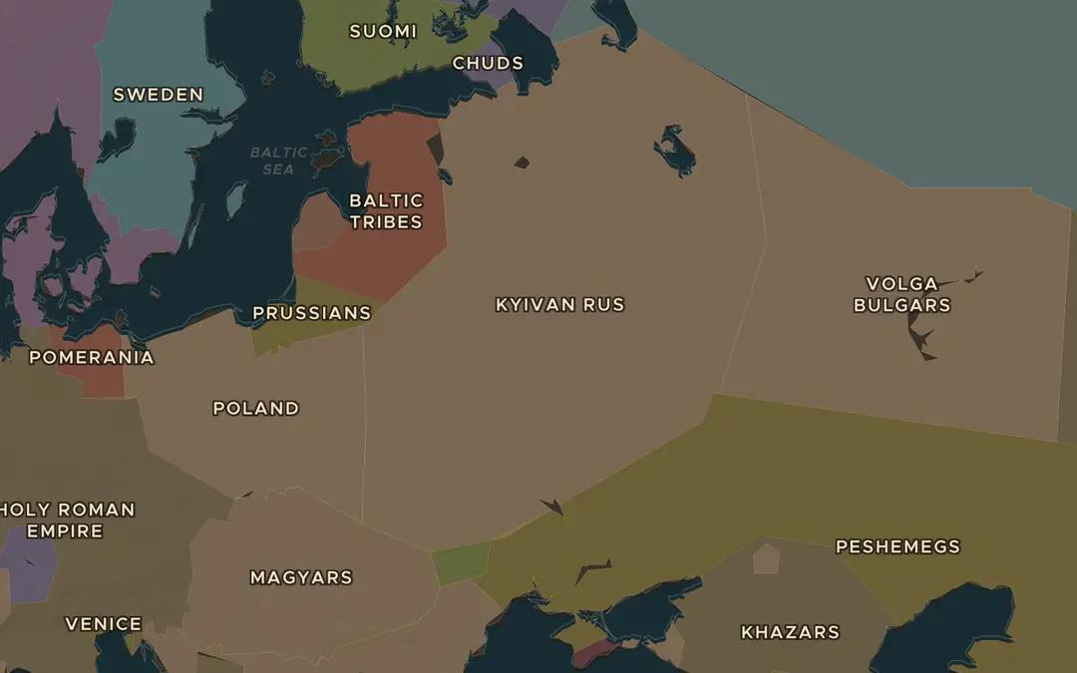
EXPLORE THE MAP · STEP A OF 3 · AD 1000
a
Kyivan Rus in 1000
Open the map in 1000 and find Kyivan Rus. How far does it stretch from north to south? Which rivers connect its cities?
Open this view on the live map →
ChronoAtlas Classroom · chronoatlas.nl/classroom/lesson/kyivan-rus-conversion
3
Notes:
Open the map in 1000 and find Kyivan Rus. How far does it stretch from north to south? Which rivers connect its cities?
https://chronoatlas.nl/?year=1000&lat=54&lng=32&zoom=4.4

Slide 4
CHRONOATLAS CLASSROOM
The rest of this deck comes with Classroom
19 more slides: the other map steps, the discussion questions, the quiz with its answers, and the worksheet.
Every lesson as a deck, every worksheet, every live lesson and homework.
€19 a month, cancel anytime. The free lesson, Rome at its height, comes whole.
https://chronoatlas.nl/pricing
ChronoAtlas Classroom · chronoatlas.nl/classroom/lesson/kyivan-rus-conversion
4

