Slide 1
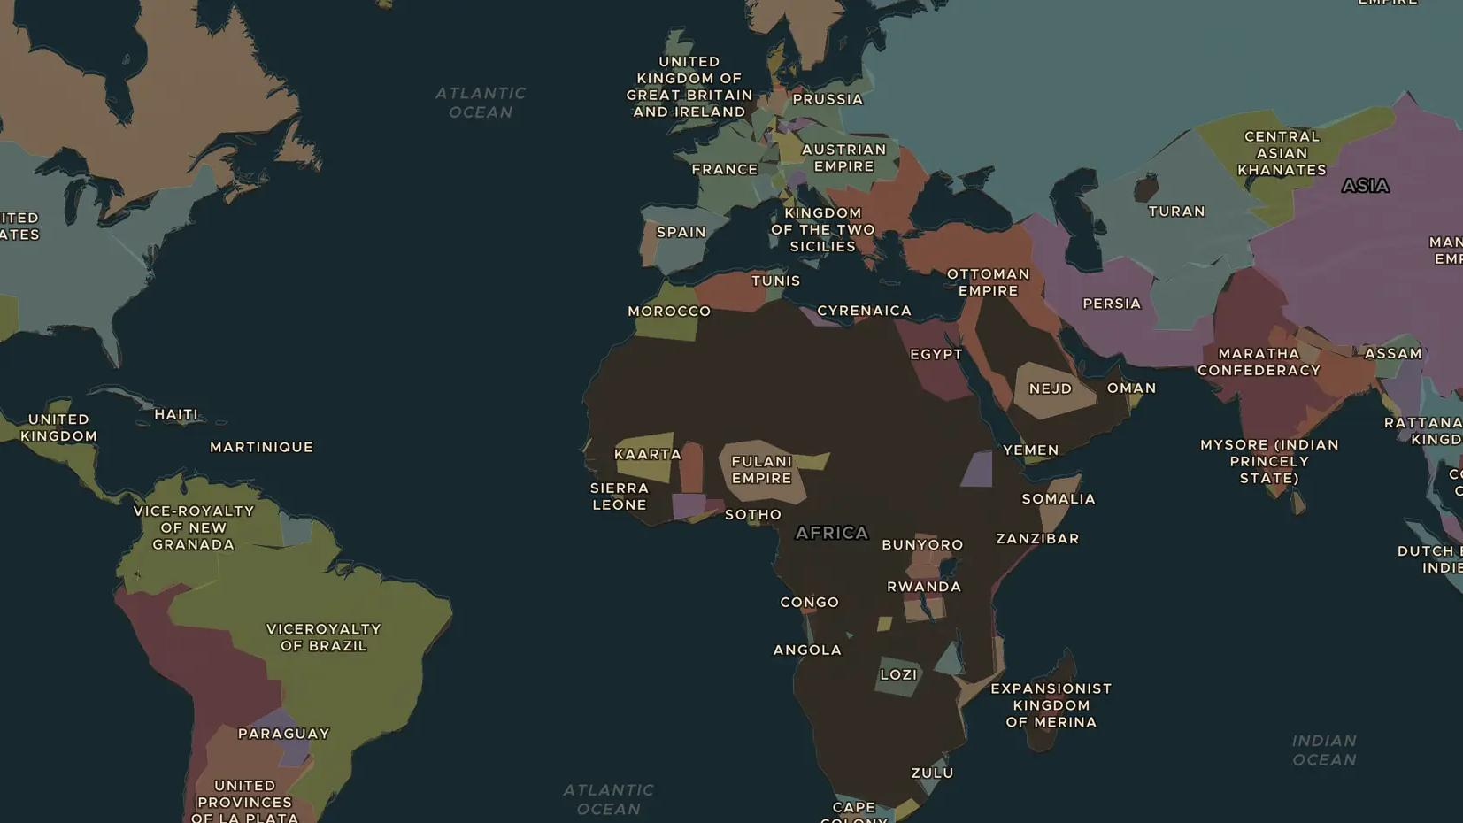
NAPOLEONIC WARS · 1813-1815
From Leipzig to Waterloo: Napoleon falls
ChronoAtlas Classroom · Plate 410 · Ages 11-14 · 45 min
ChronoAtlas Classroom · chronoatlas.nl/classroom/lesson/leipzig-to-waterloo

Slide 2
THIS LESSON
What students take from it
Beaten at Leipzig, exiled to Elba, back for a Hundred Days and finally defeated at Waterloo: students follow Napoleon's last campaigns across the map and ask why all of Europe turned against him.
LENGTH
45 min
AGES
11-14
ON THE MAP
BY THE END, STUDENTS CAN
3 steps, AD 1813
Put the events of 1813-1815 in order: Leipzig, abdication, Elba, the Hundred Days, Waterloo, Saint Helena.
Locate Leipzig, Elba, Waterloo and Saint Helena on the map.
Explain why a coalition of almost all of Europe formed against Napoleon.
QUIZ
7 rounds
ChronoAtlas Classroom · chronoatlas.nl/classroom/lesson/leipzig-to-waterloo
2

Slide 3
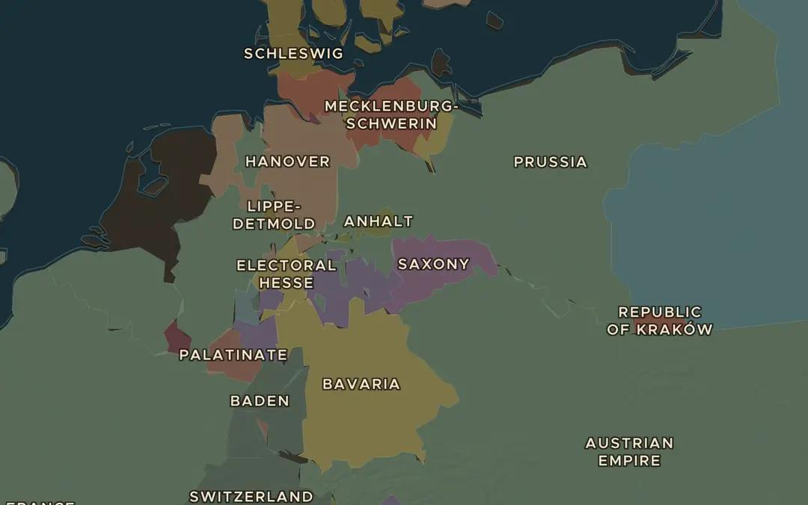
EXPLORE THE MAP · STEP A OF 3 · AD 1813
a
The Battle of the Nations
Open the map in 1813 and zoom in on Saxony. Find Leipzig. Armies of Russia, Prussia, Austria and Sweden met Napoleon here. From which directions did they come?
Open this view on the live map →
ChronoAtlas Classroom · chronoatlas.nl/classroom/lesson/leipzig-to-waterloo
3
Notes:
Open the map in 1813 and zoom in on Saxony. Find Leipzig. Armies of Russia, Prussia, Austria and Sweden met Napoleon here. From which directions did they come?
https://chronoatlas.nl/?year=1813&lat=51.3&lng=12.4&zoom=5.5

Slide 4
CHRONOATLAS CLASSROOM
The rest of this deck comes with Classroom
19 more slides: the other map steps, the discussion questions, the quiz with its answers, and the worksheet.
Every lesson as a deck, every worksheet, every live lesson and homework.
€19 a month, cancel anytime. The free lesson, Rome at its height, comes whole.
https://chronoatlas.nl/pricing
ChronoAtlas Classroom · chronoatlas.nl/classroom/lesson/leipzig-to-waterloo
4

