Slide 1
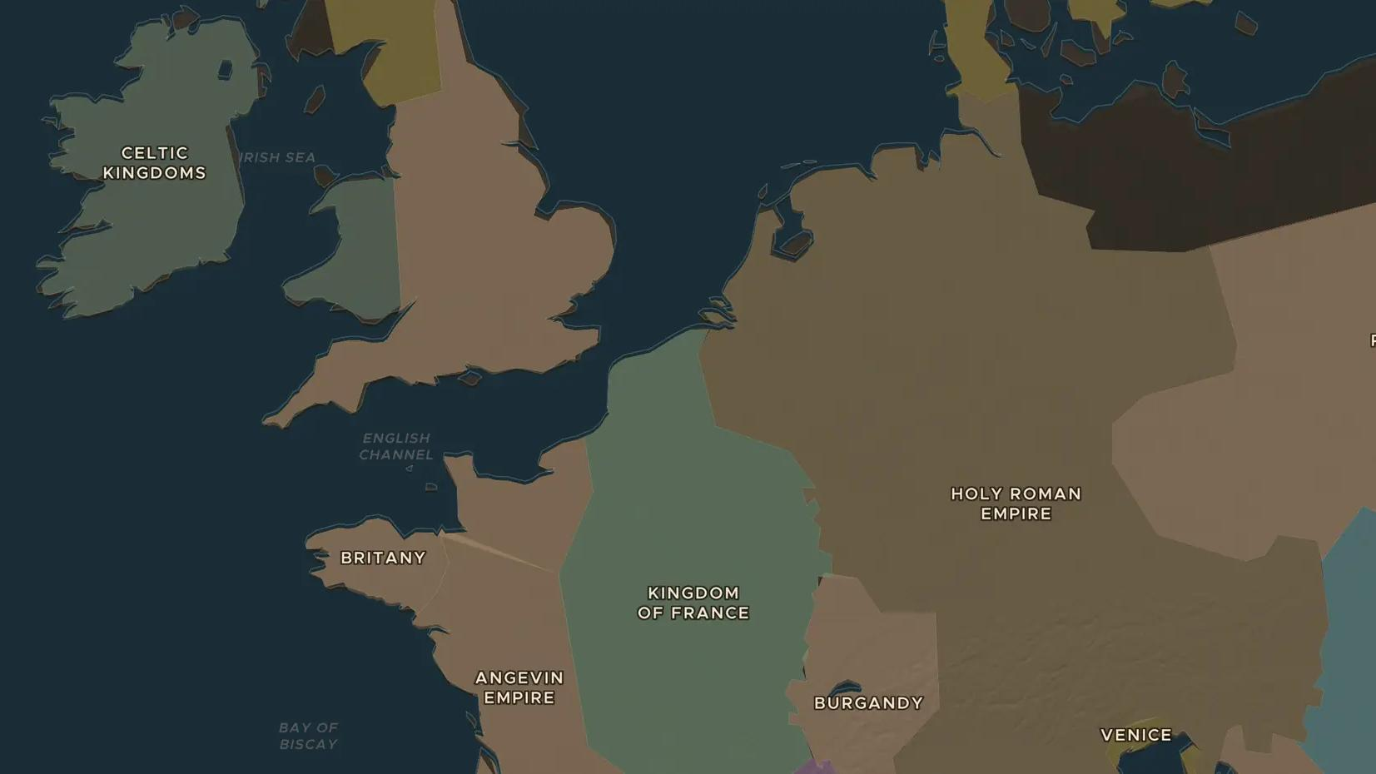
HIGH MIDDLE AGES · 1000-1300
Life on the manor: those who prayed, fought and worked
ChronoAtlas Classroom · Plate 240 · Ages 10-13 · 45 min
ChronoAtlas Classroom · chronoatlas.nl/classroom/lesson/life-on-the-manor

Slide 2
THIS LESSON
What students take from it
Around the year 1030 a French bishop wrote that society had three orders: those who pray, those who fight and those who work. Students step into a medieval village, follow the farming year and ask how much freedom a peasant really had.
LENGTH
45 min
AGES
10-13
ON THE MAP
BY THE END, STUDENTS CAN
3 steps, AD 1200
Describe the three orders of medieval society and the duties of each.
Explain how a manor worked: the lord's land, the open fields, the mill and the church.
Compare the lives of free peasants and serfs, and discuss why historians debate the word "feudalism".
QUIZ
7 rounds
ChronoAtlas Classroom · chronoatlas.nl/classroom/lesson/life-on-the-manor
2

Slide 3
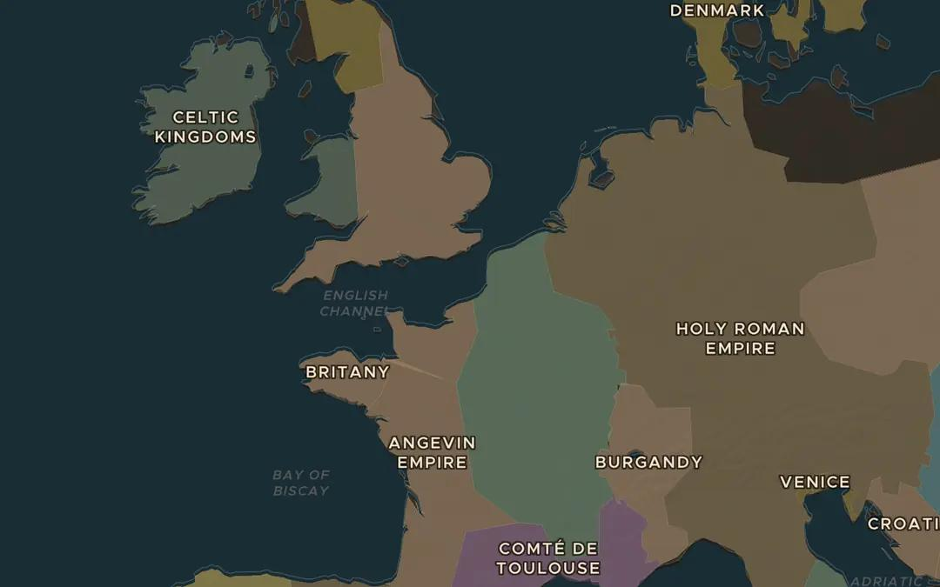
EXPLORE THE MAP · STEP A OF 3 · AD 1200
a
A warmer age
Open the map in 1200 on northern France and England. Turn on Weather of History and read the card on the Medieval Warm Period. How could milder summers change life in a farming village?
Open this view on the live map →
ChronoAtlas Classroom · chronoatlas.nl/classroom/lesson/life-on-the-manor
3
Notes:
Open the map in 1200 on northern France and England. Turn on Weather of History and read the card on the Medieval Warm Period. How could milder summers change life in a farming village?
https://chronoatlas.nl/?year=1200&lat=50&lng=1&zoom=5

Slide 4
CHRONOATLAS CLASSROOM
The rest of this deck comes with Classroom
19 more slides: the other map steps, the discussion questions, the quiz with its answers, and the worksheet.
Every lesson as a deck, every worksheet, every live lesson and homework.
€19 a month, cancel anytime. The free lesson, Rome at its height, comes whole.
https://chronoatlas.nl/pricing
ChronoAtlas Classroom · chronoatlas.nl/classroom/lesson/life-on-the-manor
4

