Slide 1
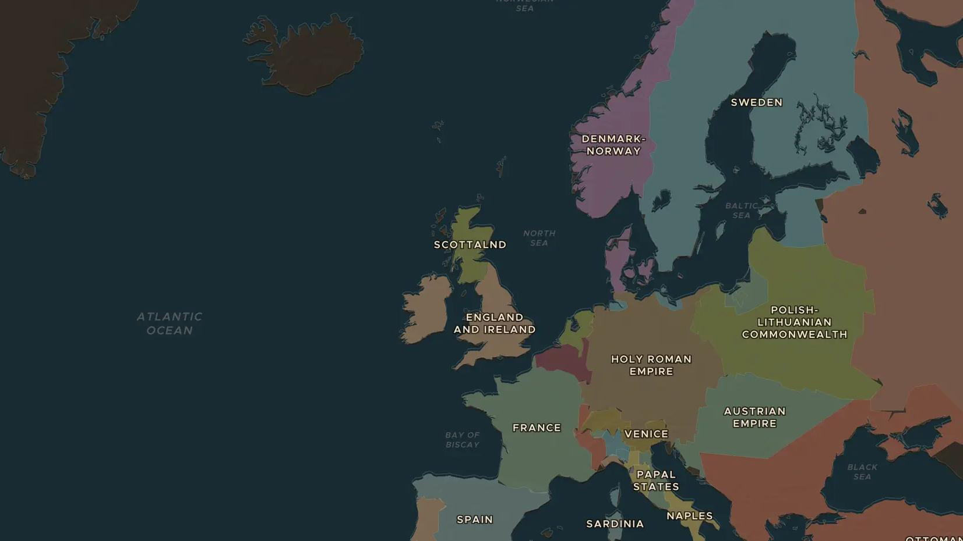
EARLY MODERN EUROPE · 1600-1789
The Little Ice Age in Europe
ChronoAtlas Classroom · Plate 365 · Ages 10-13 · 45 min
ChronoAtlas Classroom · chronoatlas.nl/classroom/lesson/little-ice-age-europe

Slide 2
THIS LESSON
What students take from it
Colder winters freeze the Thames, the Baltic and the lagoon of Venice. Students use the Weather of History layer to explore frost fairs, failed harvests and a volcano in Iceland, and ask how climate shaped wars, food and daily life between 1600 and 1789.
LENGTH
45 min
AGES
10-13
ON THE MAP
BY THE END, STUDENTS CAN
3 steps, AD 1683
Explain what historians and scientists mean by the "Little Ice Age".
Use the Weather of History layer to find three cold events between 1600 and 1789.
Give two examples of how colder weather affected war, food or daily life.
QUIZ
7 rounds
ChronoAtlas Classroom · chronoatlas.nl/classroom/lesson/little-ice-age-europe
2

Slide 3
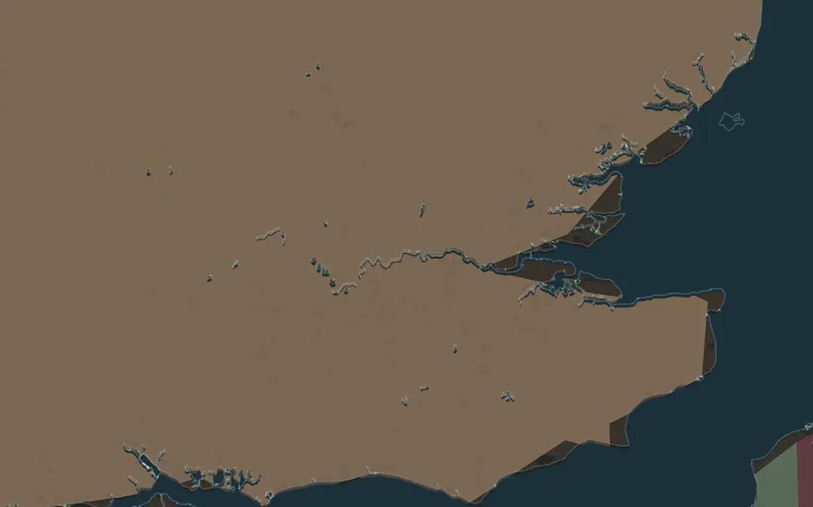
EXPLORE THE MAP · STEP A OF 3 · AD 1683
a
Frost fairs
Turn on Weather of History and go to 1683. Zoom in on London. What has happened to the river Thames, and what are Londoners doing on it?
Open this view on the live map →
ChronoAtlas Classroom · chronoatlas.nl/classroom/lesson/little-ice-age-europe
3
Notes:
Turn on Weather of History and go to 1683. Zoom in on London. What has happened to the river Thames, and what are Londoners doing on it?
https://chronoatlas.nl/?year=1683&lat=51.5&lng=-0.1&zoom=8

Slide 4
CHRONOATLAS CLASSROOM
The rest of this deck comes with Classroom
19 more slides: the other map steps, the discussion questions, the quiz with its answers, and the worksheet.
Every lesson as a deck, every worksheet, every live lesson and homework.
€19 a month, cancel anytime. The free lesson, Rome at its height, comes whole.
https://chronoatlas.nl/pricing
ChronoAtlas Classroom · chronoatlas.nl/classroom/lesson/little-ice-age-europe
4

