Slide 1
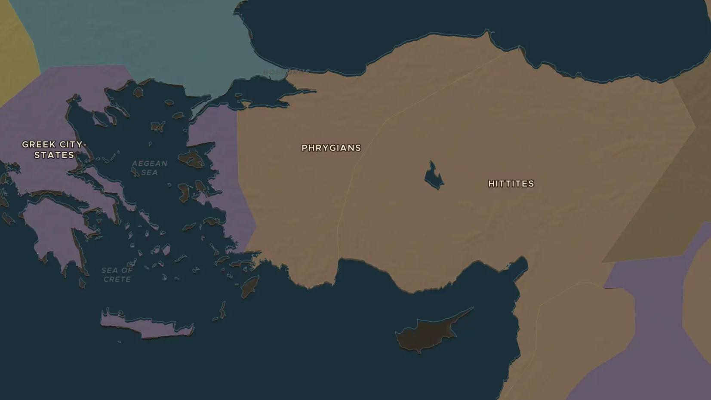
LYDIA · 650-546 BC
Lydia and the first coins
ChronoAtlas Classroom · Plate 57 · Ages 10-13 · 45 min
ChronoAtlas Classroom · chronoatlas.nl/classroom/lesson/lydia-first-coins

Slide 2
THIS LESSON
What students take from it
In the kingdom of Lydia, in western Anatolia, the first coins were struck around 600 BC. Students meet King Croesus, "rich as Croesus", follow gold down the river Pactolus, and watch the kingdom fall to Persia in 546 BC.
LENGTH
45 min
AGES
10-13
ON THE MAP
BY THE END, STUDENTS CAN
3 steps, 650 BC
Locate Sardis and the kingdom of Lydia in western Anatolia.
Explain what a coin is and why it was more useful than lumps of metal.
Tell what happened when Croesus attacked Persia in 547-546 BC and what the oracle at Delphi had told him.
QUIZ
7 rounds
ChronoAtlas Classroom · chronoatlas.nl/classroom/lesson/lydia-first-coins
2

Slide 3
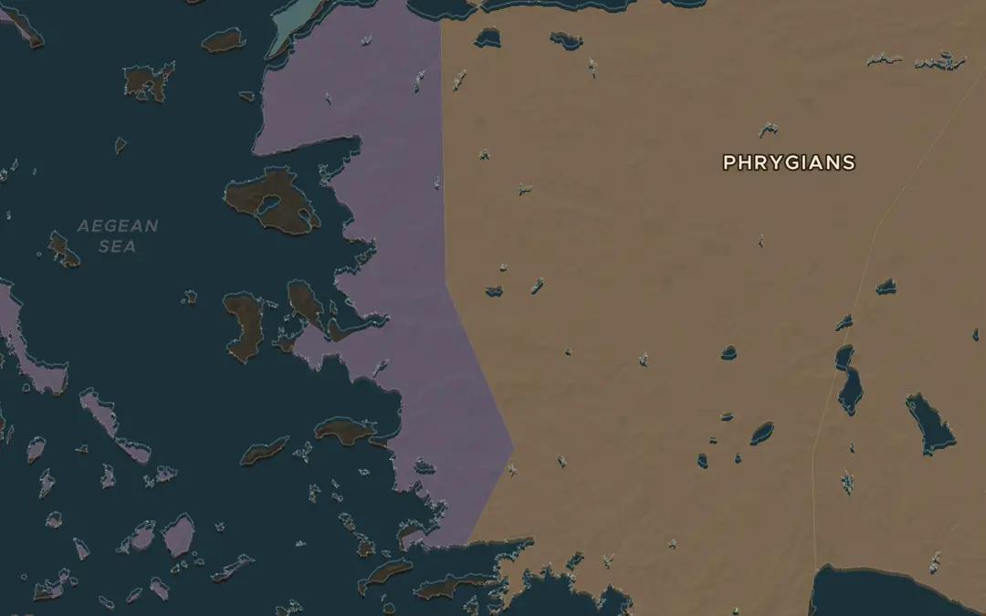
EXPLORE THE MAP · STEP A OF 3 · 650 BC
a
The gold river
Open the map in 650 BC on western Anatolia. The map's borders for this century are rough and still label the region "Phrygians", but Lydia, with its capital Sardis, ruled here. Gold dust washed down the river Pactolus through Sardis. Zoom in and find the mountains south of the city.
Open this view on the live map →
ChronoAtlas Classroom · chronoatlas.nl/classroom/lesson/lydia-first-coins
3
Notes:
Open the map in 650 BC on western Anatolia. The map's borders for this century are rough and still label the region "Phrygians", but Lydia, with its capital Sardis, ruled here. Gold dust washed down the river Pactolus through Sardis. Zoom in and find the mountains south of the city.
https://chronoatlas.nl/?year=-650&lat=38.5&lng=28&zoom=7

Slide 4
CHRONOATLAS CLASSROOM
The rest of this deck comes with Classroom
19 more slides: the other map steps, the discussion questions, the quiz with its answers, and the worksheet.
Every lesson as a deck, every worksheet, every live lesson and homework.
€19 a month, cancel anytime. The free lesson, Rome at its height, comes whole.
https://chronoatlas.nl/pricing
ChronoAtlas Classroom · chronoatlas.nl/classroom/lesson/lydia-first-coins
4

